Slide 1


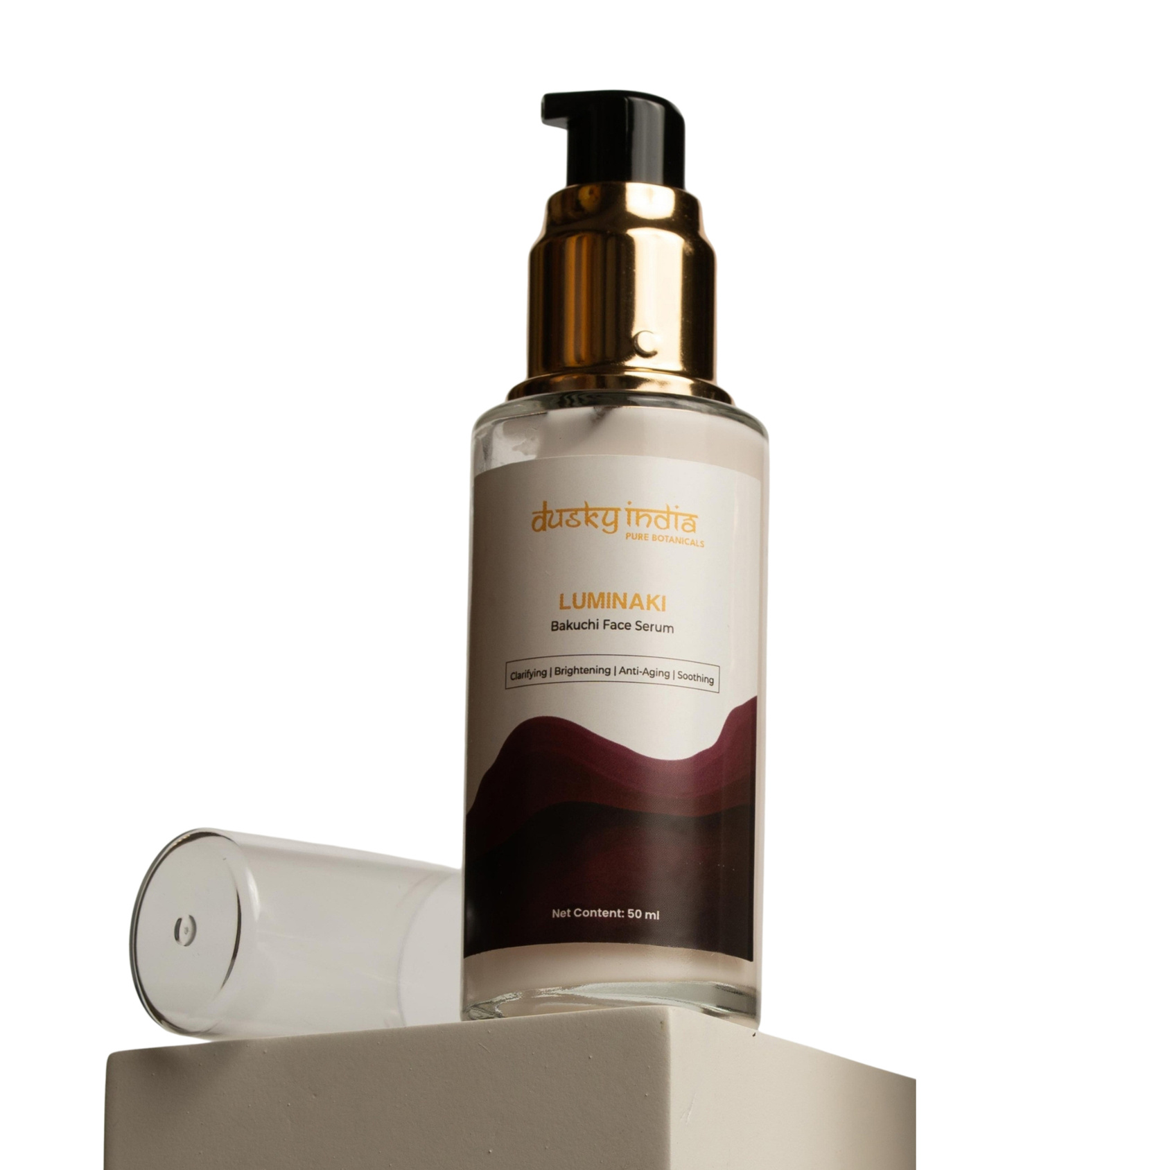
Dusky India
Luminaki – Bakuchi Face Serum

Slide 2

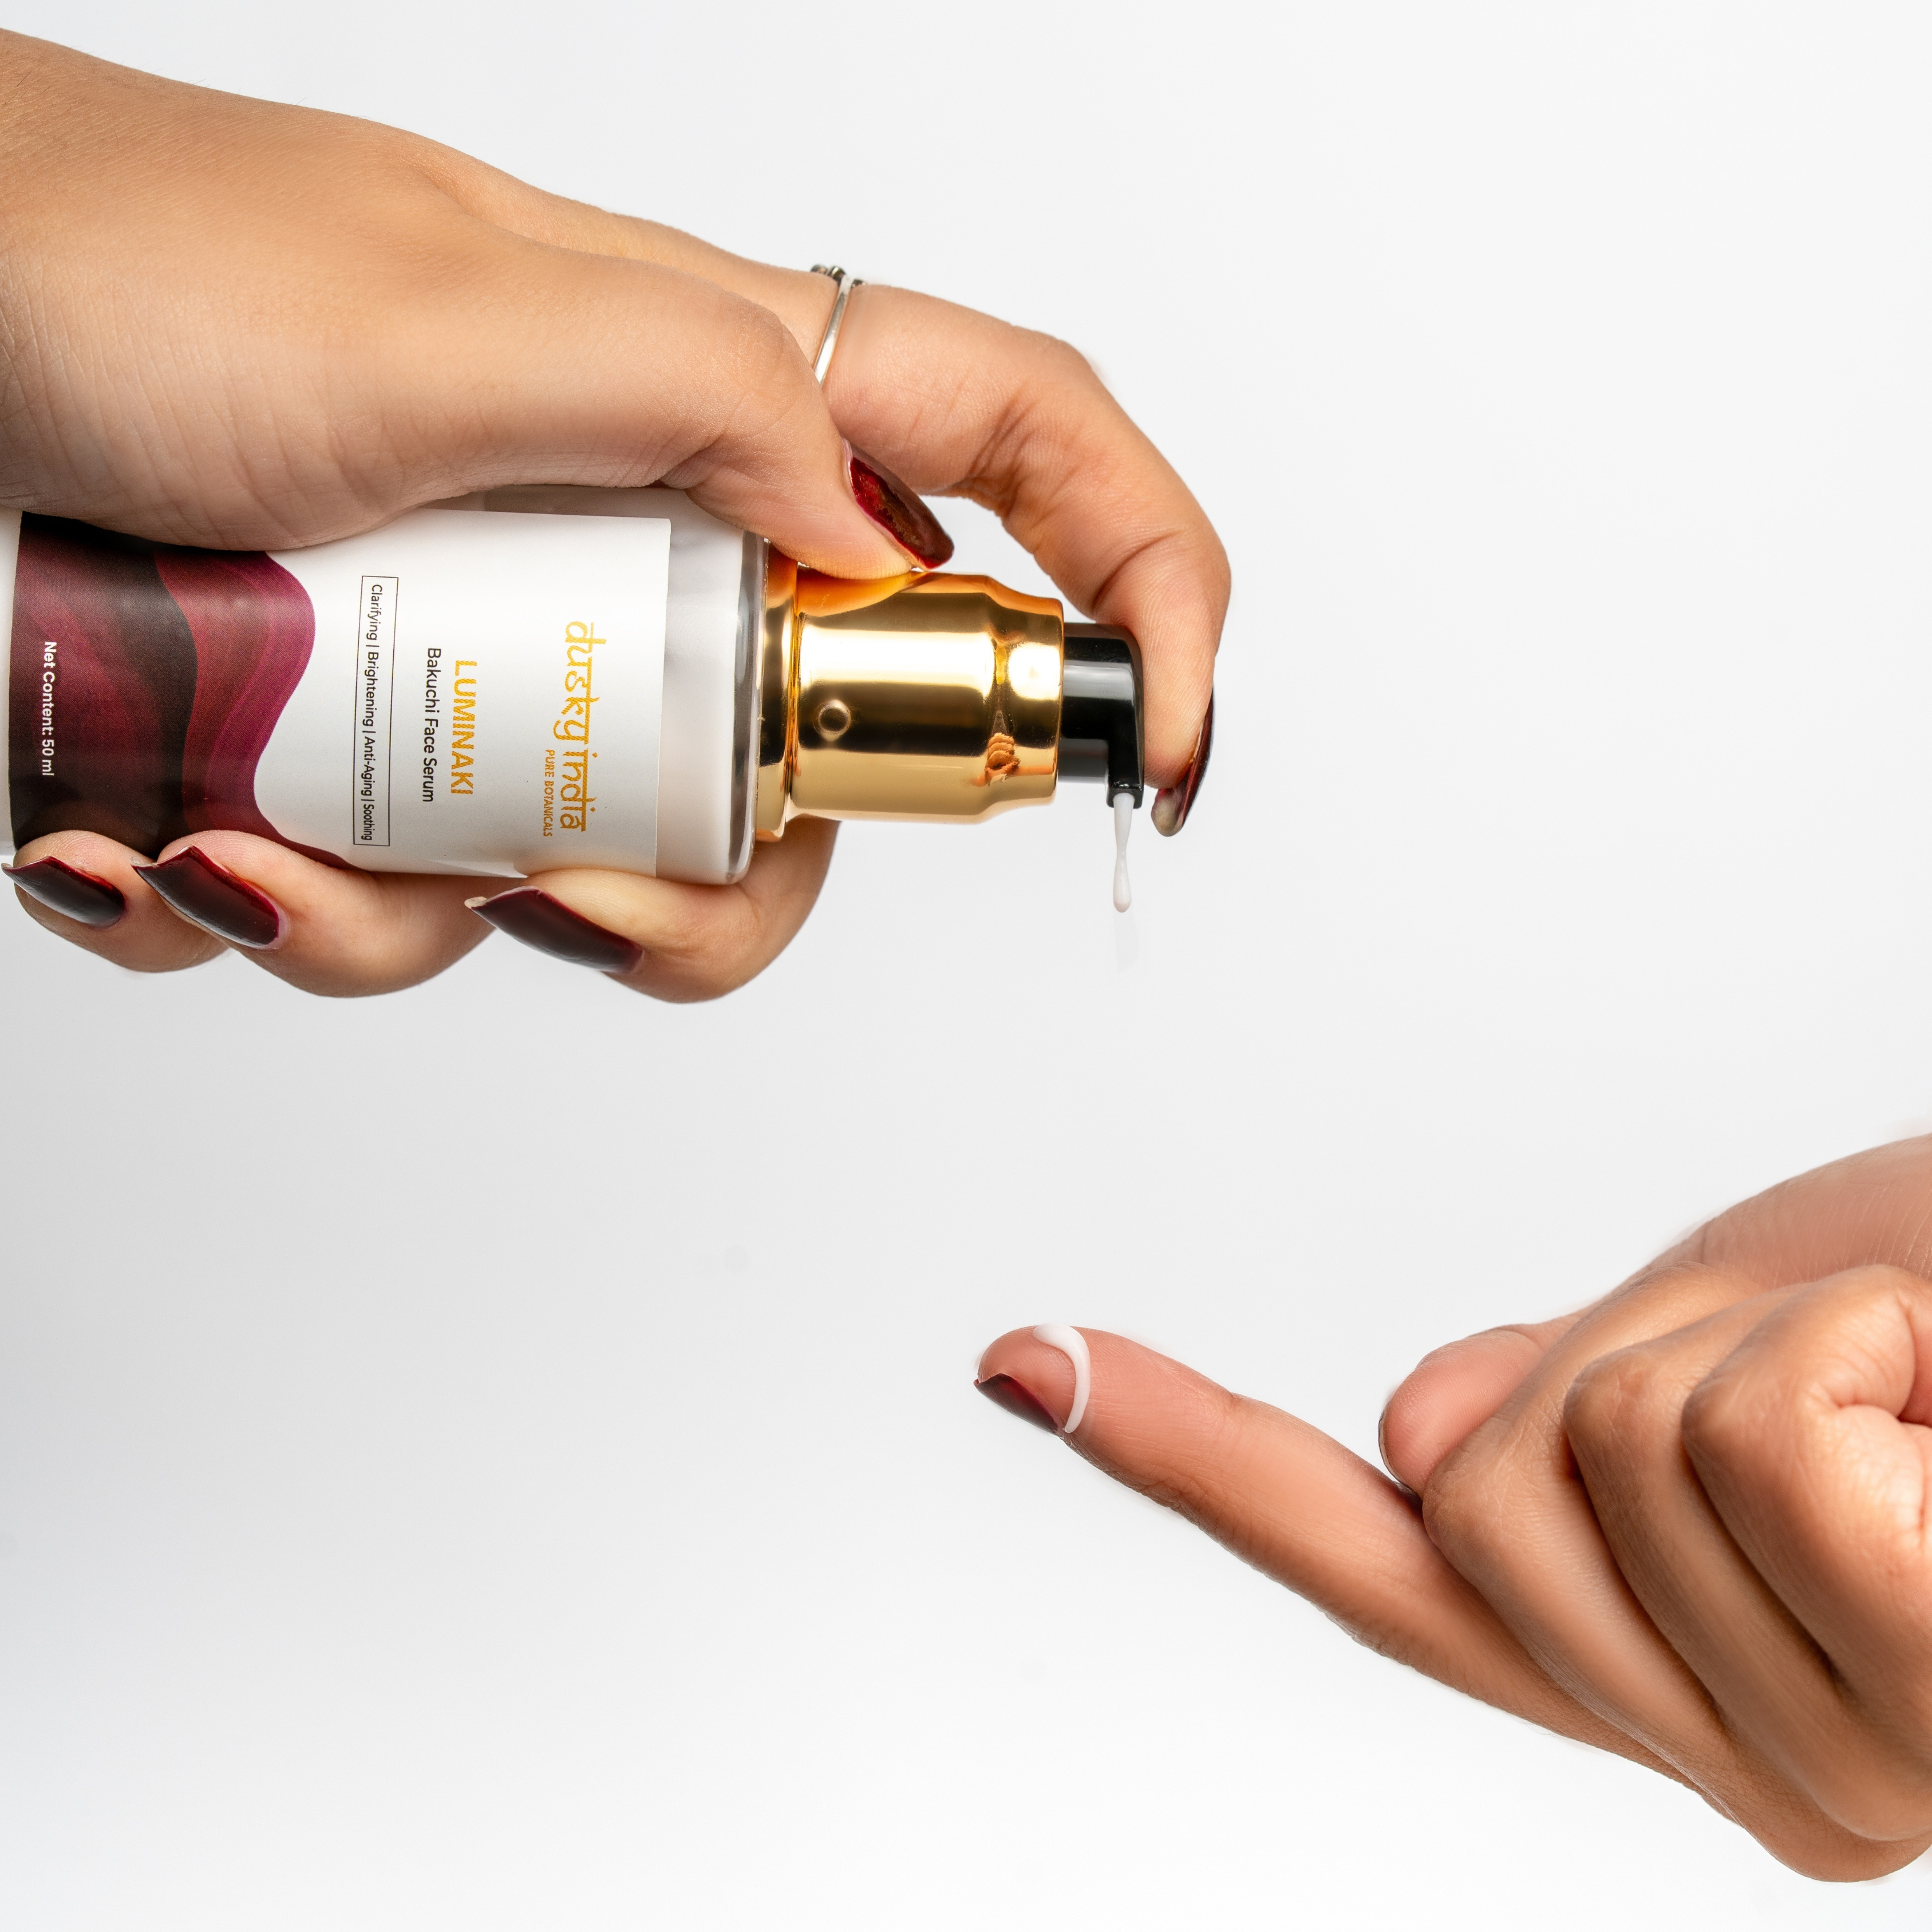
Meet Luminaki – Bakuchi Face Serum
As we age, the skin naturally changes. Fine lines, dullness, uneven texture, dryness, and loss of radiance can gradually become more noticeable.
Luminaki – Bakuchi Face Serum brings the botanical goodness of Bakuchi into a lightweight serum designed to complement your daily skincare routine and support smoother, healthier-looking skin.

Slide 3
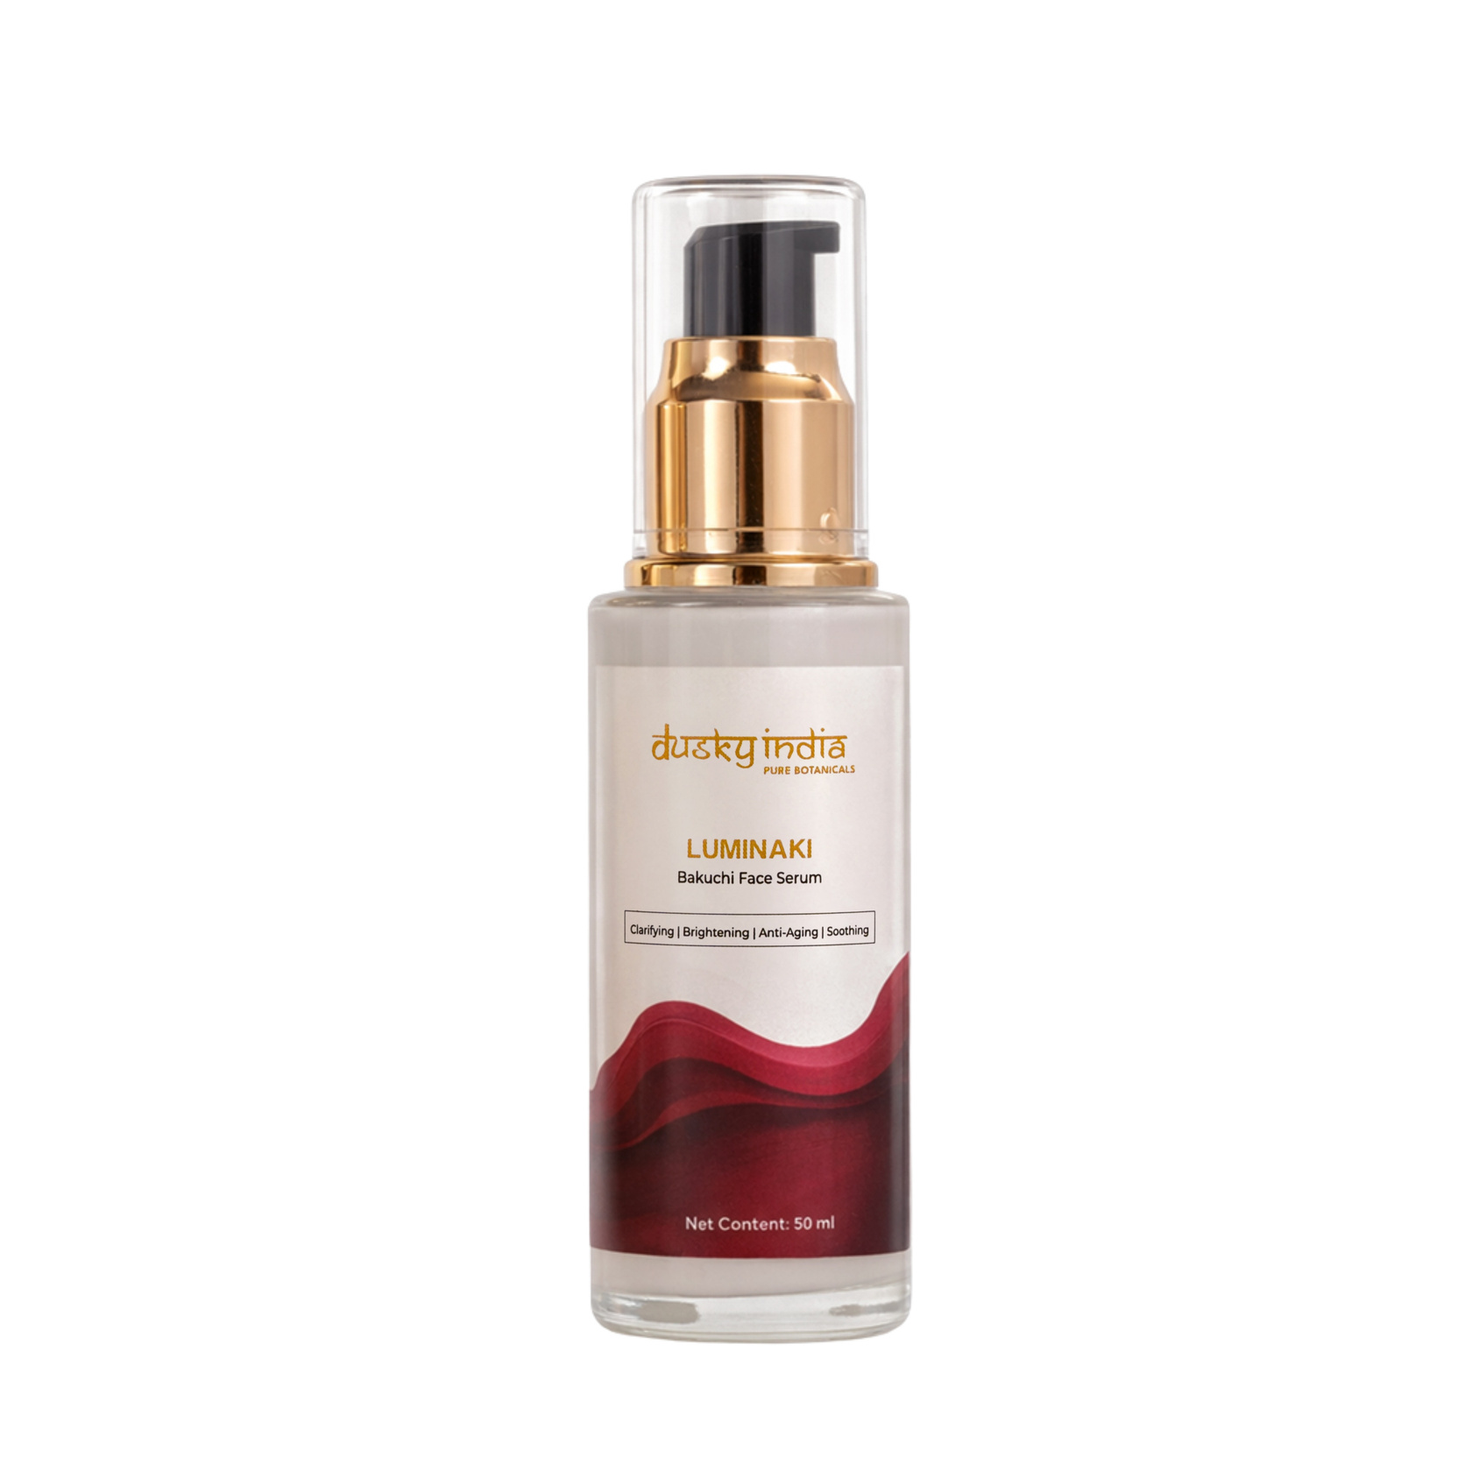
Best Face Serum for Age Control
When choosing the best face serum for age control, consistency and targeted skincare are important.
Luminaki is designed for people who want to include botanical-inspired care in a routine focused on maintaining youthful-looking skin.
It Supports:
  Smoother-looking skin
  A radiant complexion
  Hydrated-looking skin
  Improved-looking skin texture
  Daily anti-aging skincare
Instead of complicated routines, Luminaki offers a simple serum step for everyday facial care.

Slide 4
Bakuchi is a traditional botanical ingredient that has been valued in Indian wellness and skincare practices.
The Bakuchi benefits that make it interesting for modern skincare include its association with botanical skin nourishment and age-focused skincare routines.
Luminaki brings this traditional botanical into a convenient facial serum format for those who prefer nature-inspired skincare.
Understanding Bakuchi Benefits

Slide 5
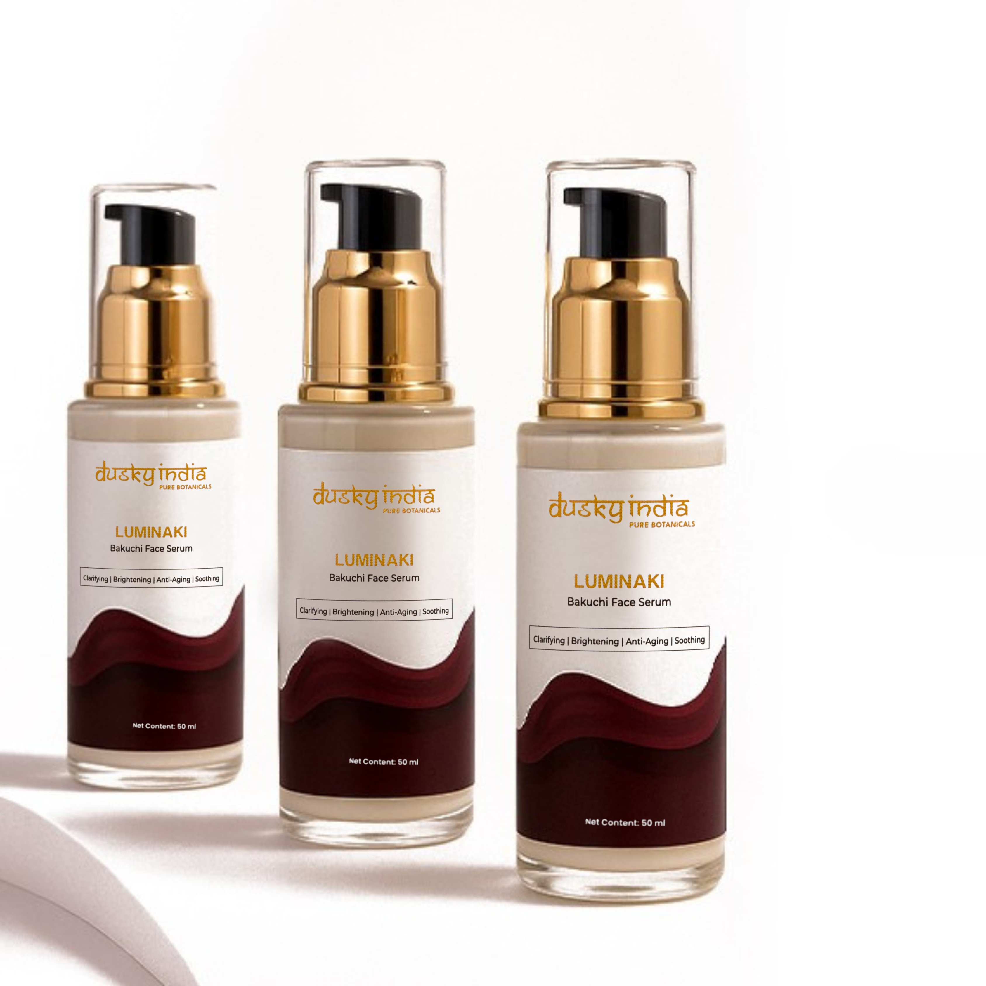
Bakuchi for Youthful-Looking Skin
Modern skincare users are increasingly exploring botanical ingredients as part of their anti-aging routines.
Luminaki – Bakuchi Face Serum is designed to support the appearance of:
  Smooth-looking skin
  Healthy-looking radiance
  Even-looking texture
  Supple, hydrated skin
  Youthful-looking complexion
With regular use, it becomes an easy addition to a consistent skincare routine.

Slide 6
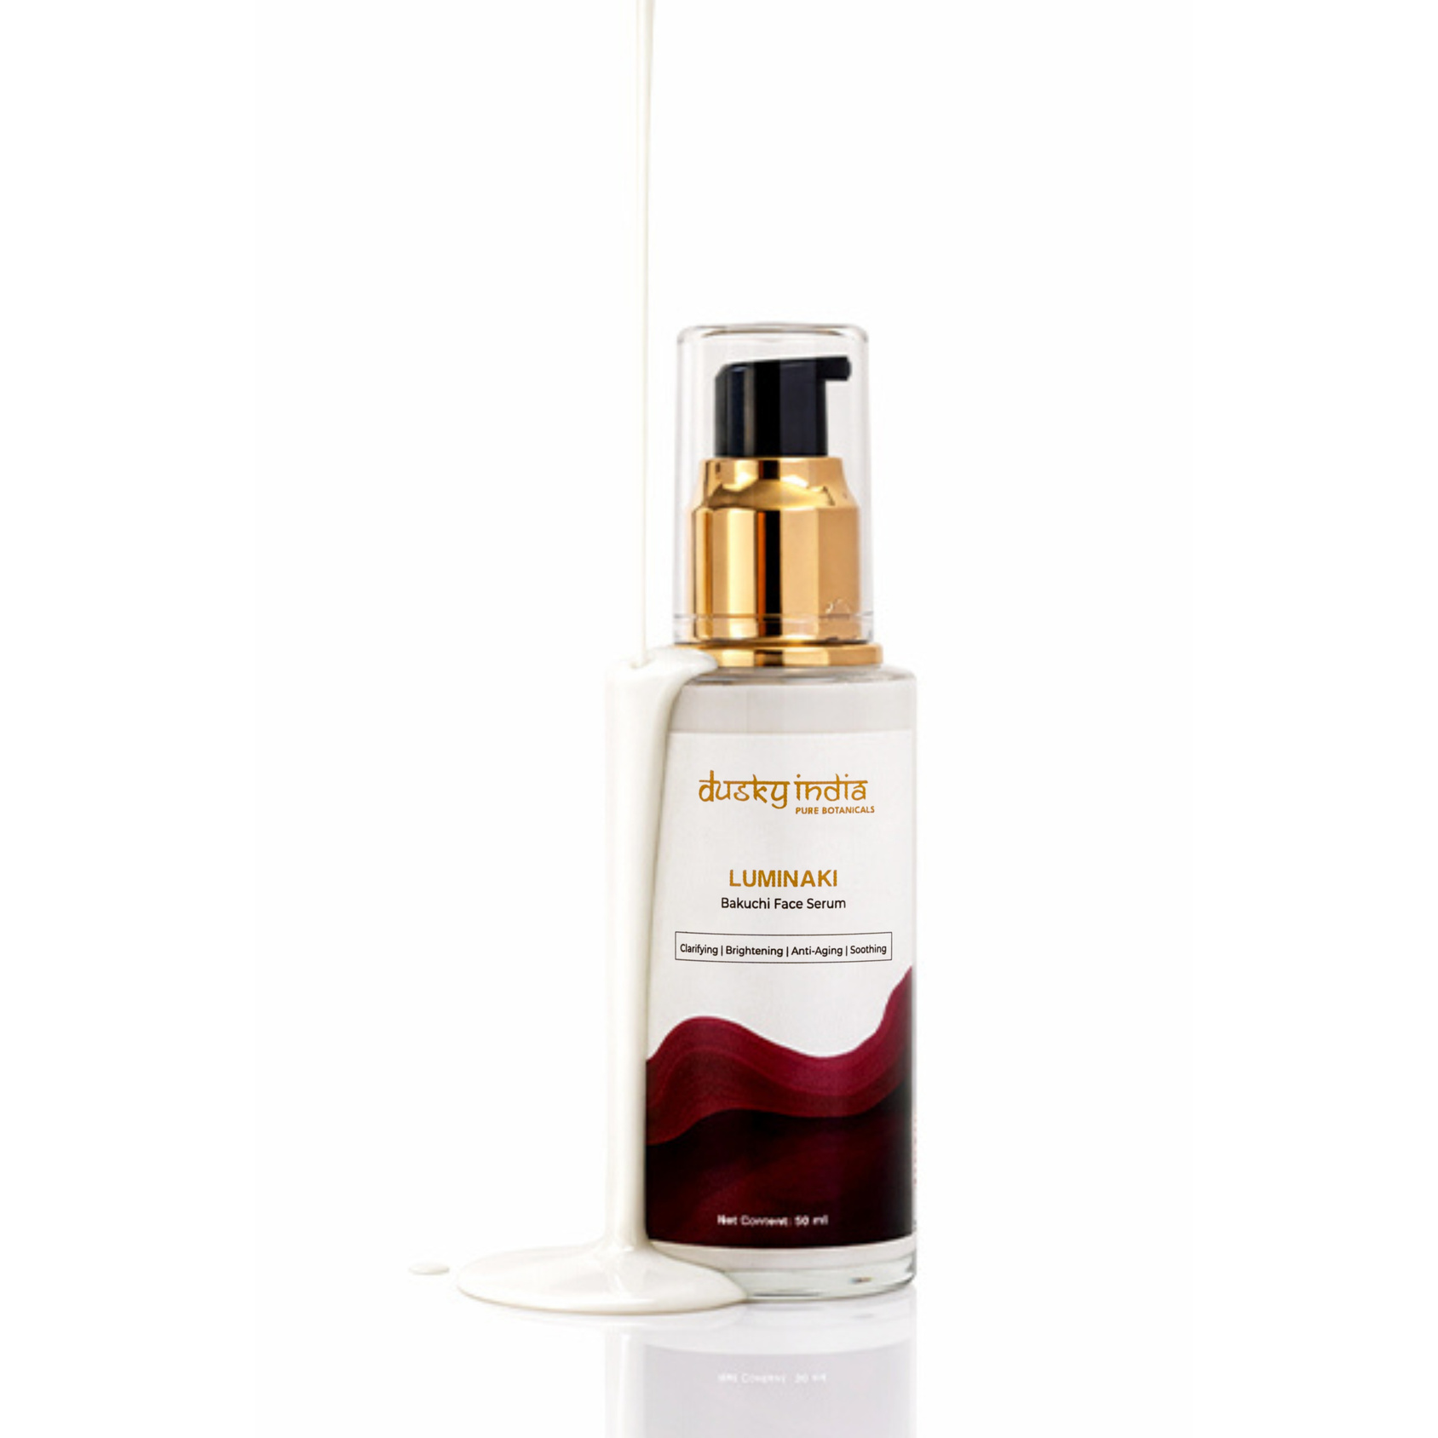
Skin Rejuvenation Serum for Daily Care
Your skin can look tired and dull due to stress, pollution, sun exposure, dehydration, and everyday environmental factors.
A skin rejuvenation serum can help make targeted skincare a regular part of your routine.
Luminaki provides lightweight, botanical-inspired care to help your complexion look:
Fresh • Hydrated • Smooth • Radiant • Healthy

Slide 7
Why Choose a Bakuchi-Based Serum?
Bakuchi has a long-standing connection with traditional Indian beauty practices, while modern skincare has renewed interest in botanical ingredients.
Choosing a Bakuchi-based serum allows you to add nature-inspired care to your daily routine without making it complicated.
Luminaki Is Designed For:
  Anti-aging skincare routines
  Dull-looking skin
  Uneven-looking texture
  Fine-line focused care
  Skin rejuvenation routines
  Botanical skincare enthusiasts

Slide 8

Luminaki – Bakuchi Face Serum is designed to feel lightweight and comfortable on the skin.
It can be easily layered with other skincare essentials, making it suitable for both morning and evening routines.
Simple Daily Routine
Cleanse → Luminaki Serum → Moisturizer → Sunscreen (AM)
This simple routine helps you maintain consistent skincare without unnecessary complexity.
Lightweight Texture, Easy Routine

Slide 9
How to Use Luminaki – Bakuchi Face Serum
For an easy application:
  Cleanse your face thoroughly.
  Take a few drops of Luminaki serum.
  Apply evenly to your face and neck.
  Gently massage or pat until absorbed.
  Follow with your preferred moisturizer.
  Apply sunscreen during the daytime.
Consistent use is an important part of any skincare routine focused on long-term skin health.

Slide 10
Why Choose Luminaki – Bakuchi Face Serum
Dusky India believes skincare should be simple, thoughtful, and inspired by nature.
Luminaki – Bakuchi Face Serum combines the traditional appeal of Bakuchi with convenient modern serum care, making it easy to include botanical skincare in your everyday routine.
The focus is simple: nourish your skin, maintain hydration, and support a fresh, youthful-looking complexion.

