Slide 1




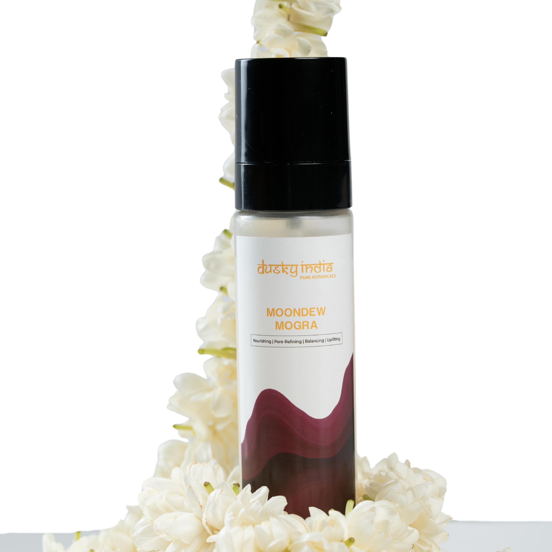

Moondew Mogra – Refresh, Hydrate & Revive Your Skin Naturally

Slide 2
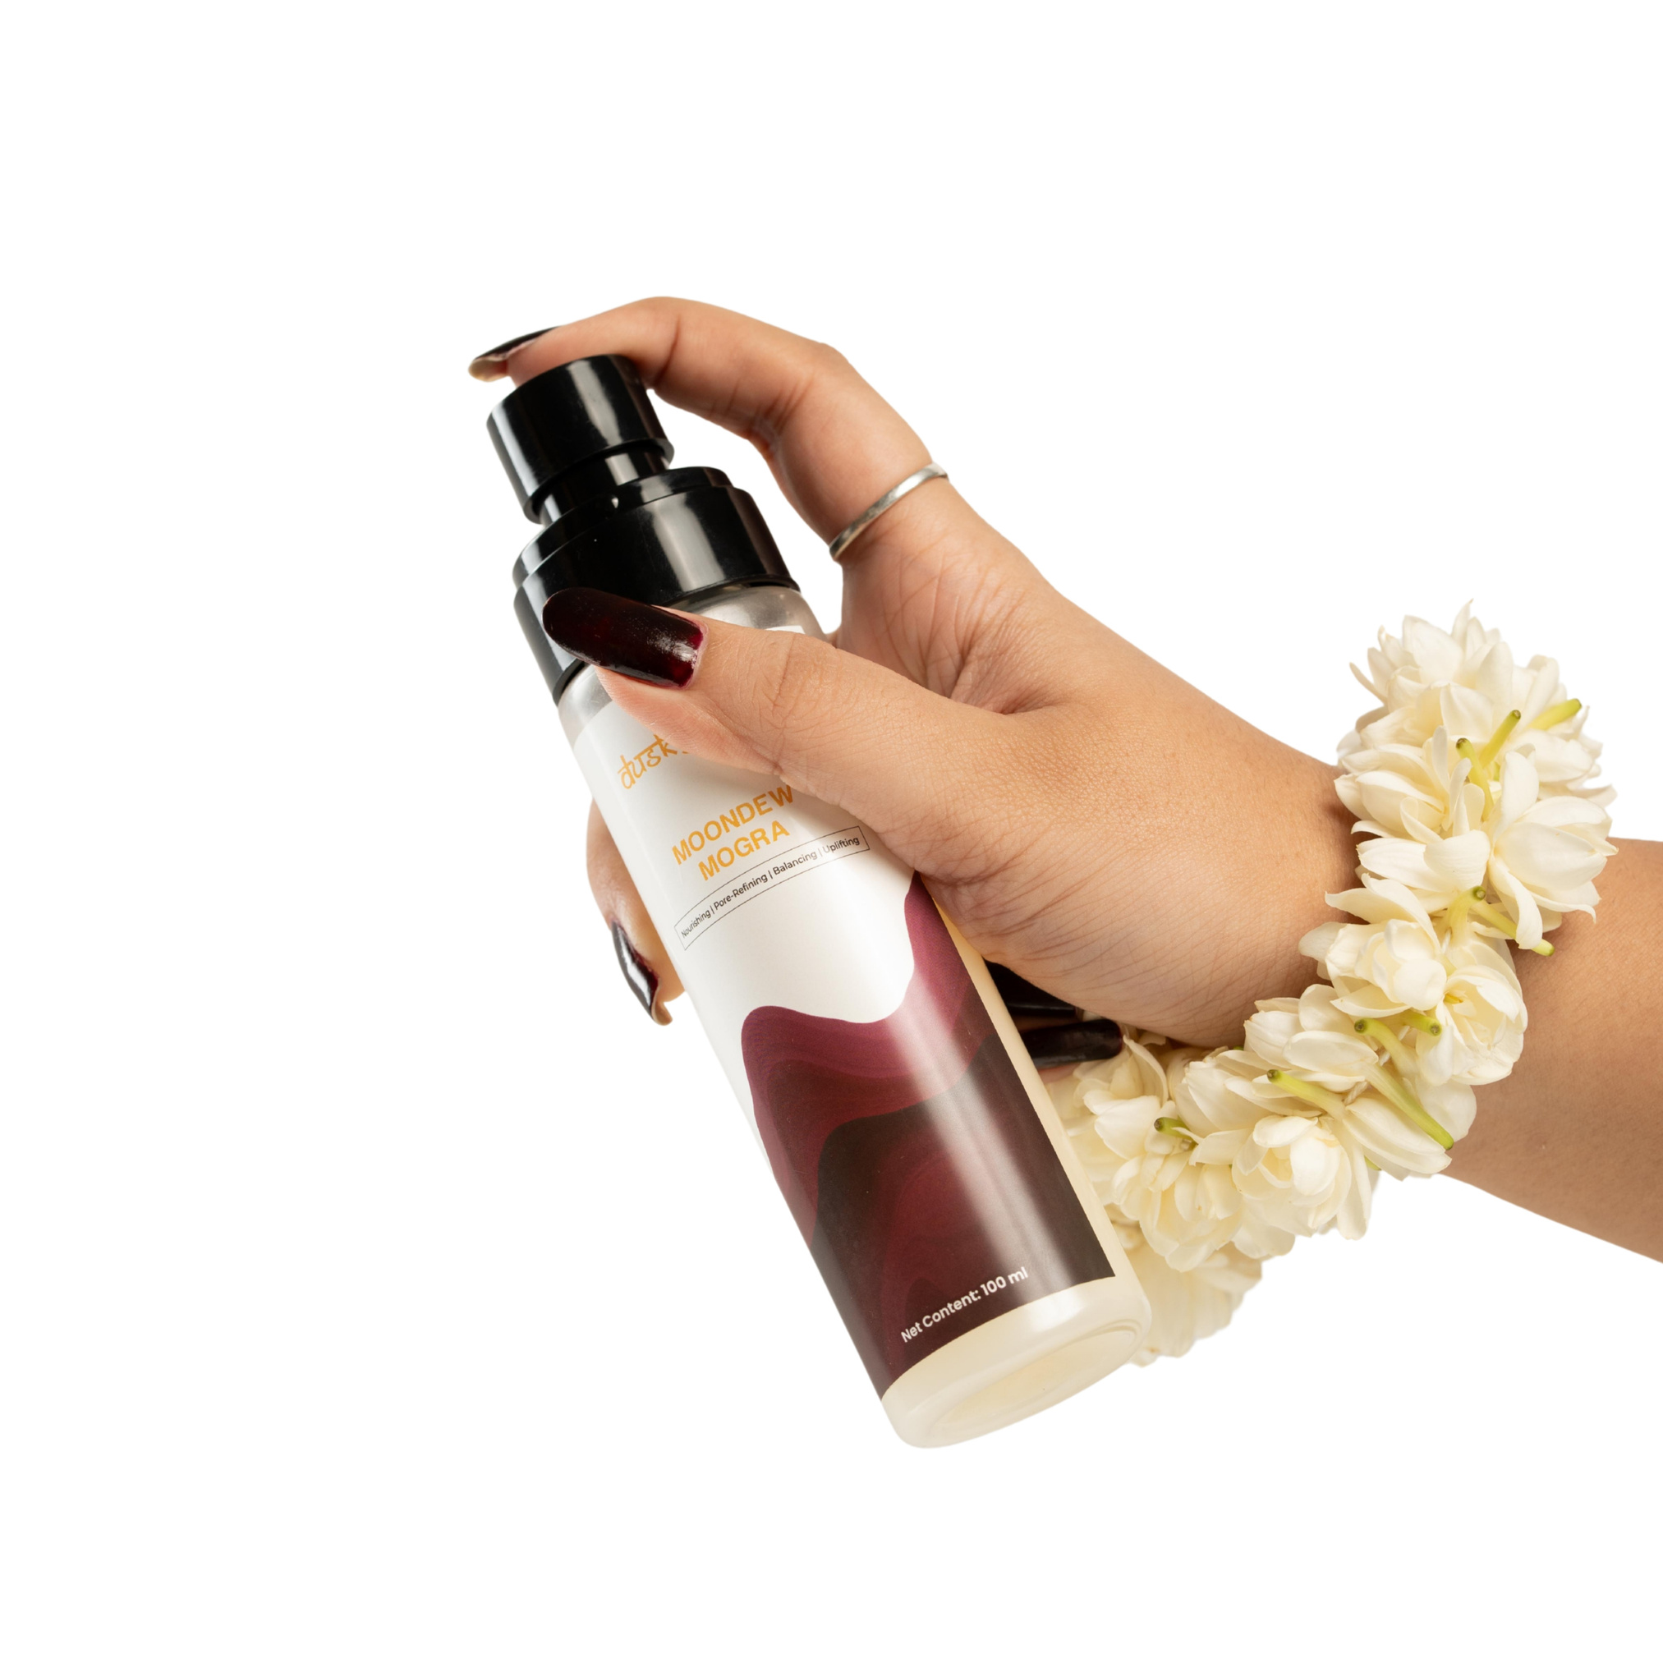

Moondew Mogra – Refresh, Hydrate & Revive Your Skin Naturally
Moondew Mogra by Dusky India is a premium floral face toner designed to refresh, hydrate, and revive tired skin instantly. Enriched with the soothing essence of Mogra (Arabian Jasmine), this lightweight facial mist delivers gentle hydration while keeping your skin soft, fresh, and naturally glowing.
In today’s fast-paced lifestyle, skin often becomes dull due to pollution, sun exposure, stress, and dehydration. A refreshing skincare step like Moondew Mogra helps restore balance and gives your skin an instant boost of freshness anytime, anywhere.

Slide 3

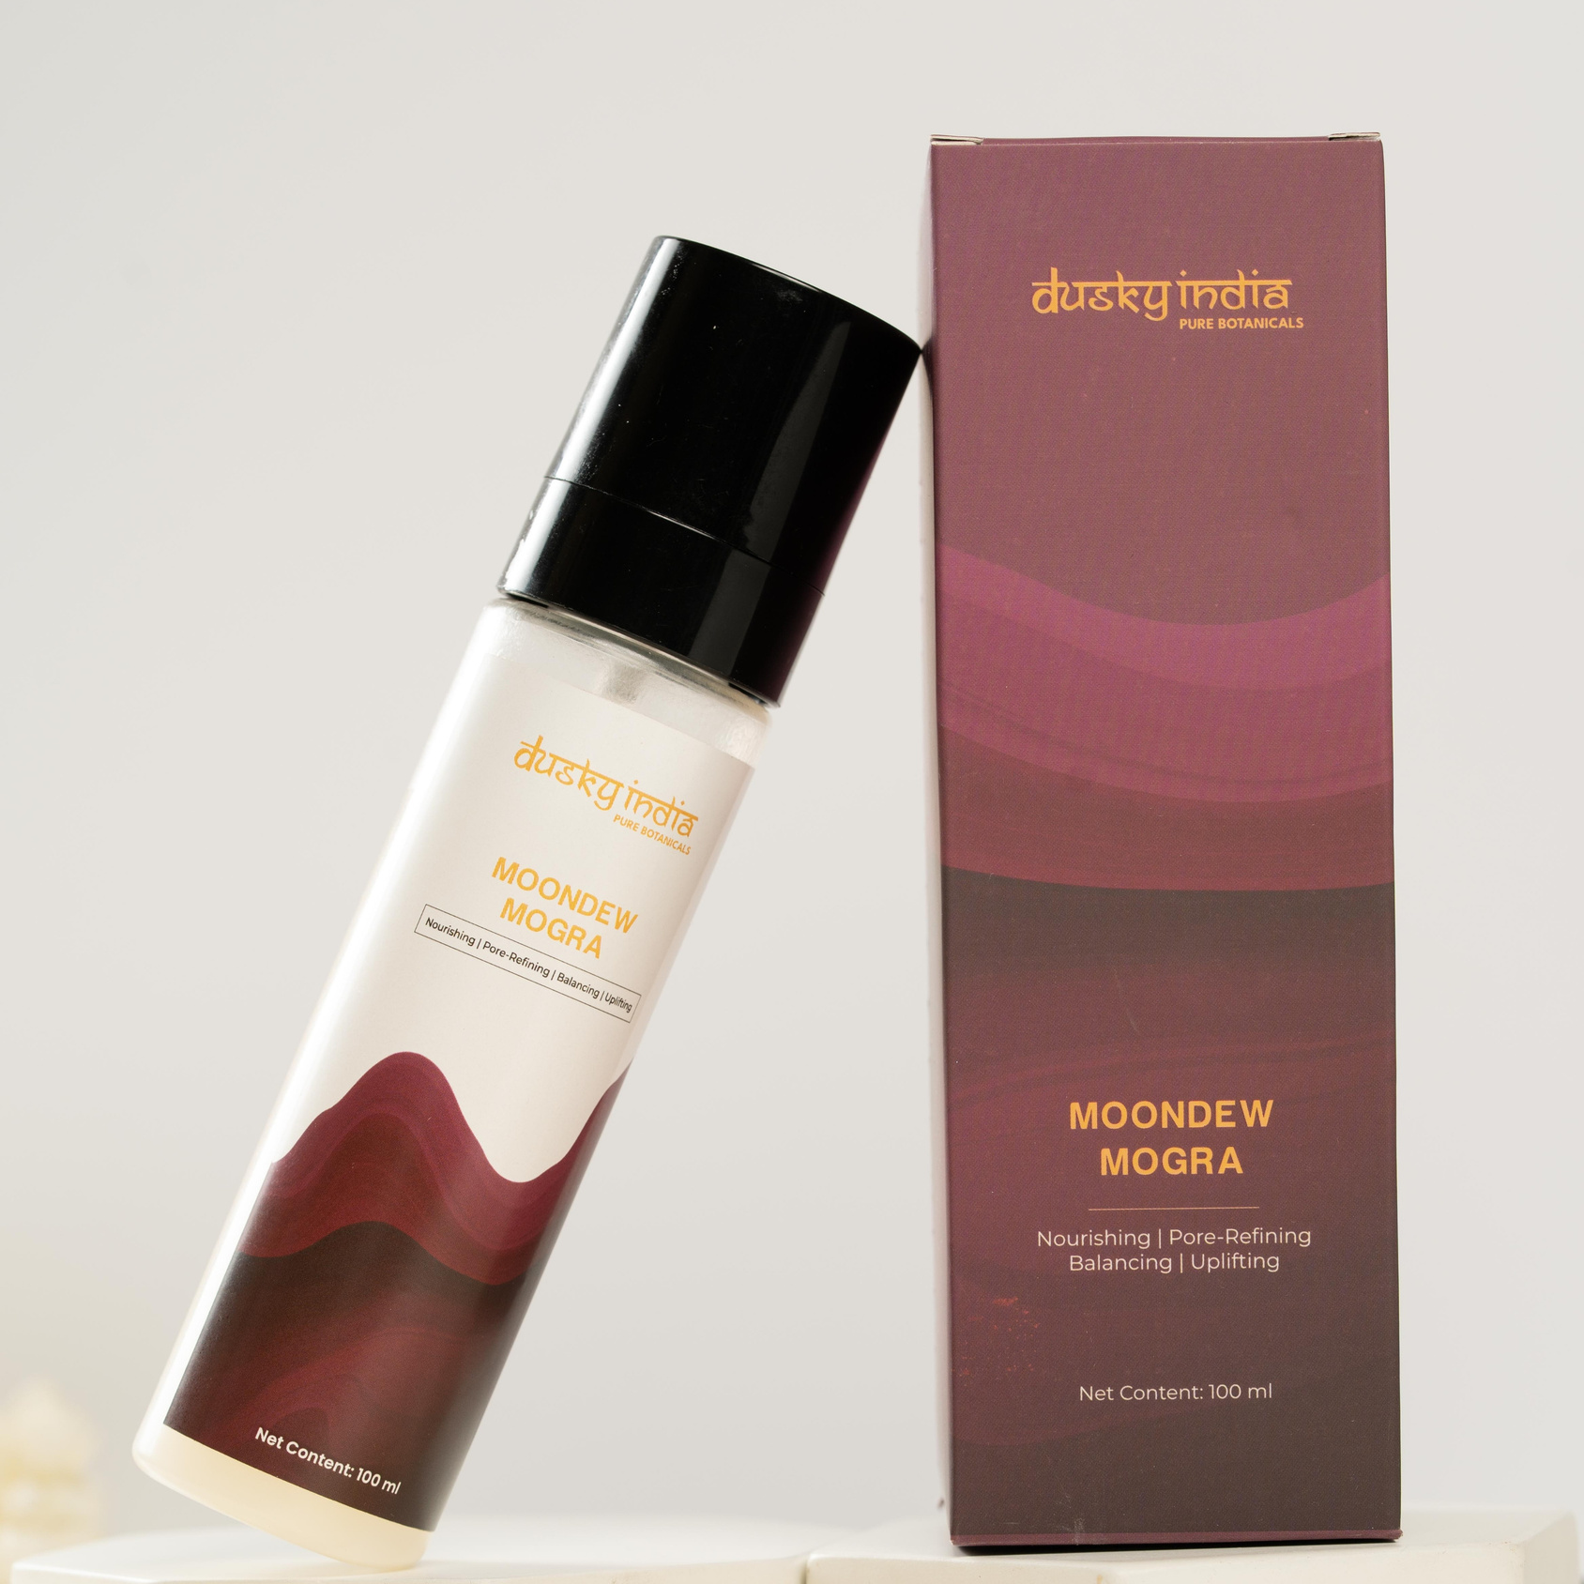

What is Moondew Mogra?
Moondew Mogra is a Mogra face toner that works as a daily skincare essential for all skin types. It is designed in a fine mist format, making it easy to apply and quickly absorbed by the skin without leaving any sticky residue.
This floral toner is perfect for people who prefer natural, lightweight, and refreshing skincare solutions. Whether used in the morning, after cleansing, or during the day, it helps maintain a healthy and dewy skin appearance.

Slide 4
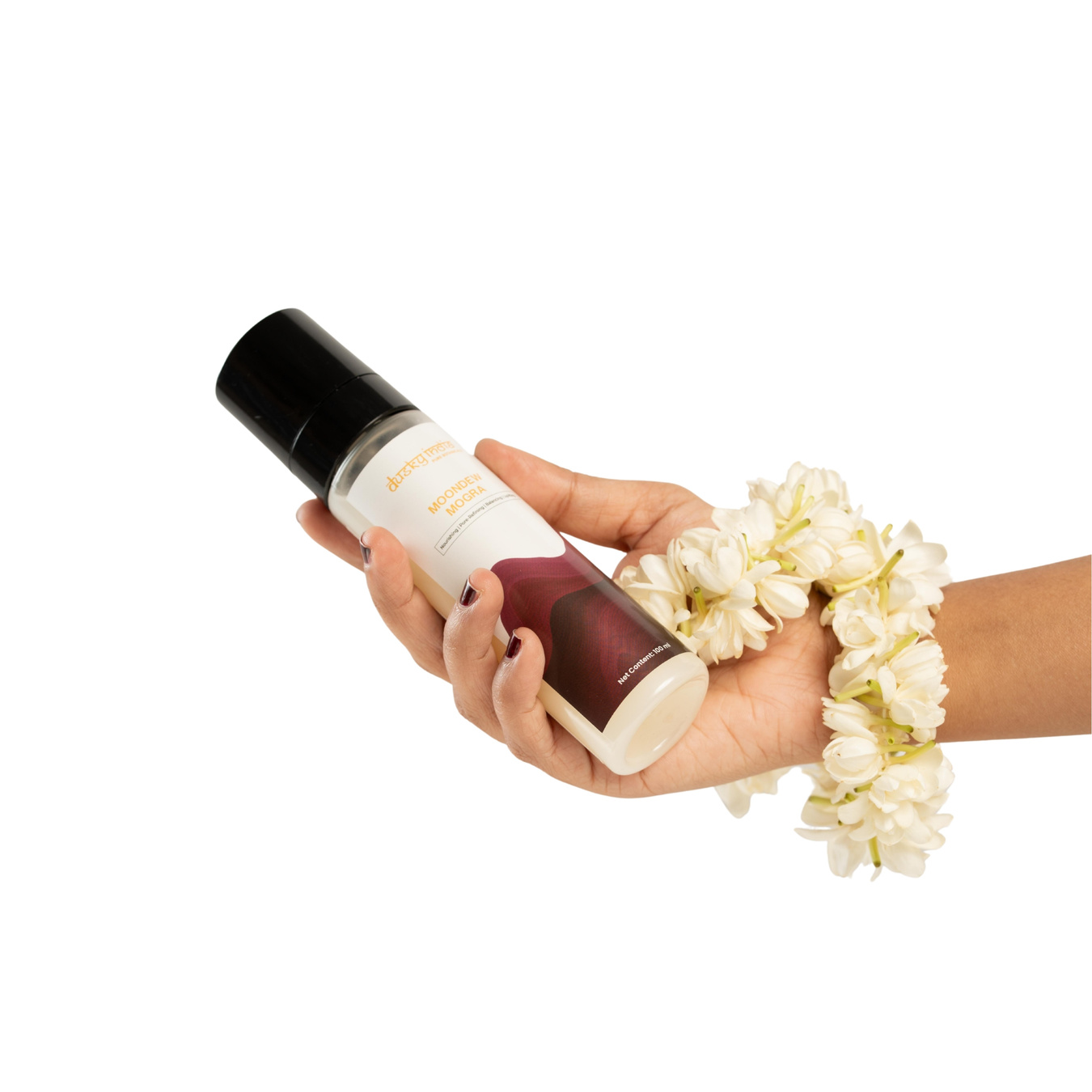

Mogra Face Toner for Everyday Skincare
A toner plays an important role in any skincare routine. It helps prepare the skin after cleansing and enhances the absorption of serums and moisturizers.
Moondew Mogra Mogra face toner is specially crafted to provide:
  Instant skin refreshment
  Lightweight hydration
  Soft and smooth skin texture
  A natural dewy glow
  Gentle floral care for daily use
It is suitable for all skin types, including normal, dry, combination, and sensitive skin.

Slide 5
Jasmine Toner for Face – Natural Floral Care
Mogra, also known as Arabian Jasmine, is widely loved for its calming fragrance and skin-soothing properties. As a jasmine toner for face, Moondew Mogra brings the essence of floral freshness into your skincare routine.
Its gentle mist helps calm tired skin and provides a refreshing sensation, especially after long exposure to heat or pollution. The floral aroma also adds a relaxing self-care experience, making your skincare routine more enjoyable.

Slide 6

Floral Hydrating Mist for Instant Glow
If your skin often feels dry, tight, or dull, a floral hydrating mist like Moondew Mogra can be a game-changer. It delivers instant hydration and helps restore skin comfort within seconds.
You can use it:
  After cleansing your face
  Before applying moisturizer
  Over makeup for a dewy finish
  Anytime your skin feels dry or tired
The lightweight formula ensures that your skin feels refreshed without any heaviness.

Slide 7
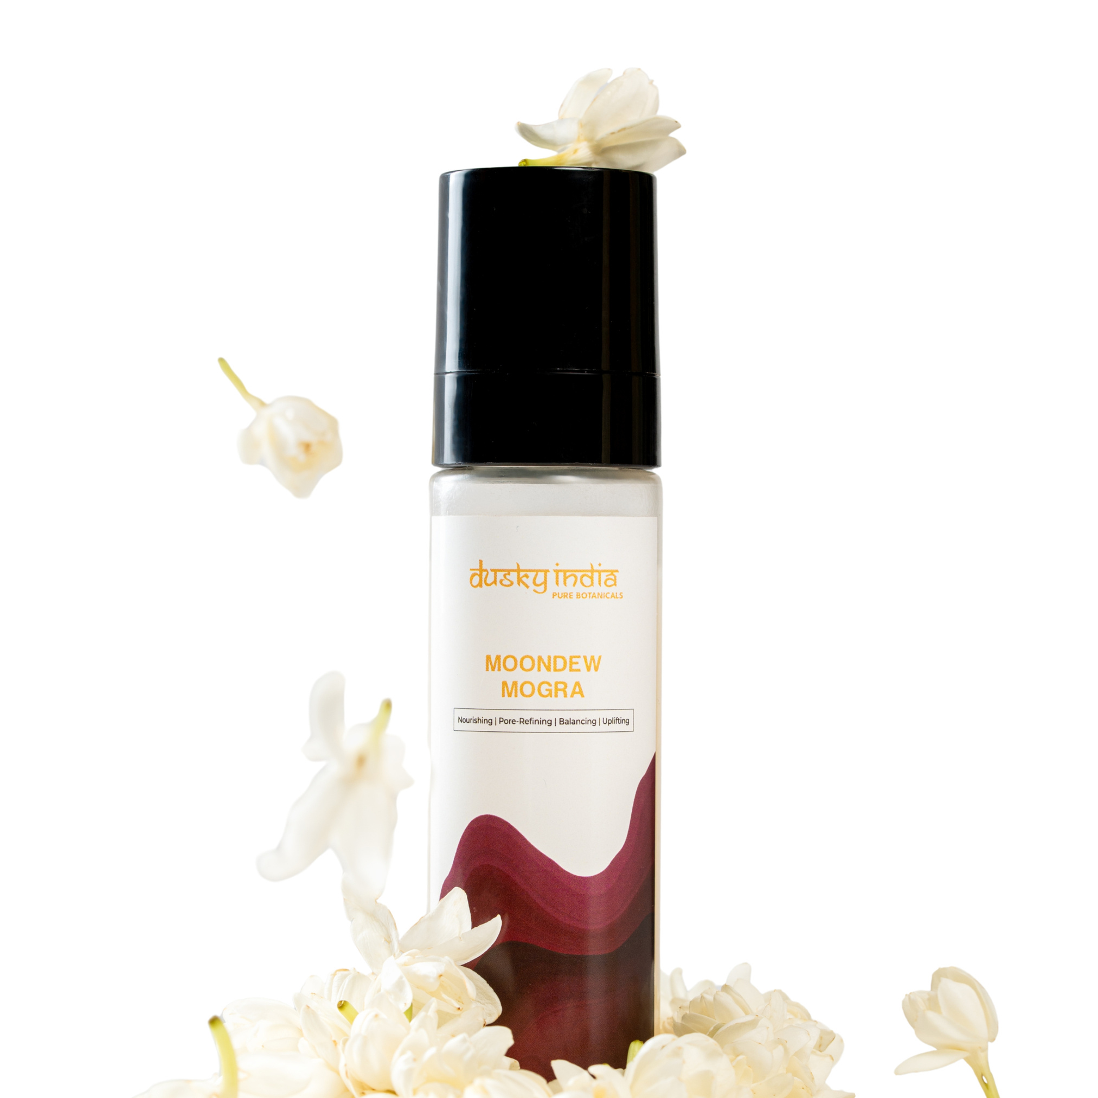
How to Use Moondew Mogra
Using Moondew Mogra floral face toner is simple and quick:
  Cleanse your face thoroughly.
  Hold the bottle a few inches away.
  Close your eyes and spray evenly on your face.
  Let it absorb naturally into the skin.
  Follow with serum or moisturizer for best results.
You can reapply it throughout the day whenever your skin needs a refresh.

Slide 8
Who Should Use Moondew Mogra?
This jasmine toner for face is suitable for:
  People exposed to pollution and sun daily
  Those with dull or tired-looking skin
  Skincare lovers who prefer natural floral products
  Individuals looking for lightweight hydration
  Anyone wanting a quick skin refresh during the day
It is gentle enough for daily use and works well in all seasons.

Slide 9
Why Choose Dusky India Moondew Mogra?
Dusky India focuses on creating skincare that is simple, natural, and effective. Moondew Mogra reflects this philosophy by combining floral inspiration with modern skincare needs.
Unlike heavy toners, it offers a refreshing mist experience that fits easily into any skincare routine. It is designed for people who want glowing, hydrated, and healthy-looking skin without complicated steps.

