Slide 1


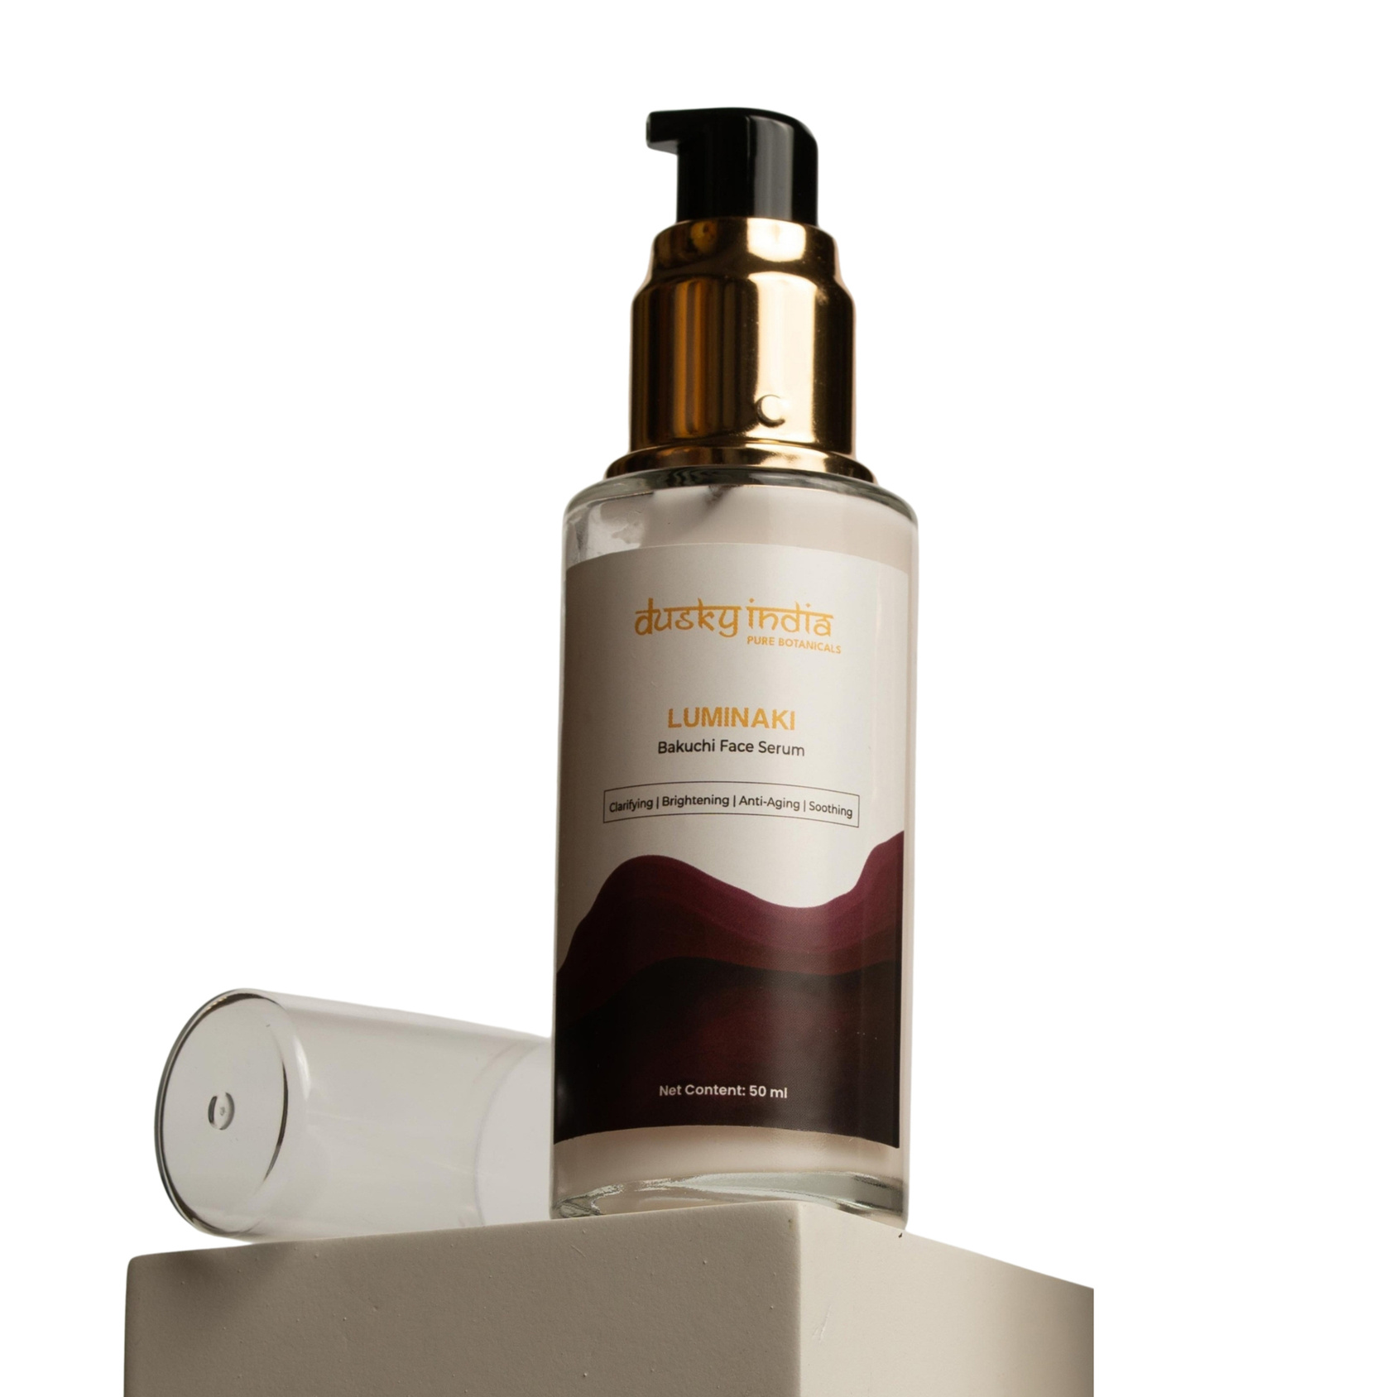
Dusky India
Luminaki – Bakuchi Face Serum

Slide 2

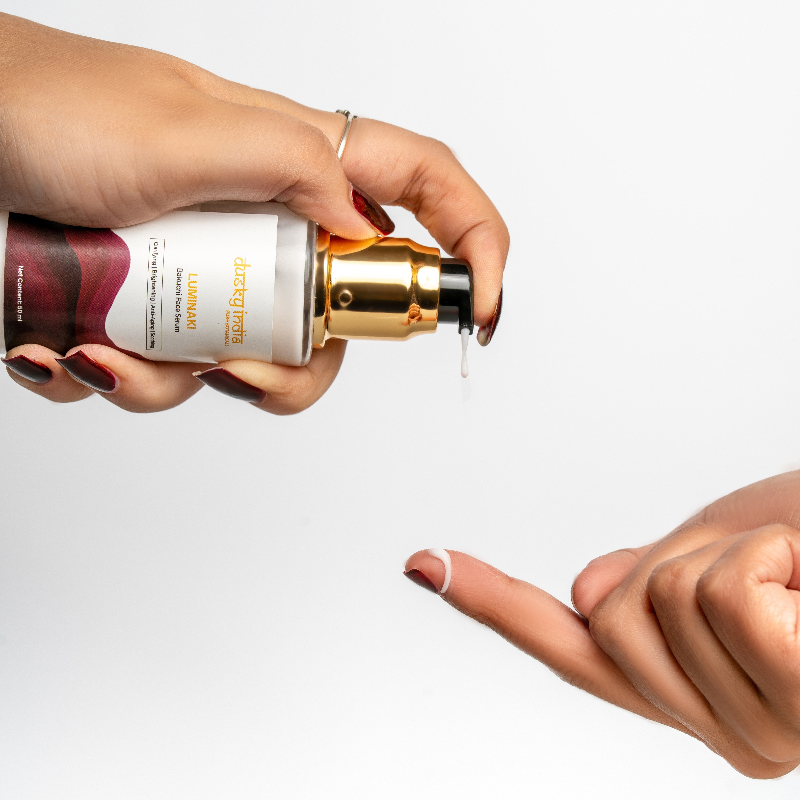
Meet Luminaki – Bakuchi Face Serum
Your skin is exposed to pollution, sunlight, stress, and other environmental factors every day. Over time, this can contribute to dullness, uneven-looking texture, and visible signs of aging.
Luminaki – Bakuchi Face Serum brings Bakuchi-inspired skincare into a modern, easy-to-use formula designed to support a brighter, smoother, and healthier-looking complexion.

Slide 3
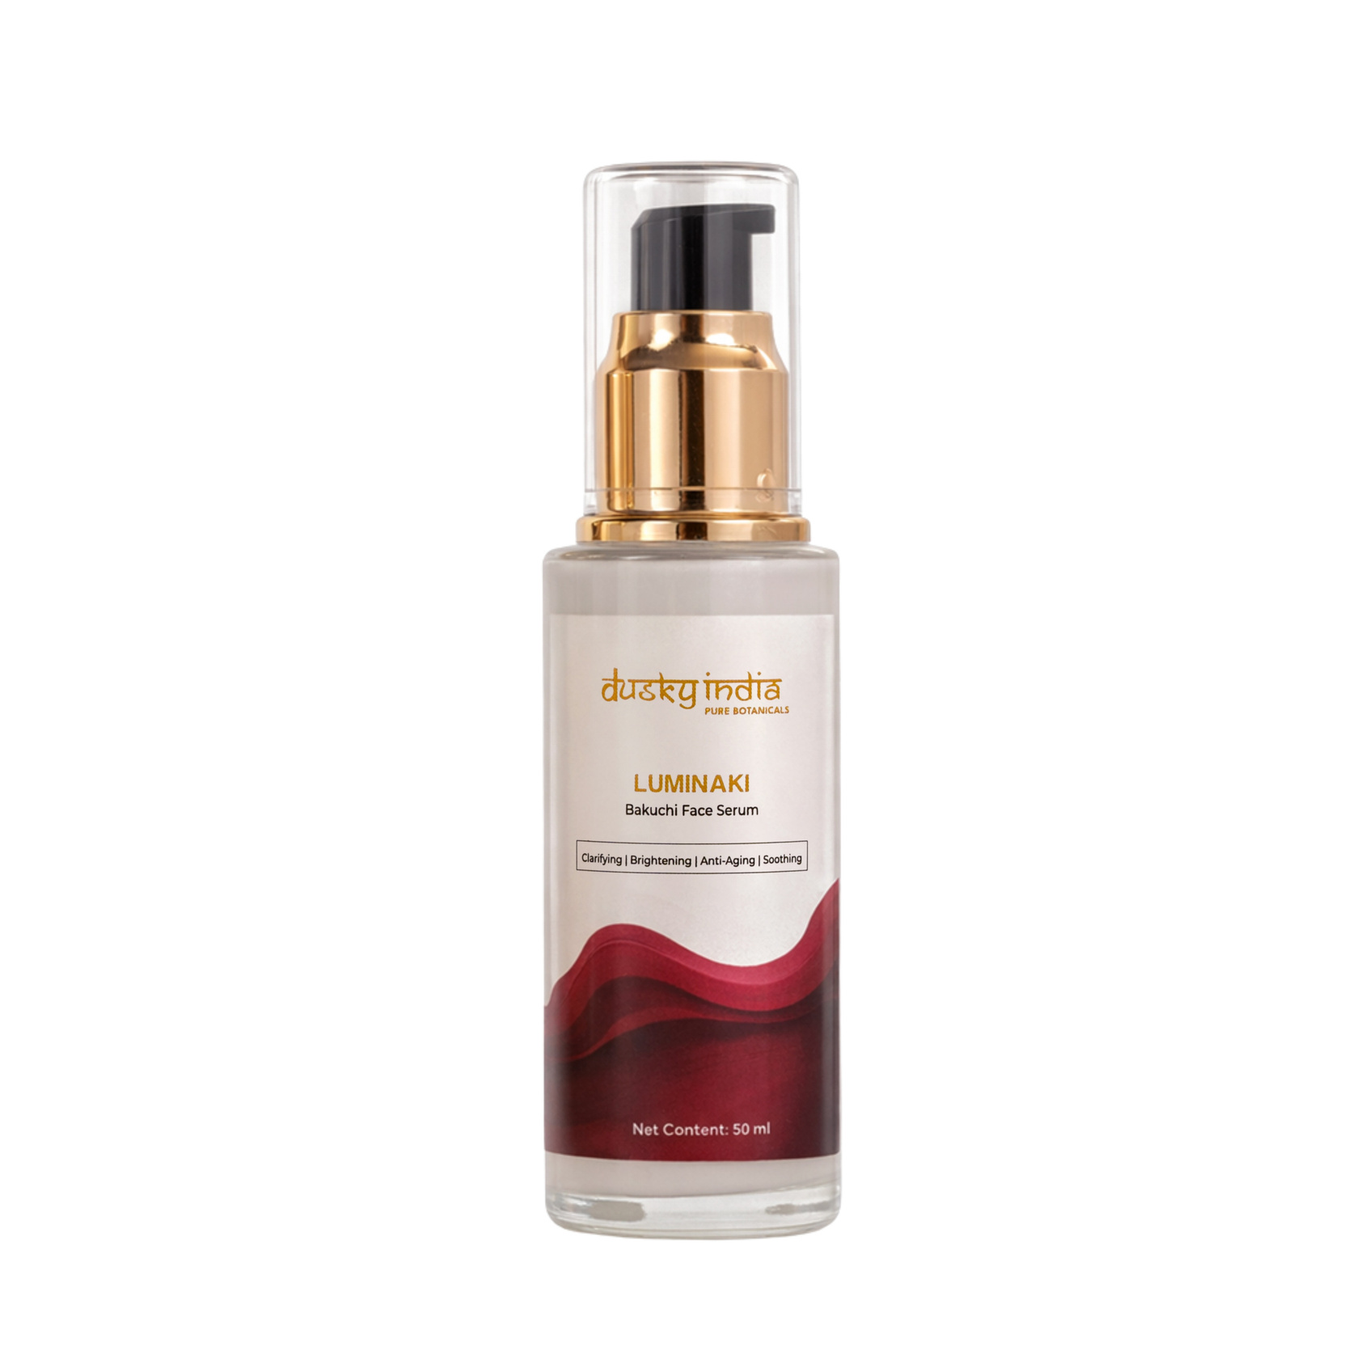
Why Add a Face Serum to Your Routine?
A face serum is a concentrated skincare step that can be layered between cleansing and moisturizing.
Luminaki is designed to provide targeted care while remaining lightweight and comfortable on the skin.
Benefits of Adding a Serum
  Supports a healthy-looking glow
  Helps maintain skin hydration
  Complements an anti-aging skincare routine
  Helps improve the appearance of dull skin
  Supports smoother-looking skin
  Easy to layer with moisturizer and sunscreen

Slide 4
As we age, skin can naturally become drier and less radiant, while fine lines and uneven texture may become more noticeable.
An anti-aging serum can be an important part of a consistent skincare routine focused on maintaining a youthful-looking complexion.
Luminaki – Bakuchi Face Serum helps support:
  Smoother-looking skin
  Improved-looking radiance
  Hydrated, supple skin
  A healthy-looking complexion
  Daily nourishment
Consistency is key when building an effective anti-aging skincare routine.
Anti-Aging Serum for Youthful-Looking Skin

Slide 5
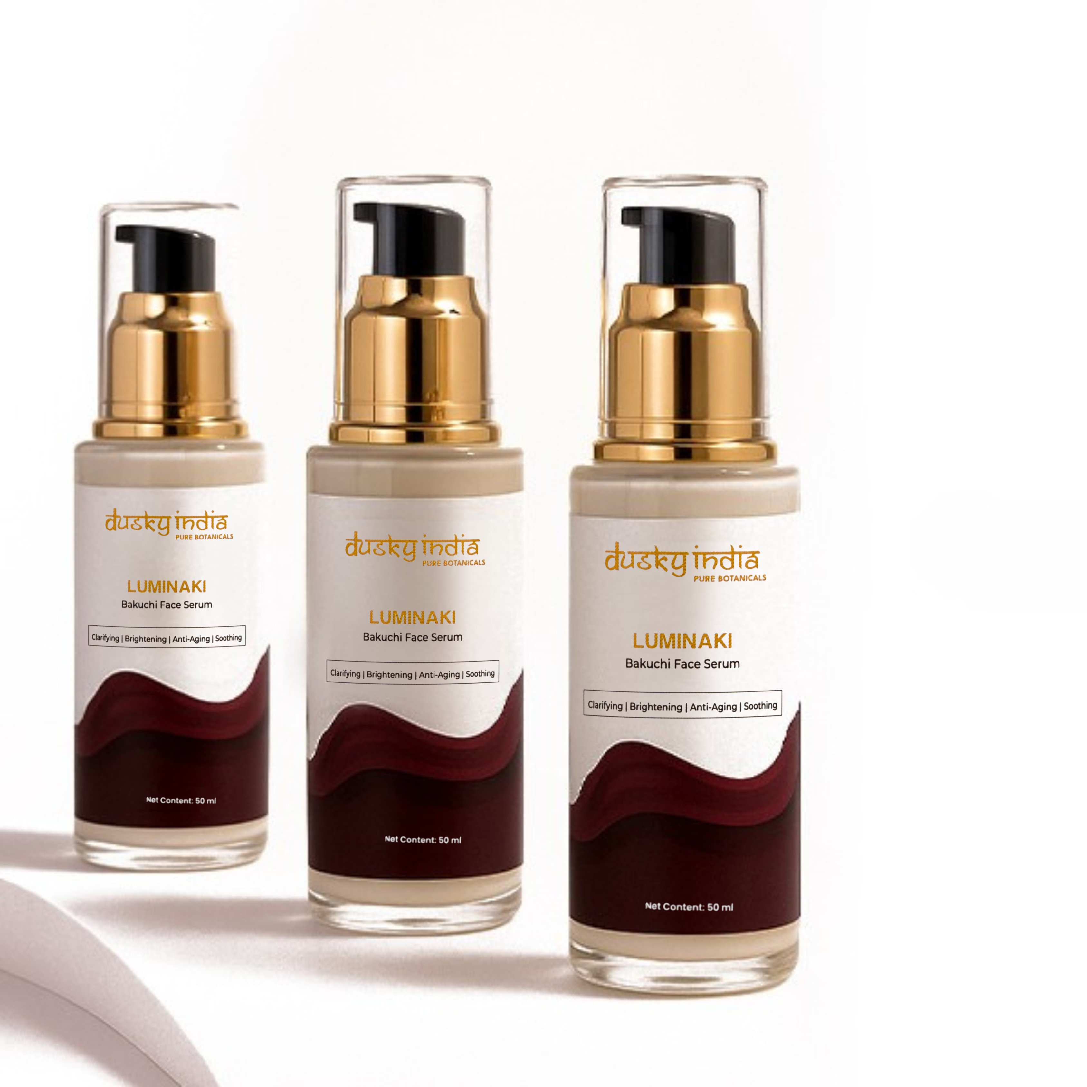
Bakuchi – A Traditional Botanical for Modern Skincare
Bakuchi is a botanical ingredient traditionally valued in Indian wellness and beauty practices.
Luminaki – Bakuchi Face Serum by Dusky India brings the botanical appeal of Bakuchi into a convenient modern skincare format.
It is an ideal choice for those who enjoy nature-inspired skincare while looking for a simple serum to complement their daily routine.

Slide 6
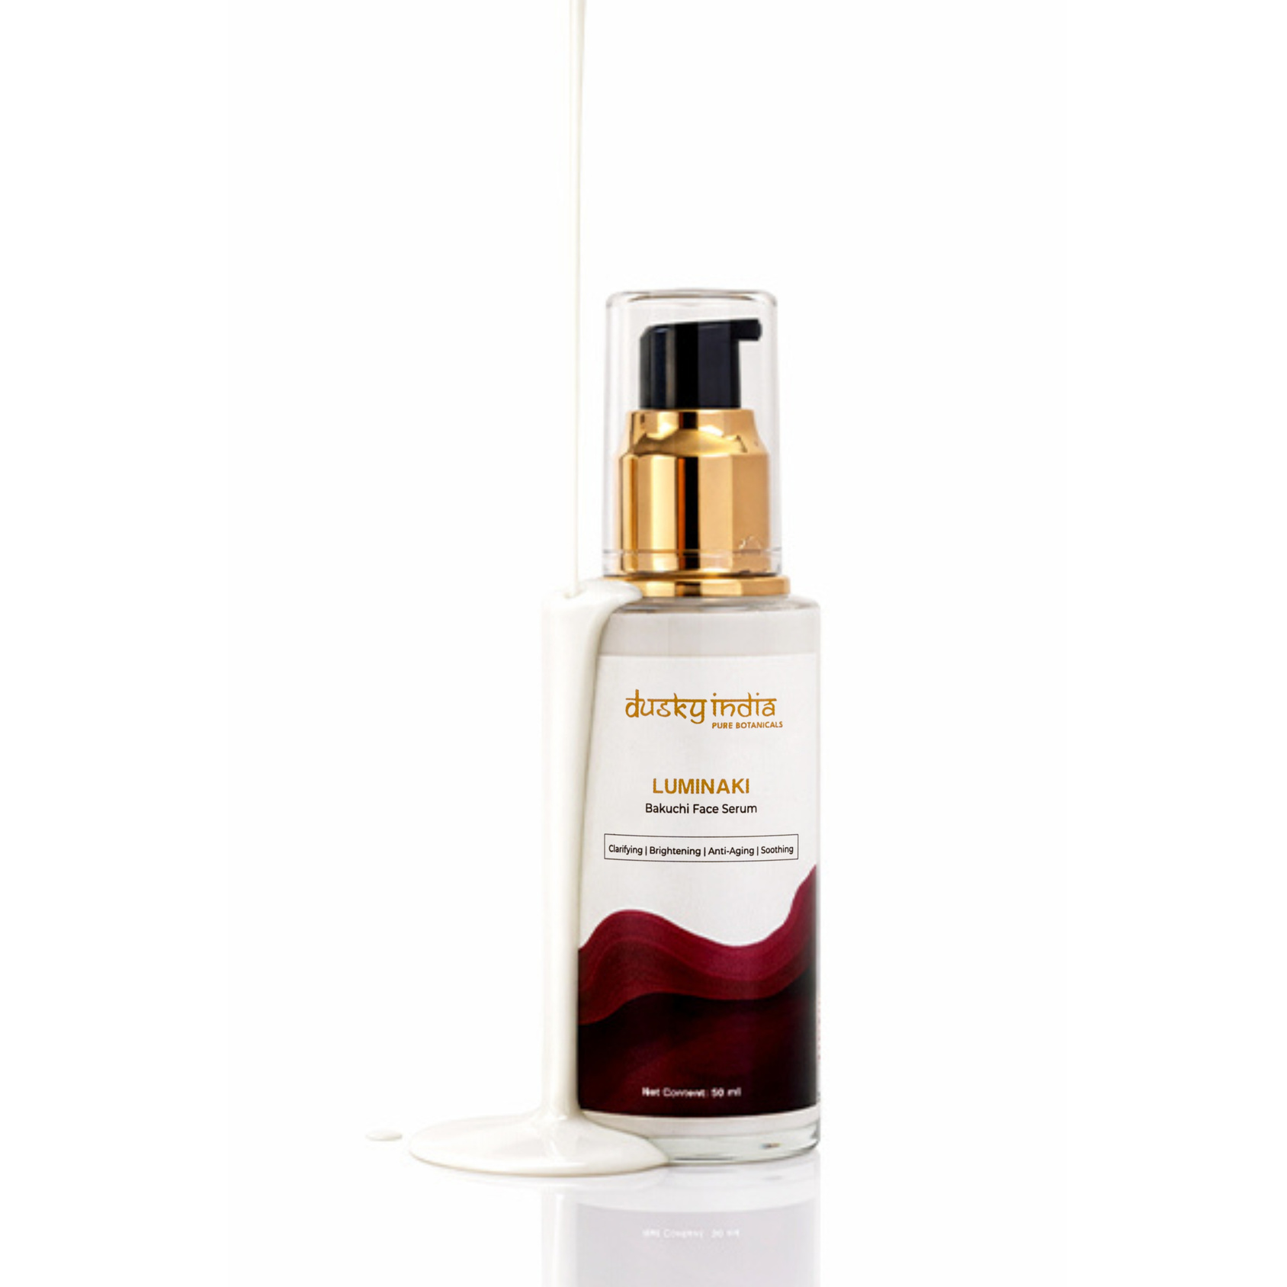
Brightening Serum for a Radiant-Looking Complexion
Dullness and an uneven-looking complexion can make skin appear tired. A consistent skincare routine focused on nourishment and hydration can help support a naturally radiant appearance.
Luminaki works as a brightening serum designed to help your skin look fresh, luminous, and healthy.
Add It to Your Routine for:
  A brighter-looking complexion
  A fresh, radiant appearance
  Smoother-looking skin
  Hydrated skin
  Everyday skin nourishment

Slide 7
Lightweight Face Serum for Daily Skincare
Nobody wants a serum that feels heavy or sticky. Luminaki is designed to fit comfortably into your everyday routine.
This face serum can be easily layered with your other skincare products and works well as part of both morning and evening routines.
Simple. Lightweight. Easy to Layer.
Apply a few drops to clean skin before moisturizer and allow the serum to absorb before completing your routine.

Slide 8

Follow these simple steps for your daily skincare routine:
  Cleanse your face with a gentle cleanser.
  Take a few drops of Luminaki – Bakuchi Face Serum.
  Apply evenly to your face and neck.
  Gently massage or pat until absorbed.
  Follow with a moisturizer.
  Apply sunscreen during the daytime.
For best skincare results, use consistently according to your routine.
How to Use Luminaki – Bakuchi Face Serum

Slide 9
Who Can Use Luminaki?
Luminaki – Bakuchi Face Serum is suitable for people looking to add targeted serum care to their skincare routine.
It can be a great addition if you are concerned about:
  Dull-looking skin
  Uneven-looking complexion
  Visible signs of aging
  Fine lines
  Loss of natural-looking radiance
  Dry or tired-looking skin

Slide 10
Why Choose Dusky India?
Dusky India believes skincare should be simple, thoughtful, and inspired by nature.
Luminaki – Bakuchi Face Serum brings together the traditional appeal of Bakuchi with modern facial serum care, making it easy to add targeted nourishment and radiance-focused care to your everyday routine.

