Slide 1
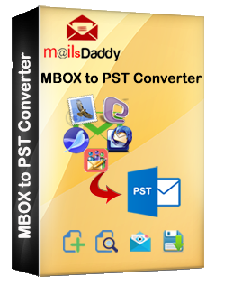
About MailsDaddy MBOX to PST Converter
MailsDaddy MBOX to PST Converter is the best GUI based Application & most demanding product around the world. Our software expert embedded advanced features to make its better , secure and reliable. If you have .mbox file or huge data of .mbox and want to move in MS Outlook then MailsDaddy MBOX to PST Converter is made for you.
1

Slide 2

How to entire process has been performed
Open the downloaded MailsDaddy MBOX to PST Converter.
Click on Add file Button.
Select one of them multiple option for Adding .mbox files, then click OK.
See preview of selected Email & their attachment in right pane.
Save the Emails & their attachment on the spot in given formats.
Click on Export button for converting whole emails in once.
Select PST or other given format if you want.
Select single PST or separate PST for all MBOX files.
Save your desired location.
Click on next.
In few second your PST file is ready to export in MS Outlook.
2

Slide 3

How many advanced features are embedded by software expert
Automatically Fetch .mbox file in one click, don’t waste time on search.
Multiple option for Adding MBOX files or Folders
Save Emails and their attachments on spot in given formats
Export Bulk .mbox file in one click .
Make single PST or separate PST of all MBOX files.
Migrate the .mbox files in PST/EML/MSG formats.
Desired location for saving in PC
Supported in all Window version such as Window XP, 7, 8 ,8.1, 10.(32bit & 64 bit)
Support in all MS Outlook version like 2007, 2010, 2012, 2013, & 2016
3

Slide 4


How to reach our best MailsDaddy MBOX to PST converter
Website : www.mailsdaddy.com
Or
https://www.mailsdaddy.com/mbox-to-pst-converter/
4

Slide 5

5
Support and Claims
Our Team is ready to help you 24x7
We serve live chat option for our costumer.
Customer select one appropriate license form three different types.
Live video of conversion process or screen shot are available on website.
FAQ available if you have any question about related product.
30 Days money back guarantee if you have any issue

Slide 6
Thanks for Watching
MailsDaddy MBOX to PST Converter Review

