Slide 1
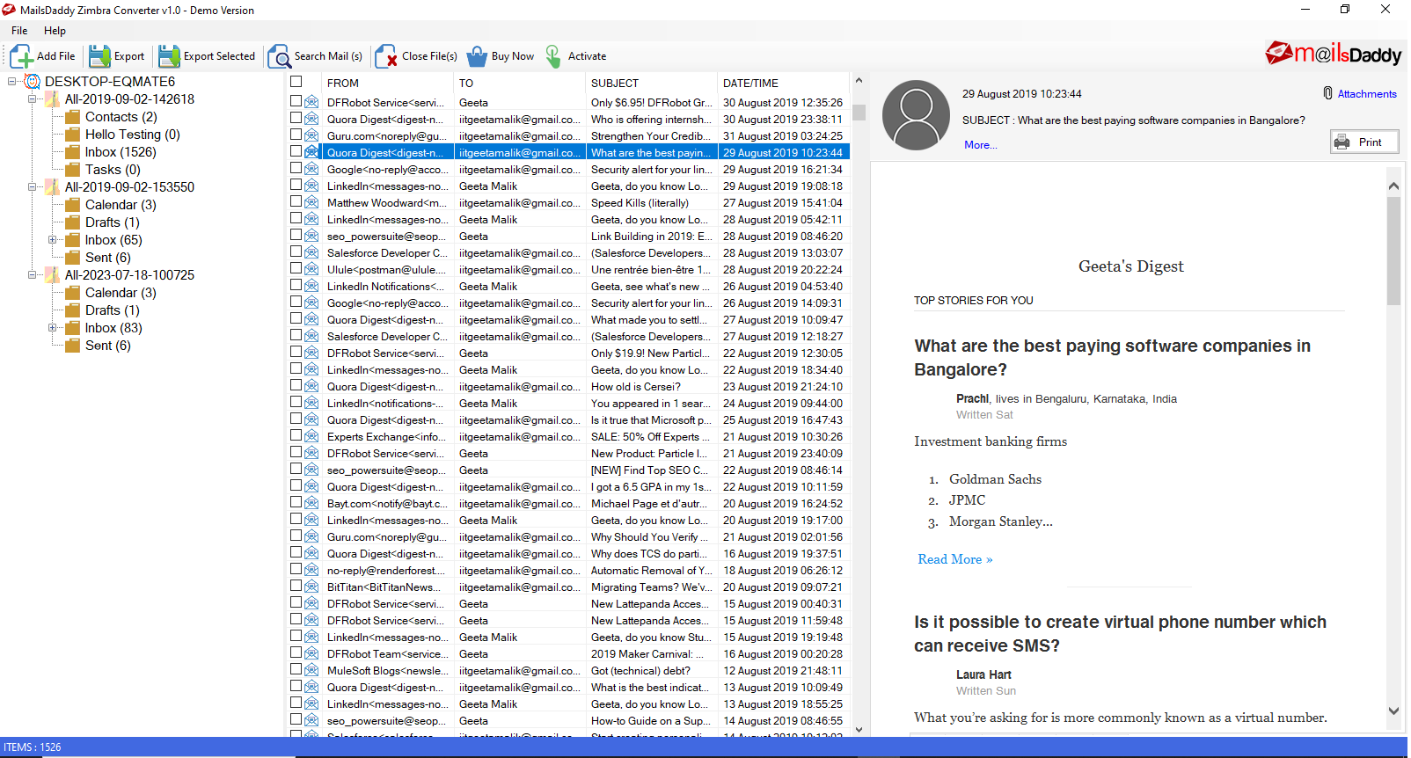

MailsDaddy
Zimbra Converter
Migrate Zimbra TGZ mailbox into various email clients like MS Outlook.

Slide 2






Background Introduction
How does it simplify the migration?
TGZ data file is an unextracted file that the user cannot directly open it.
It saves the entire Zimbra mailbox like Email, Contact, Calendar, Task and others.

Slide 3


How to Converter?
Mostly users know that without conversion, user cannot open data into any other email clients like Outlook.
01. Manual
02. Automate
The manual method of exporting Zimbra mailbox to Outlook & others is comparatively a very lengthy process and also takes a lot of time.
Third-party tools or business applications are designed to migrate personal and organization data to Outlook, Office 365, etc.

Slide 4


Why Choose a third-party tool?
When you compare both methods, you will understand the advantages of a third-party tool like the manual method may work differently for each email client while a third-party tool gives you multiple results from a single interface.

Slide 5

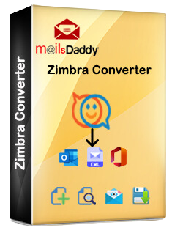

MailsDaddy Zimbra Converter
MailsDaddy

Slide 6

About
MailsDaddy Zimbra Converter tool is expertly crafted to convert and open mailboxes in eight different file formats. It is a top choice for anyone looking to transform or extract data from TGZ files.
The application has numerous advanced features and is capable of holding the similar folder hierarchy in a resultant data file. You can also try the free demo edition of the solution and migrate few items from each folder.

Slide 7
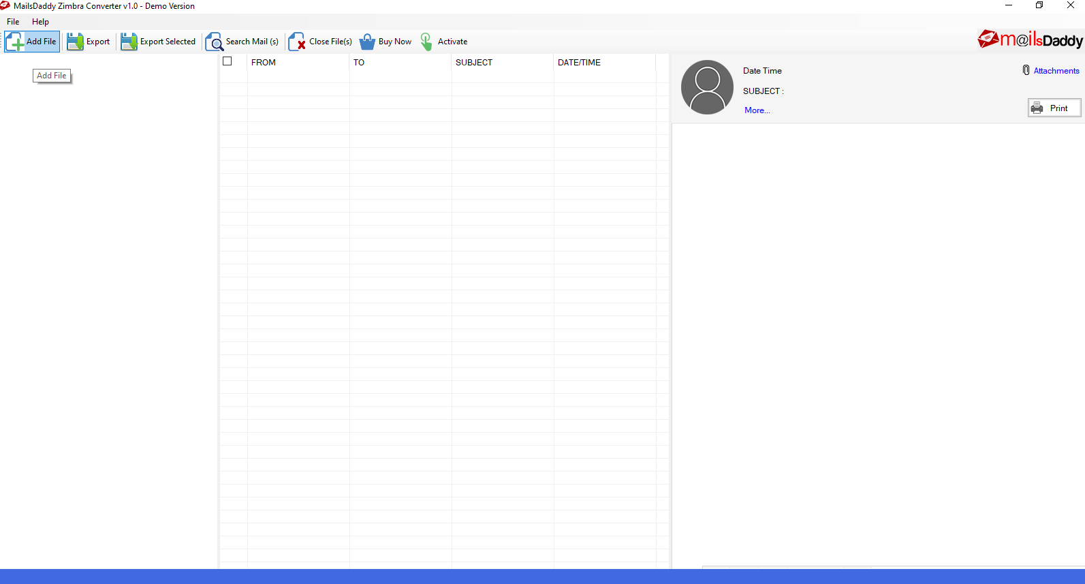
Download, Run and Add TGZ files

Slide 8
Preview is optional, Press Export button

Slide 9
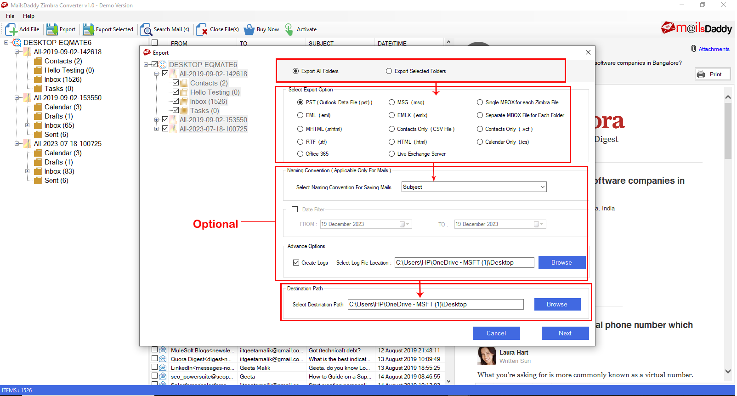
Choose Output, Loacation then Next.

Slide 10
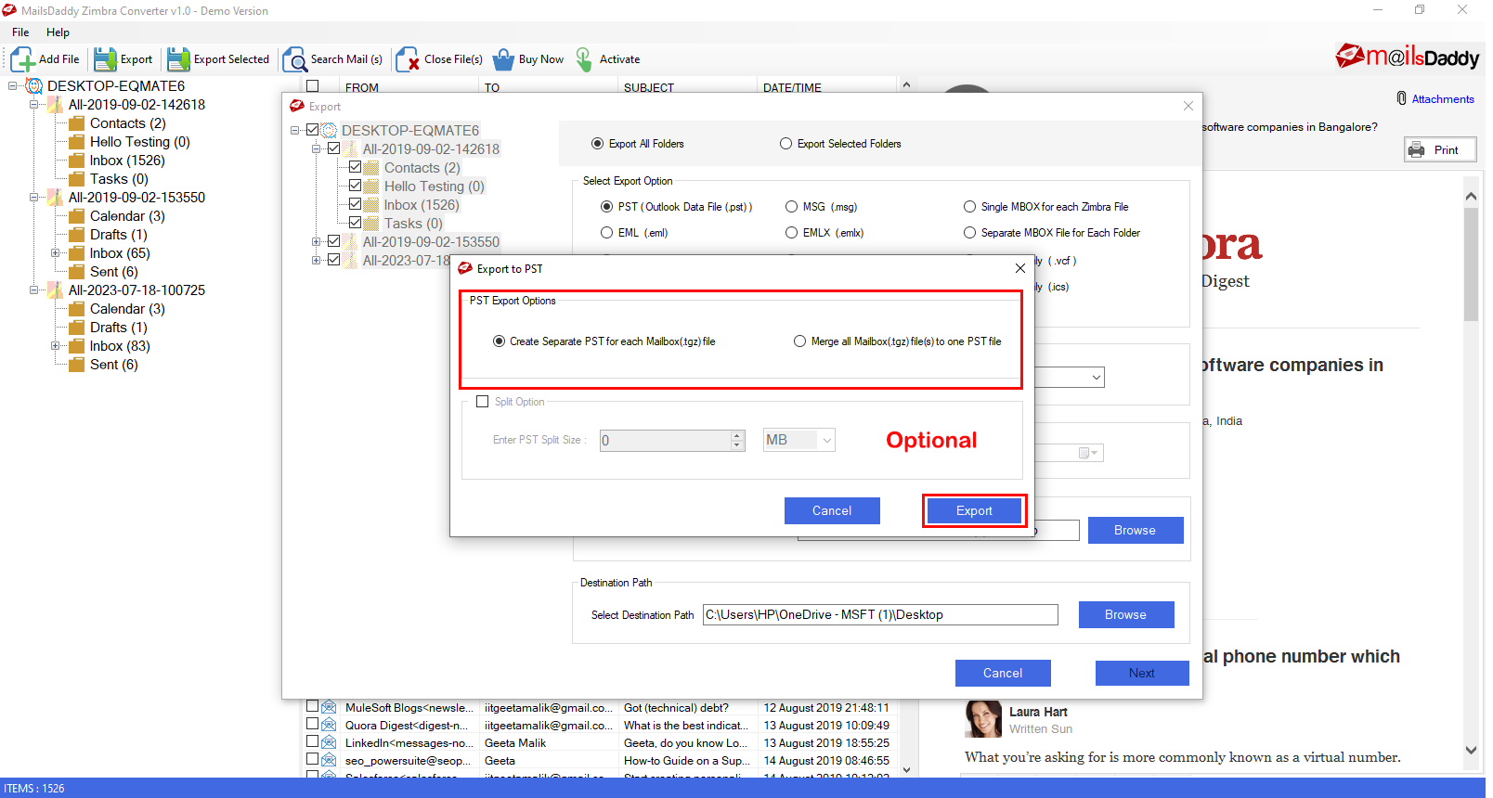
PST Export option for Outlook

Slide 11
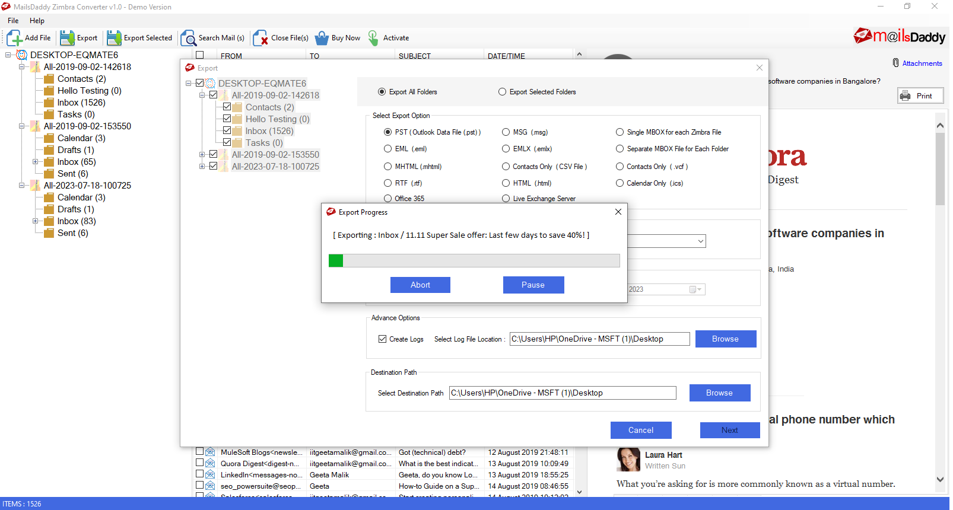
Start the Migration and Wait for the confirmation.

Slide 12



Thank You So Much!
For your time....!
WEBSITE
https://www.mailsdaddy.com/zimbra-converter/
CONTACT US
+91 8750750629

