Slide 1


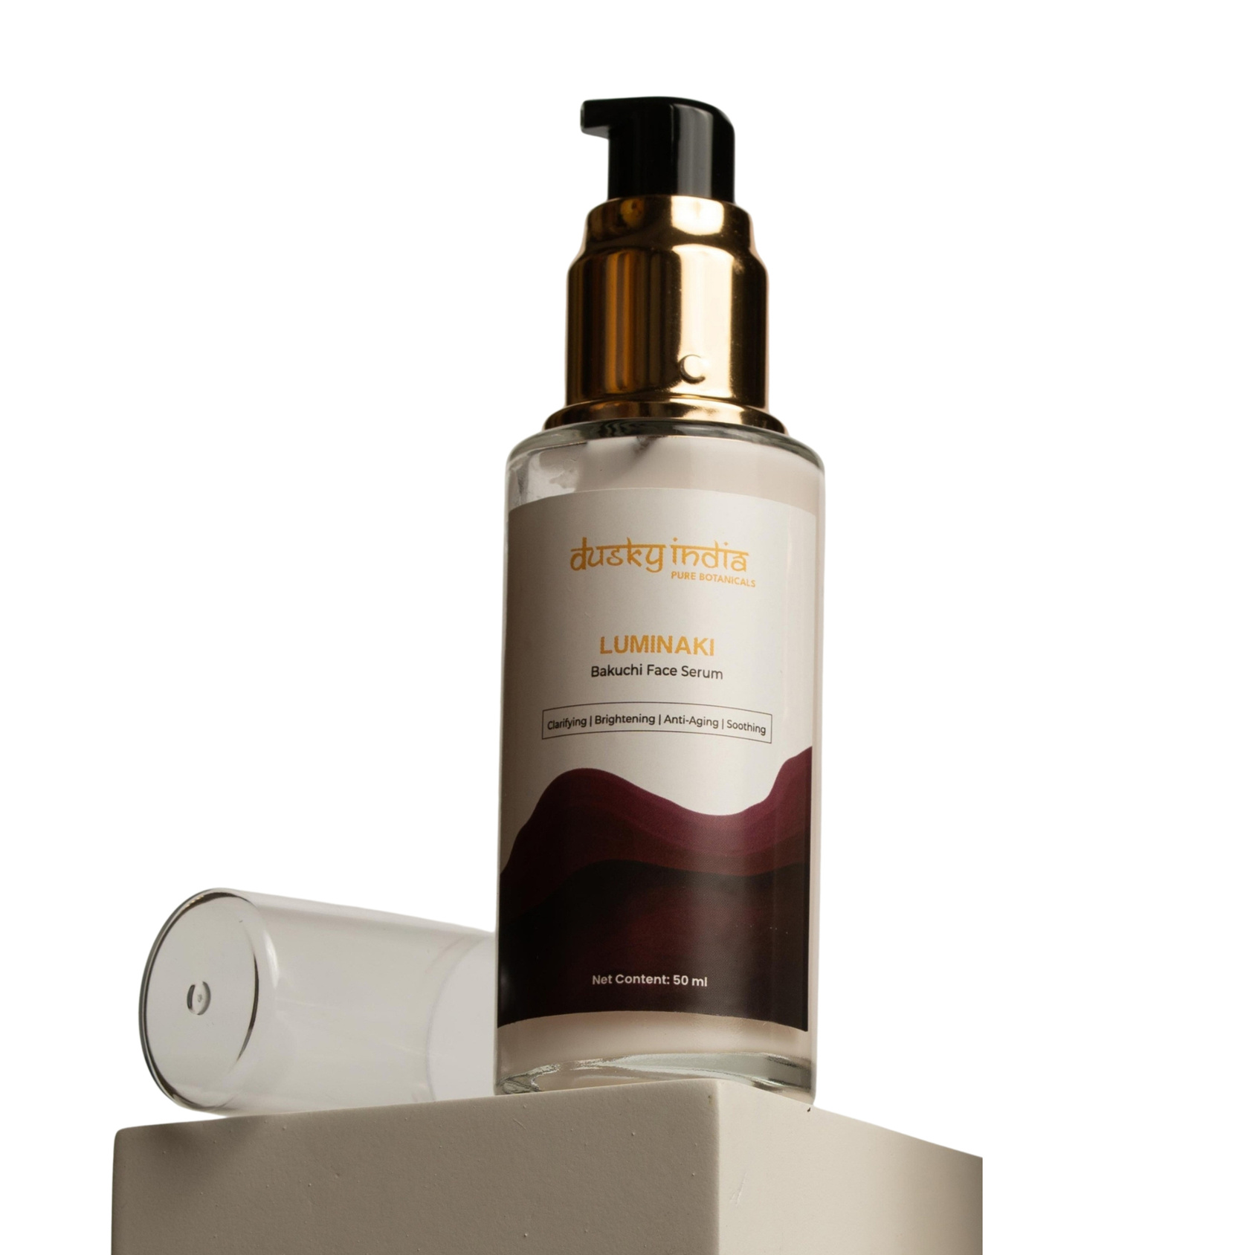
Dusky India
Luminaki – Bakuchi Face Serum by Dusky India

Slide 2

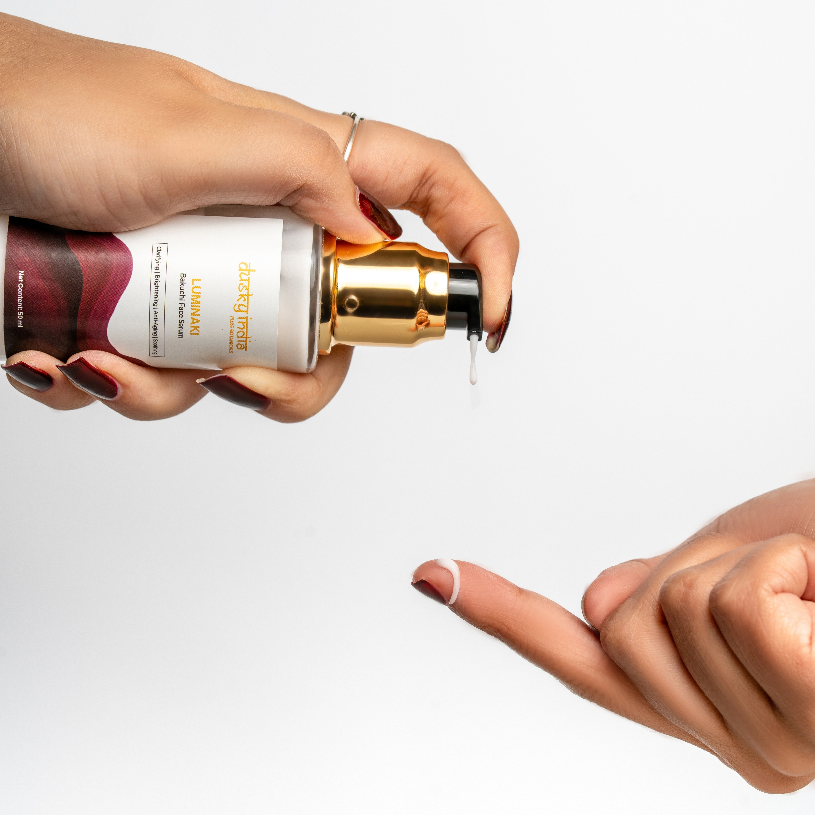
What Is a Retinol Alternative Serum?
Retinol is widely used in skincare routines focused on visible signs of aging, but some people prefer botanical-inspired alternatives as part of their daily routine.
A retinol alternative serum can be a useful option for those looking to explore plant-based skincare while focusing on a smoother, brighter, and more youthful-looking complexion.
Luminaki offers Bakuchi-inspired care in a lightweight serum designed for everyday use.

Slide 3
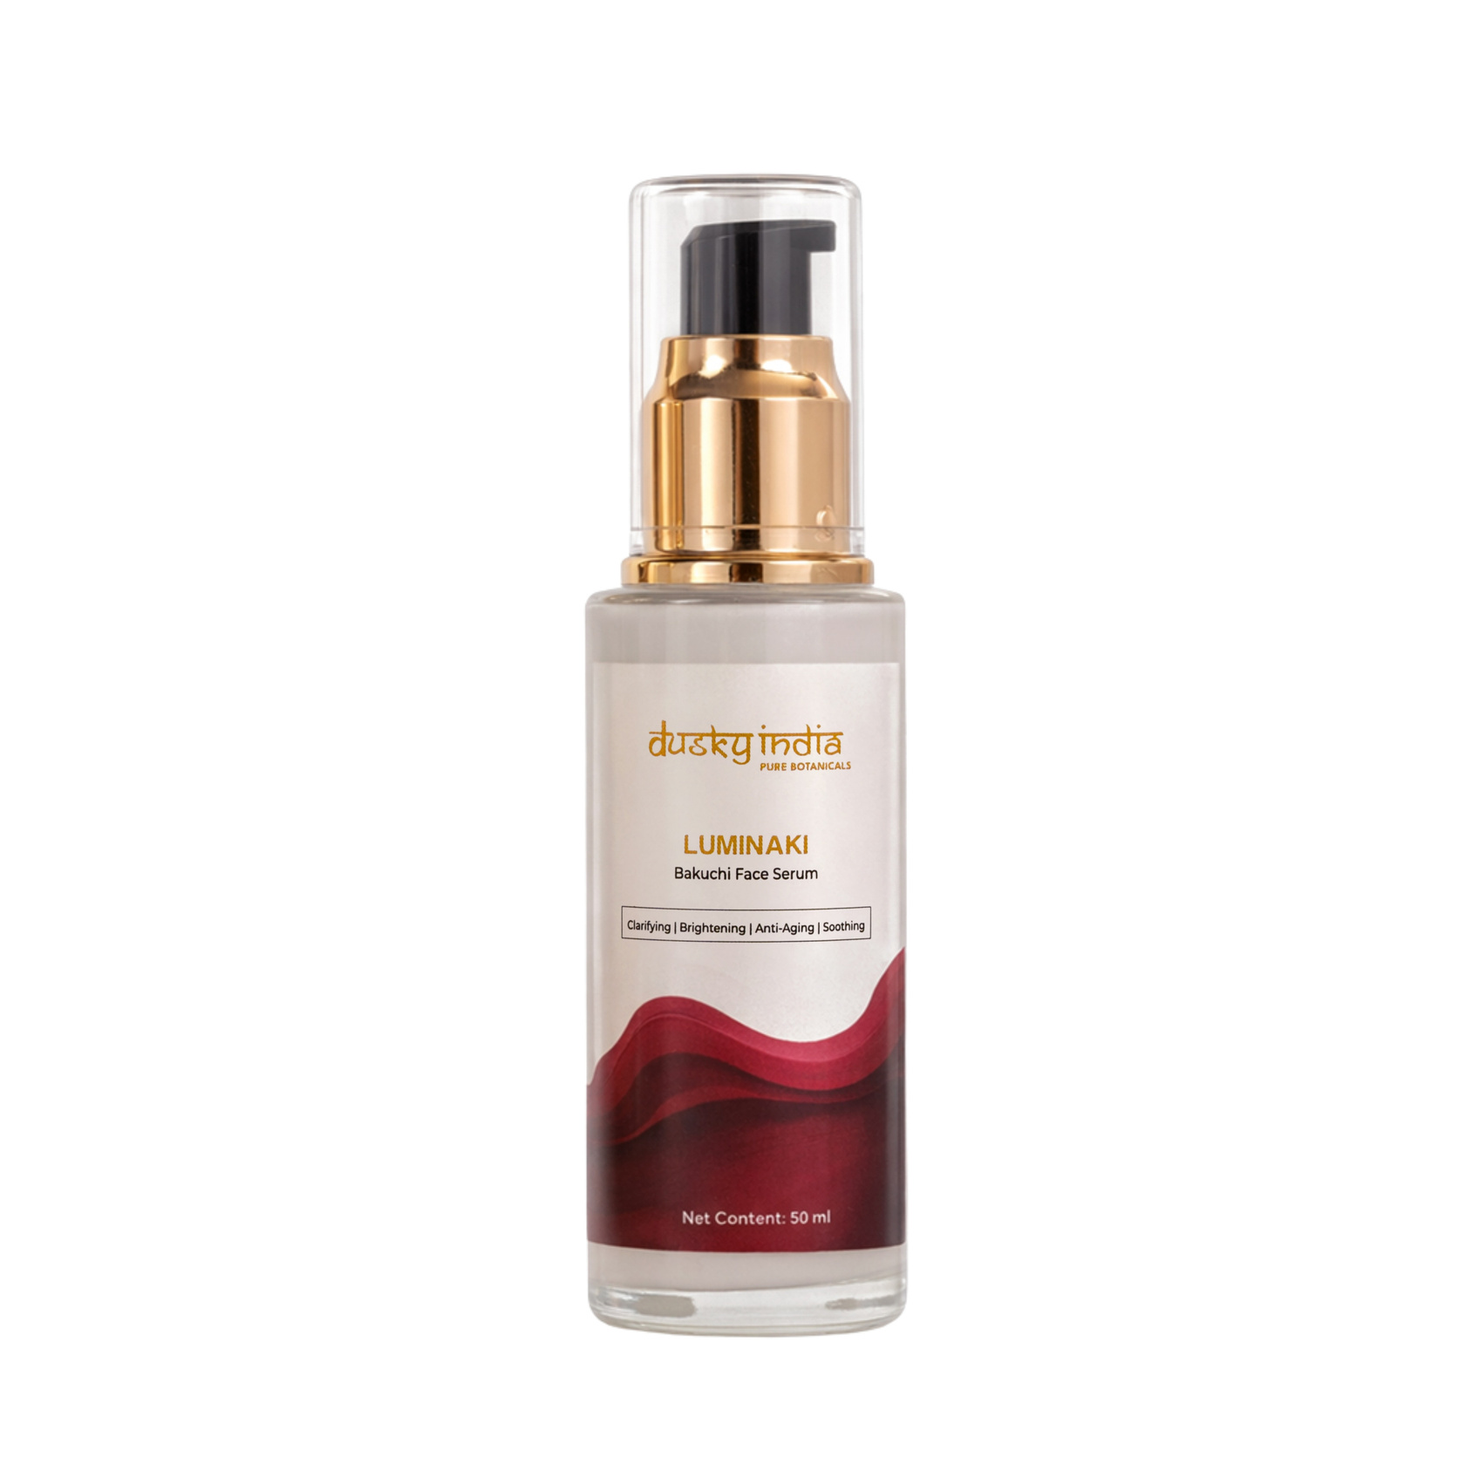
Bakuchi as a Botanical Retinol Alternative
Bakuchi is often associated with bakuchiol, a naturally occurring compound derived from the Psoralea corylifolia plant. Bakuchiol has become popular in modern skincare as a botanical alternative to traditional retinol-focused routines.
Luminaki – Bakuchi Face Serum by Dusky India brings this botanical-inspired approach into a simple facial serum routine.
Ideal for Skincare Focused On:
  Youthful-looking skin
  Smoother-looking texture
  Natural-looking radiance
  Daily nourishment
  Botanical-inspired anti-aging care

Slide 4
Visible signs of aging can include fine lines, uneven-looking texture, dullness, and loss of skin's natural radiance.
An anti-aging botanical serum can become an important part of a consistent skincare routine by providing targeted care while keeping the routine lightweight.
Luminaki – Bakuchi Face Serum is designed to support:
  Smoother-looking skin
  A more radiant appearance
  Hydrated-looking skin
  Healthy-looking texture
  Youthful-looking skin
Anti-Aging Botanical Serum

Slide 5
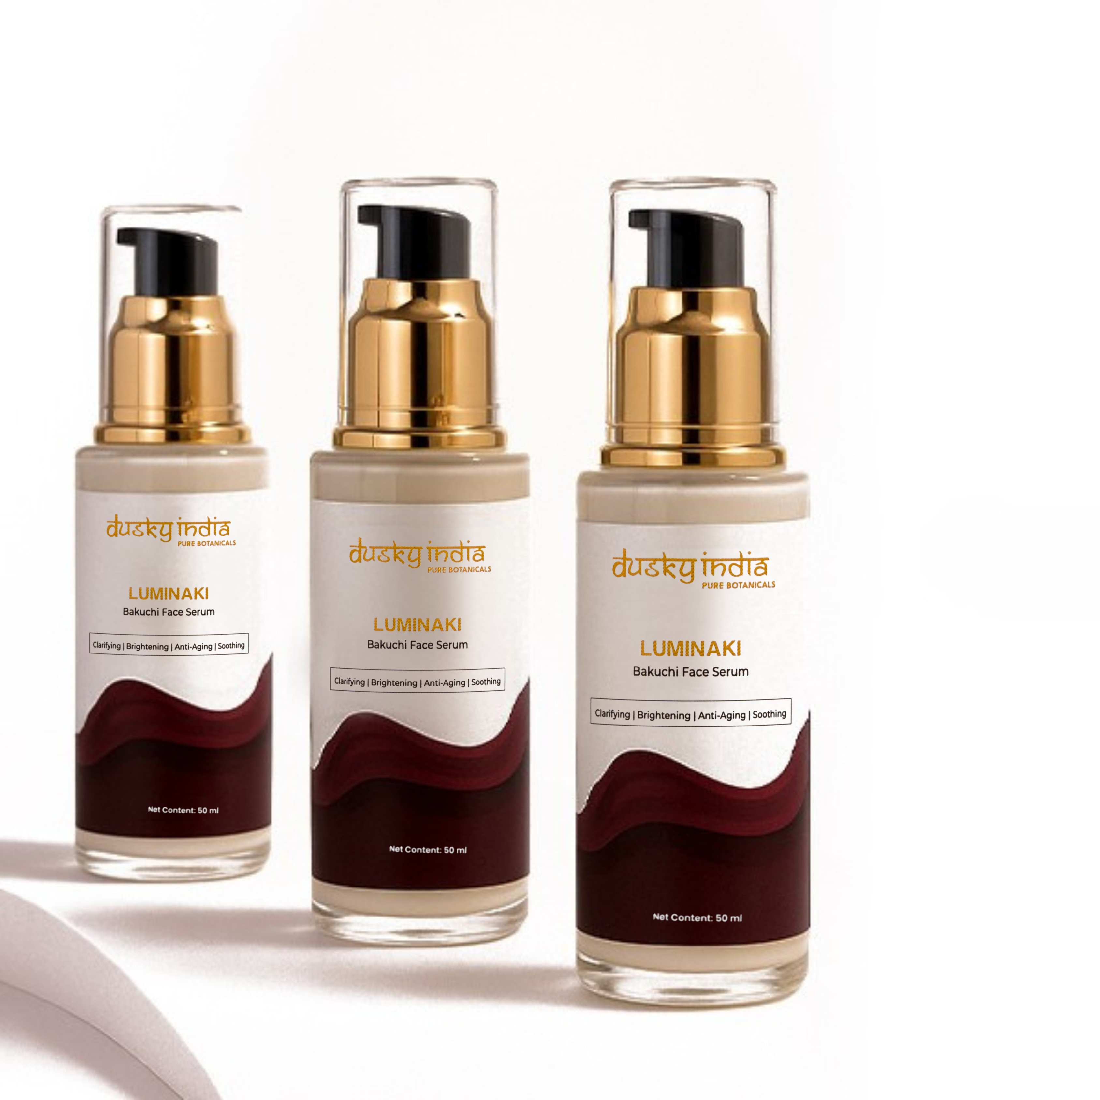
Bakuchi Serum Anti-Aging India
For people searching for Bakuchi serum anti-aging India, Luminaki offers a botanical-inspired approach to everyday skincare.
Its formula is designed for people who want to incorporate Bakuchi-based care into their routine while focusing on the appearance of fine lines, dullness, and uneven-looking skin.
Why Add It to Your Routine?
  Botanical-inspired skincare
  Lightweight serum texture
  Suitable for daily skincare routines
  Supports youthful-looking skin
  Easy to layer with moisturizer

Slide 6
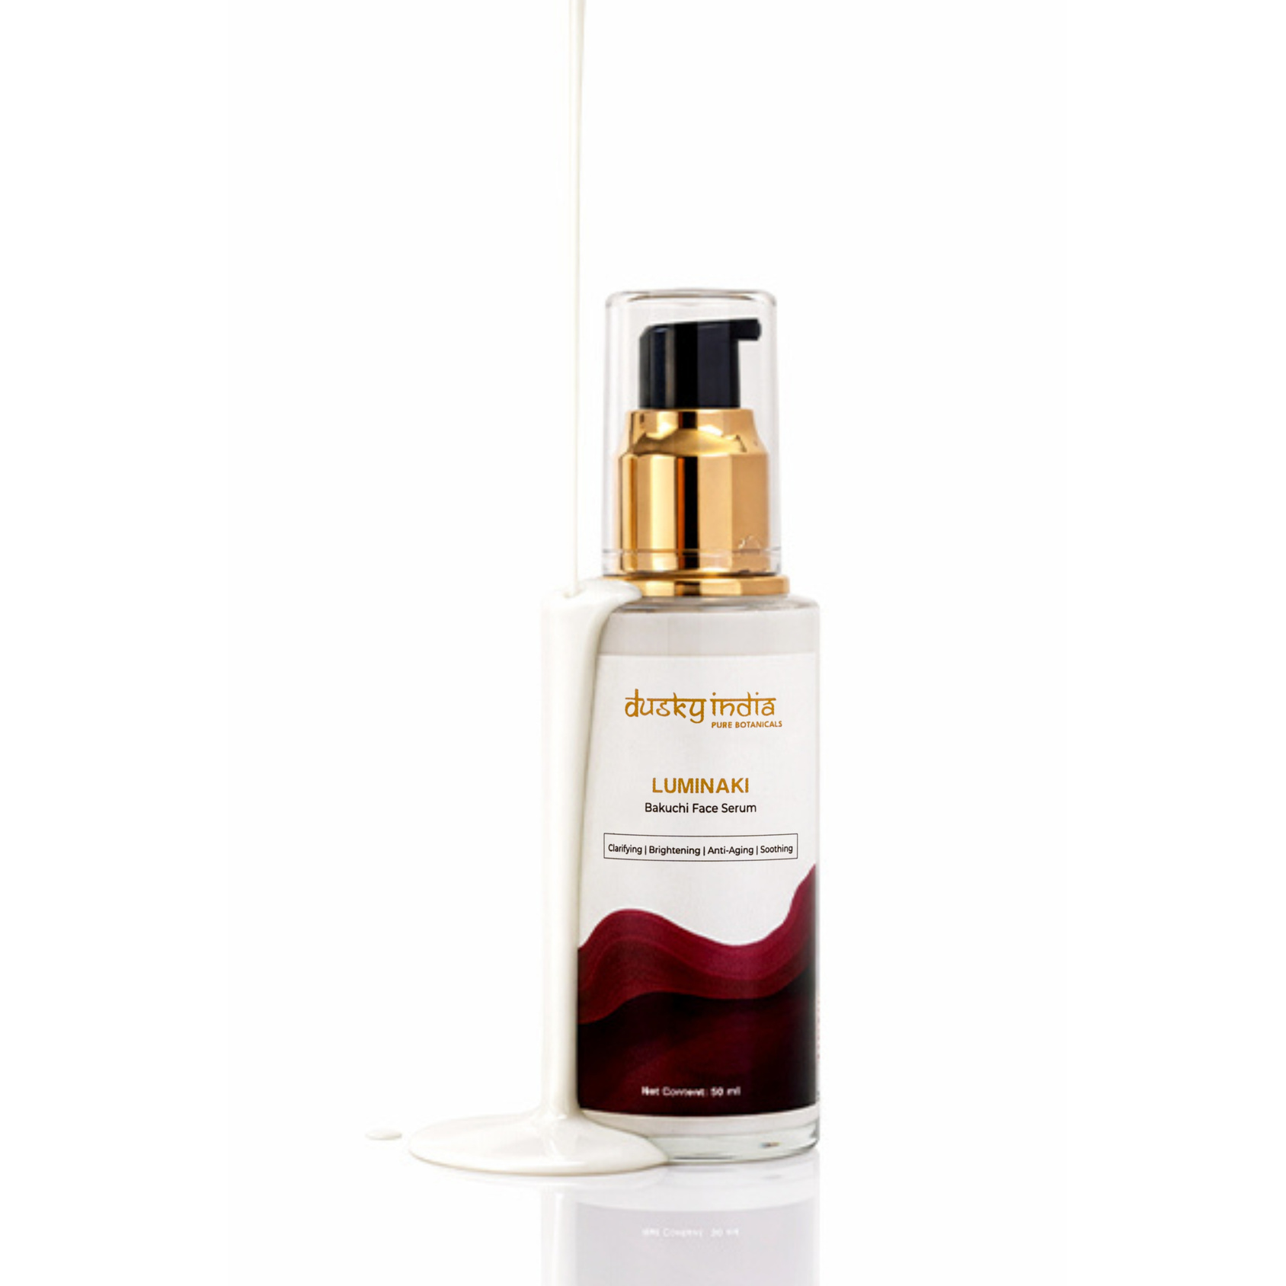
Lightweight Face Serum for Daily Care
Luminaki is designed to feel comfortable on the skin without adding unnecessary heaviness to your routine.
This lightweight face serum can be applied after cleansing and before moisturizer, making it easy to incorporate into both morning and evening skincare routines.
Simple Skincare Routine
Cleanse → Luminaki Serum → Moisturize → Sunscreen (AM)

Slide 7
How to Use Luminaki – Bakuchi Face Serum
Follow these simple steps:
  Cleanse your face with a gentle cleanser.
  Apply a few drops of Luminaki – Bakuchi Face Serum.
  Gently spread across the face and neck.
  Pat or massage lightly until absorbed.
  Follow with a moisturizer.
  Apply sunscreen during the daytime.
Start gradually if you're introducing a new active botanical serum into your skincare routine.

Slide 8

Luminaki – Bakuchi Face Serum is ideal for anyone interested in botanical-inspired anti-aging skincare.
It can be added to routines focused on:
  Fine lines
  Dull-looking skin
  Uneven-looking texture
  Loss of radiance
  Youthful-looking skin
  Plant-based skincare
Who Can Use Luminaki?

Slide 9
Why Choose Dusky India?
Dusky India believes skincare should combine nature-inspired ingredients with simple, modern routines.
Luminaki – Bakuchi Face Serum reflects this philosophy by bringing the botanical appeal of Bakuchi into a convenient serum format for everyday skincare.
It is an easy choice for those exploring a retinol alternative serum and looking for a more botanical approach to their anti-aging routine.

Slide 10
Choose Botanical Anti-Aging Care
If you're searching for a retinol alternative serum, an anti-aging botanical serum, or a Bakuchi serum anti-aging India, Luminaki – Bakuchi Face Serum by Dusky India offers a nature-inspired option for your daily skincare routine.
With consistent care, it can become a simple step toward smoother-looking, radiant, and youthful-looking skin.

