Slide 1




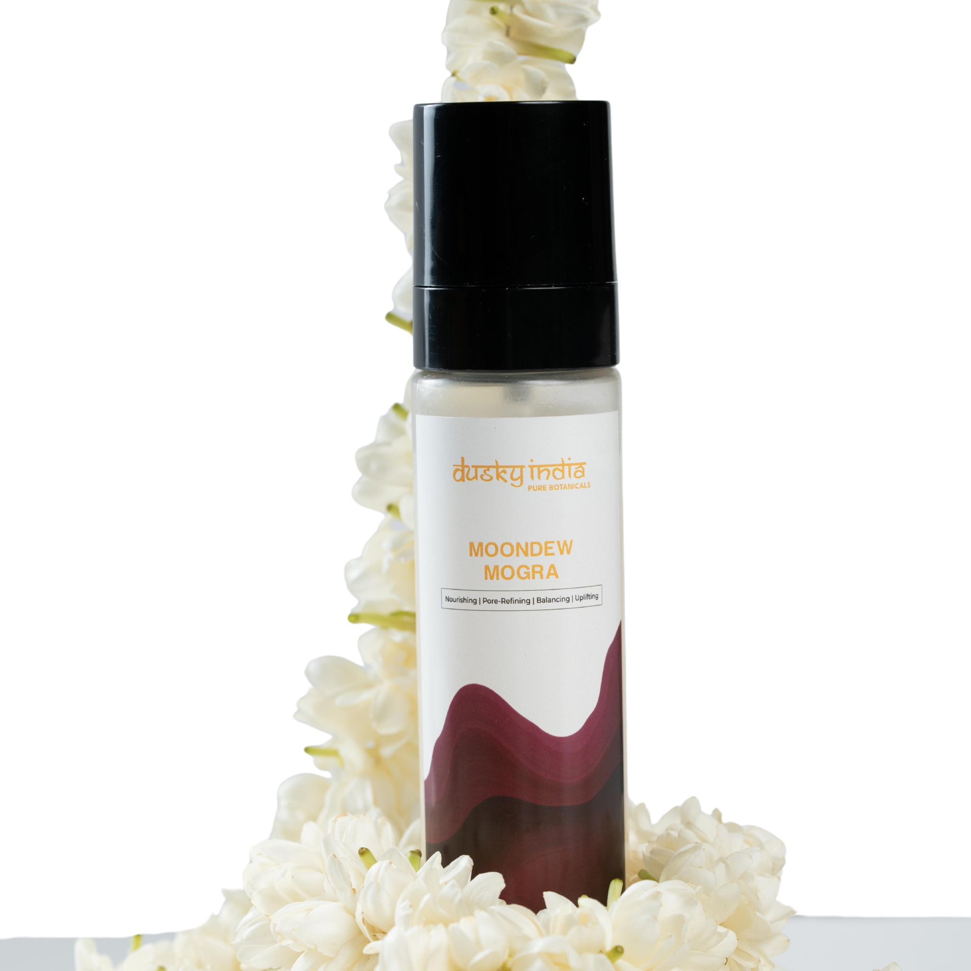

Moondew Mogra: Hydrating Mogra Toner for Glowing, Fresh-Looking Skin

Slide 2
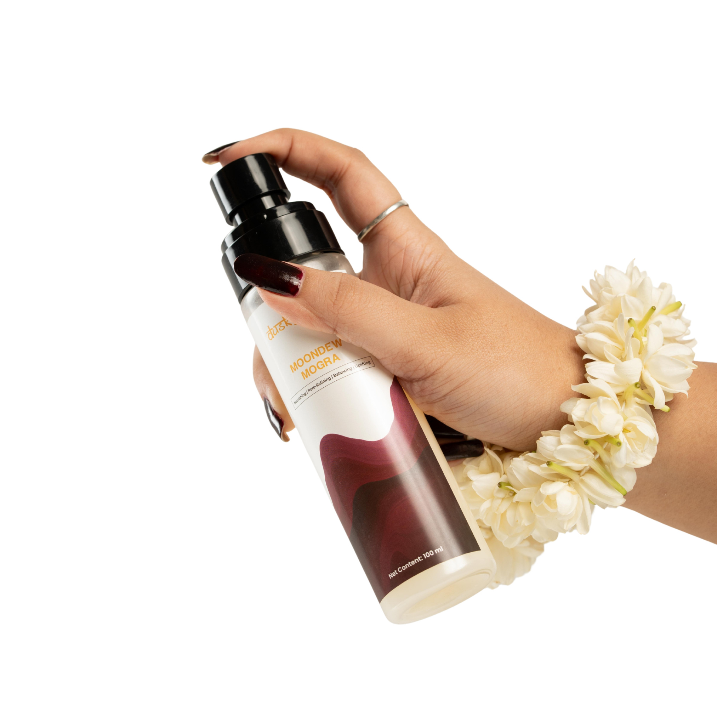

Moondew Mogra: Hydrating Mogra Toner for Glowing, Fresh-Looking Skin
Your skin can lose its natural freshness throughout the day. Pollution, heat, sun exposure, air conditioning, and everyday stress can leave your face feeling dry, tired, and dull. A simple misting step can bring instant freshness to your routine while adding lightweight hydration.
Moondew Mogra by Dusky India is a refreshing natural jasmine face mist designed to make everyday skincare simple and enjoyable. Inspired by the delicate beauty of Mogra, this lightweight mist can be used after cleansing, before moisturizer, or anytime your skin needs a quick refresh.
If you're looking for a convenient hydrating toner that fits easily into your skincare routine, Moondew Mogra offers a refreshing way to keep your skin feeling soft, comfortable, and naturally radiant.

Slide 3

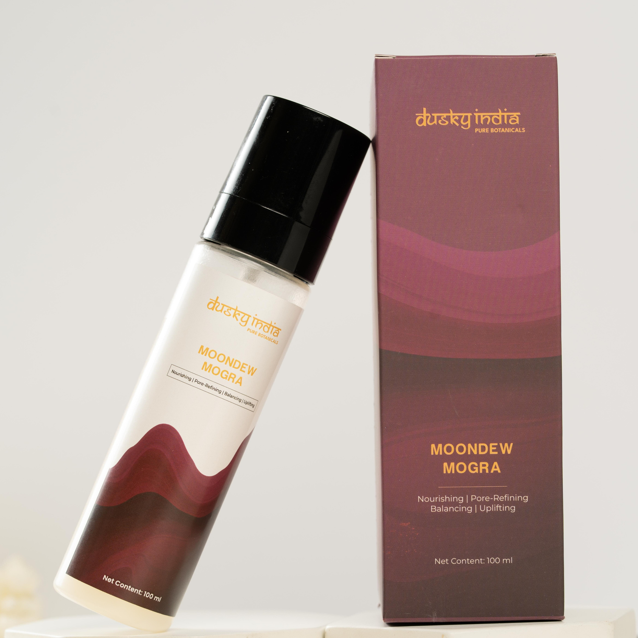

What Is Moondew Mogra?
Moondew Mogra is a floral facial mist inspired by the refreshing character of Mogra, also known as Arabian Jasmine. Its fine mist format makes application quick and convenient, allowing you to refresh your skin without rubbing or adding a heavy layer of product.
The lightweight formula makes it easy to use throughout the day. Keep it on your vanity for your regular skincare routine or carry it with you for a quick skin refresh while travelling, working, or spending time outdoors.

Slide 4
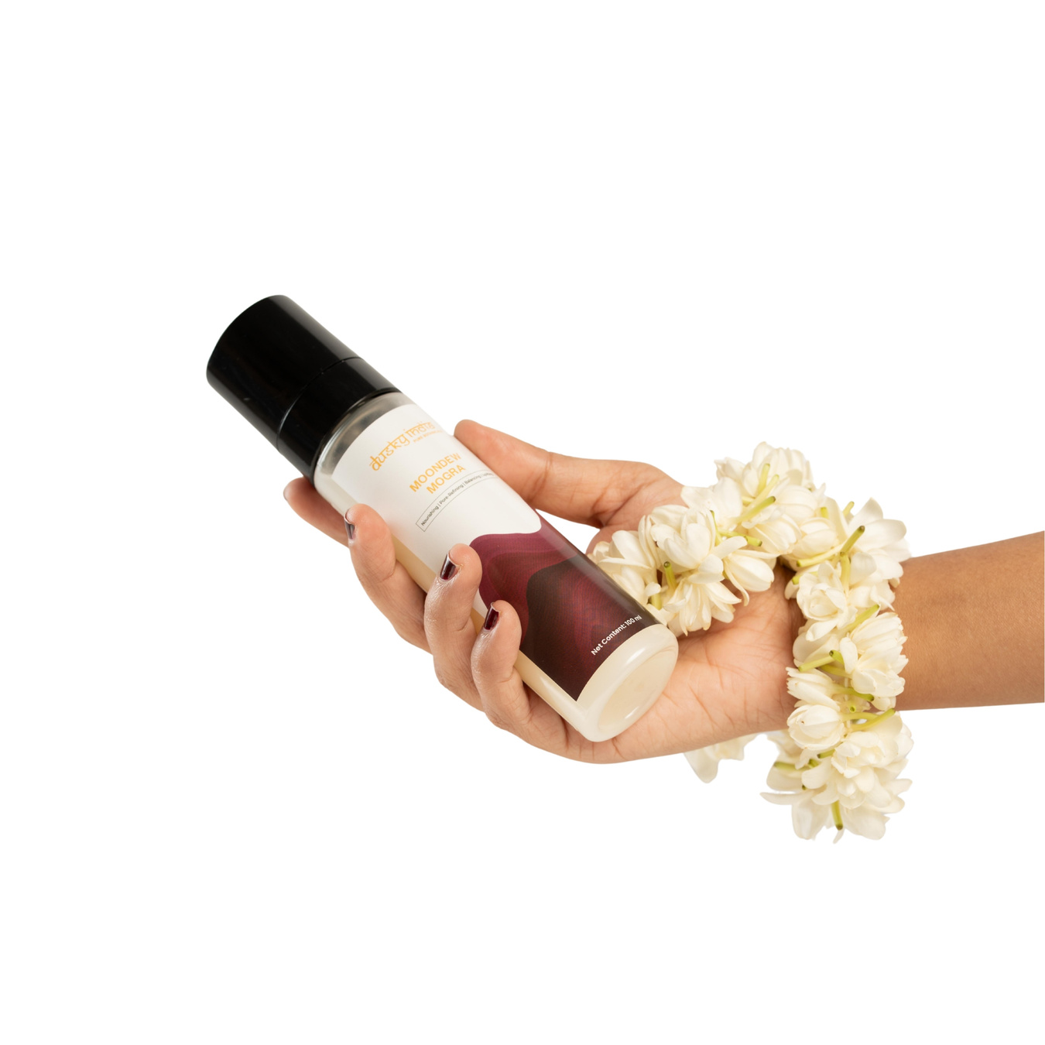

Natural Jasmine Face Mist for Everyday Freshness
A natural jasmine face mist can be a beautiful addition to a simple skincare routine, especially when your skin needs a quick boost of freshness.
Moondew Mogra provides a fine, refreshing mist that can be applied whenever your skin feels tired or uncomfortable. The floral-inspired experience also adds a relaxing touch to your daily self-care routine.
Use Moondew Mogra:
  After cleansing
  Before serum or moisturizer
  Before makeup
  After spending time outdoors
  During long workdays
  Whenever your skin needs a refresh
Its easy application makes it suitable for both morning and evening routines.

Slide 5
Hydrating Toner for Soft, Dewy-Looking Skin
Hydration is essential for maintaining healthy-looking skin. When the skin becomes dehydrated, it may appear rough, dull, or tired. Adding a hydrating toner after cleansing can provide an additional layer of moisture and help prepare your skin for the next steps in your routine.
Moondew Mogra offers a lightweight misting experience that helps your skin feel refreshed and comfortable. Regular use can complement a hydration-focused skincare routine and support a soft, naturally dewy-looking appearance.

Slide 6

Why Add a Face Mist to Your Skincare Routine?
A face mist is one of the easiest skincare products to use. Unlike products that require careful application, a mist can be sprayed directly onto the face in seconds.
Moondew Mogra makes this simple step more enjoyable while giving your routine a refreshing floral touch.
A Face Mist Can Be Useful For:
  Refreshing tired-looking skin
  Adding lightweight hydration
  Supporting a dewy appearance
  Refreshing skin during travel
  Reapplying throughout the day
  Creating a relaxing skincare ritual

Slide 7
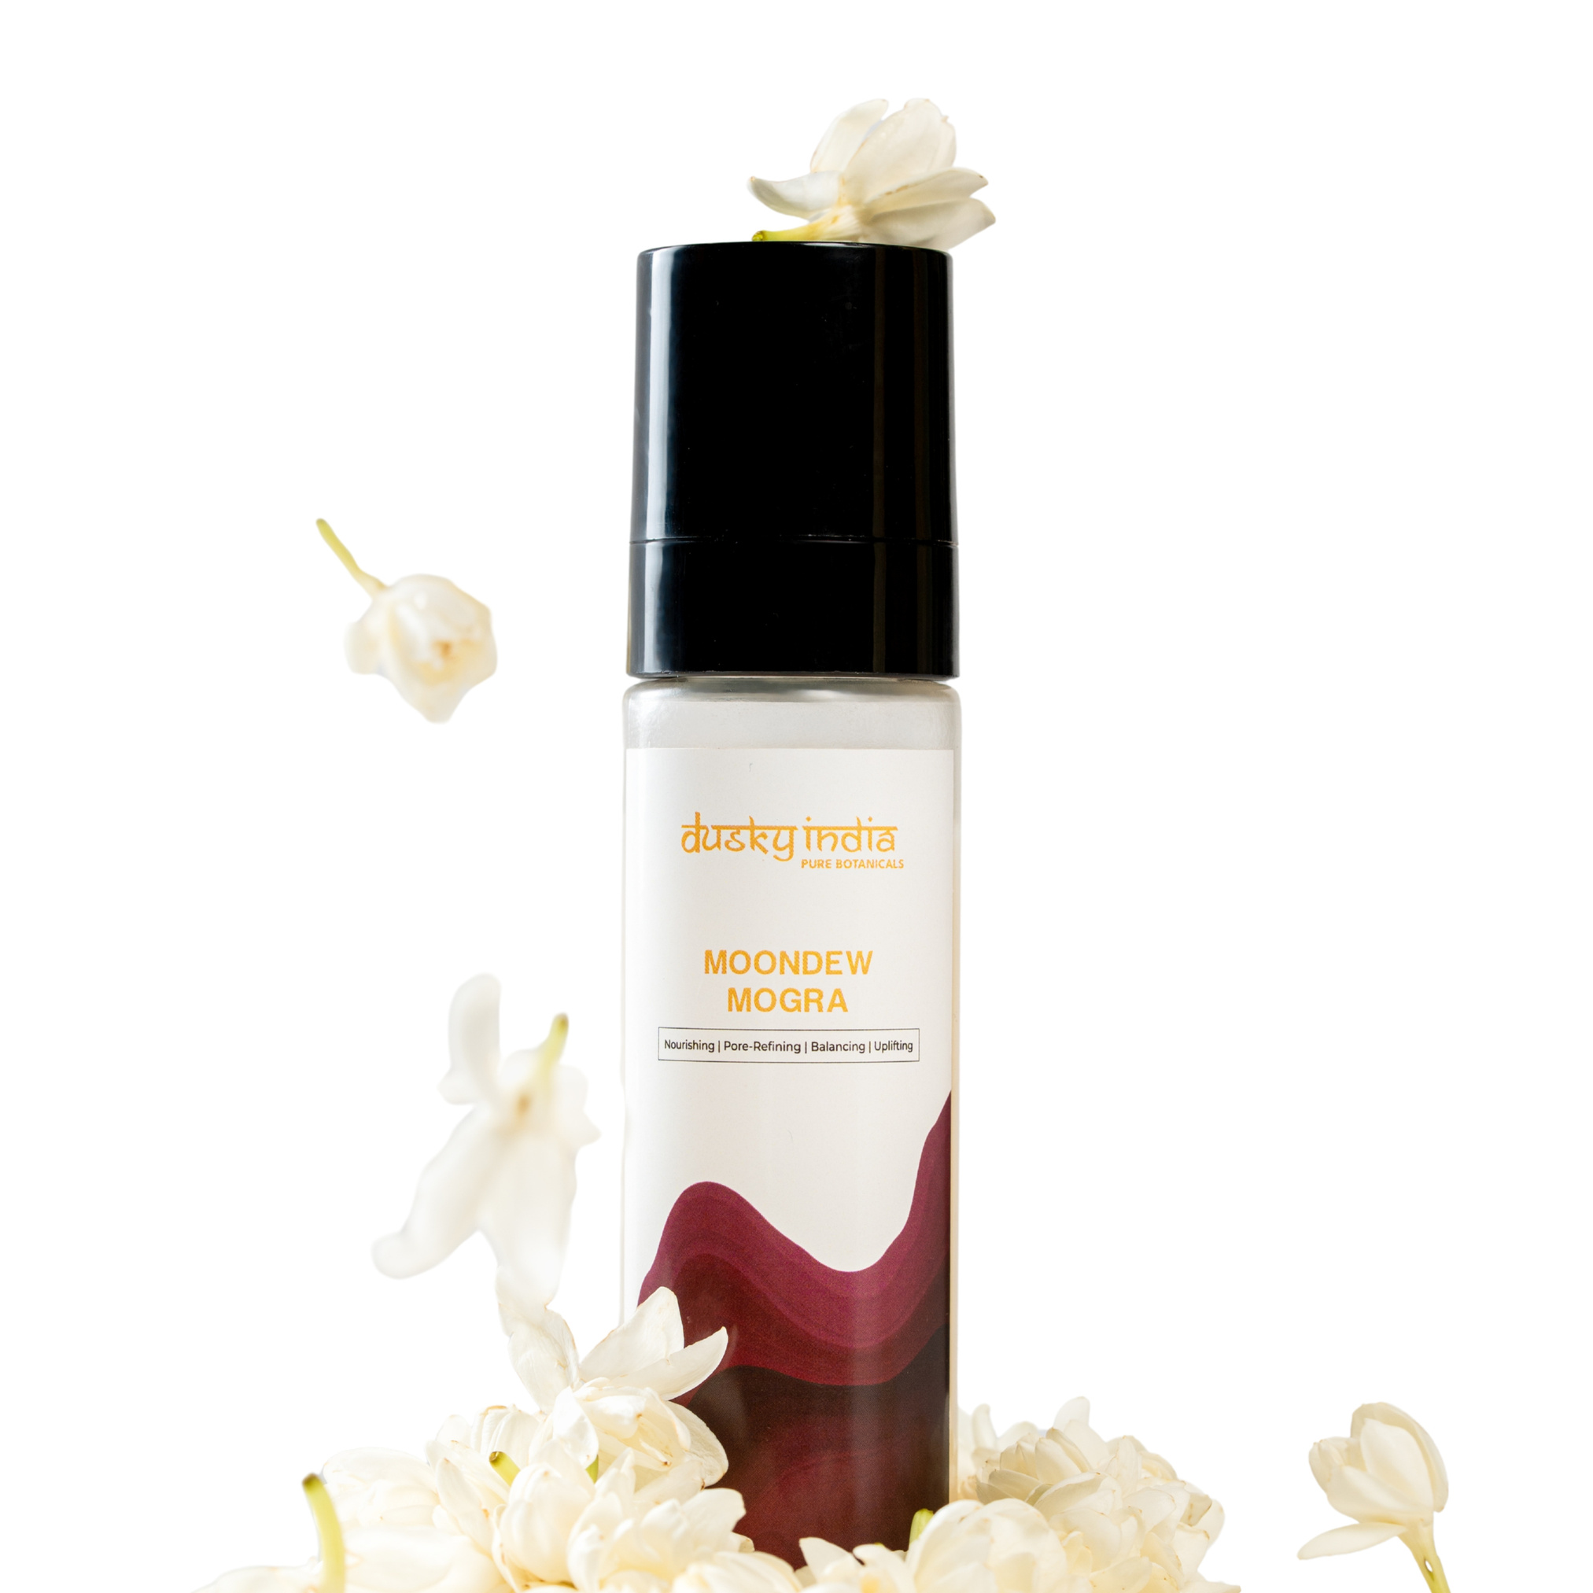
How to Use Moondew Mogra
Using this natural jasmine face mist is simple.
  Cleanse your face with a gentle cleanser.
  Hold the bottle a few inches away from your face.
  Close your eyes and mist evenly over your skin.
  Allow the mist to absorb naturally.
  Follow with your serum and moisturizer.
  Apply sunscreen during the daytime.
You can also use Moondew Mogra throughout the day whenever your skin needs a refreshing boost.

Slide 8
Who Can Use Moondew Mogra?
Moondew Mogra is suitable for anyone who enjoys lightweight, refreshing skincare.
It can be a useful addition to routines focused on:
  Daily hydration
  Dull or tired-looking skin
  A soft, dewy appearance
  Floral-inspired skincare
  Minimalist skincare routines
  Convenient on-the-go refreshment
If you have particularly sensitive or reactive skin, patch testing a new product before regular use is always a sensible precaution.

Slide 9
Why Choose Moondew Mogra by Dusky India?
Dusky India believes skincare should be simple, thoughtful, and inspired by nature. Moondew Mogra reflects this philosophy by combining the refreshing experience of a floral mist with the convenience of modern facial care.
Rather than adding unnecessary complexity to your routine, this mist provides an easy way to make hydration and refreshment part of your everyday skincare ritual.

Slide 10
Dusky India
Conclusion
A good skincare routine doesn't have to be complicated. Sometimes, a simple mist is all you need to bring a little freshness back to tired-looking skin.
Moondew Mogra by Dusky India is a refreshing natural jasmine face mist that fits effortlessly into your daily routine. Whether you use it after cleansing, before moisturizer, or throughout the day, it provides a convenient and refreshing hydration step.
If you're looking for a lightweight hydrating toner with a floral-inspired skincare experience, Moondew Mogra is a beautiful addition to your everyday routine.
https://duskyindia.in/pages/jasmine-toner-for-face-moondew-mogra-by-dusky-india

