Slide 1




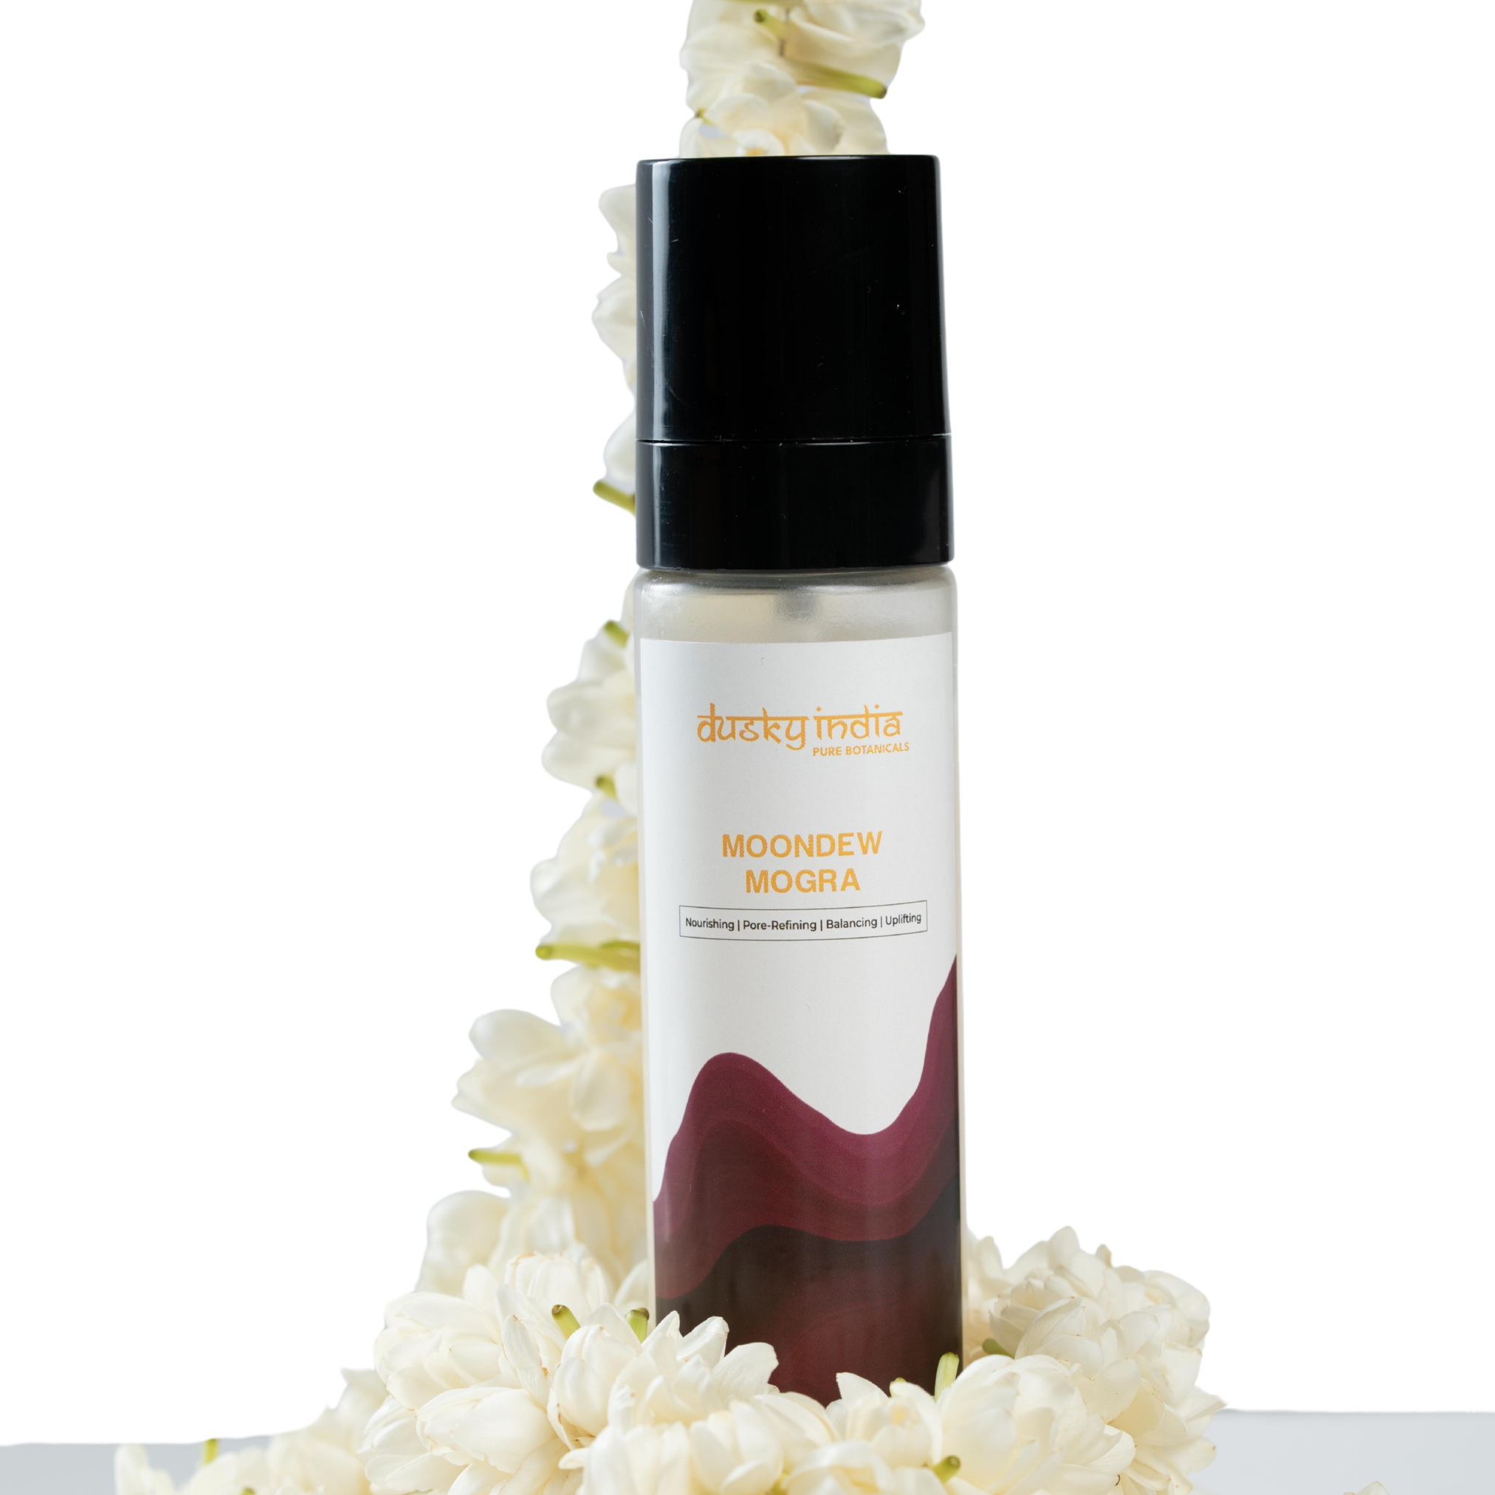

Moondew Mogra: Hydrating Mogra Toner for Glowing, Fresh-Looking Skin

Slide 2
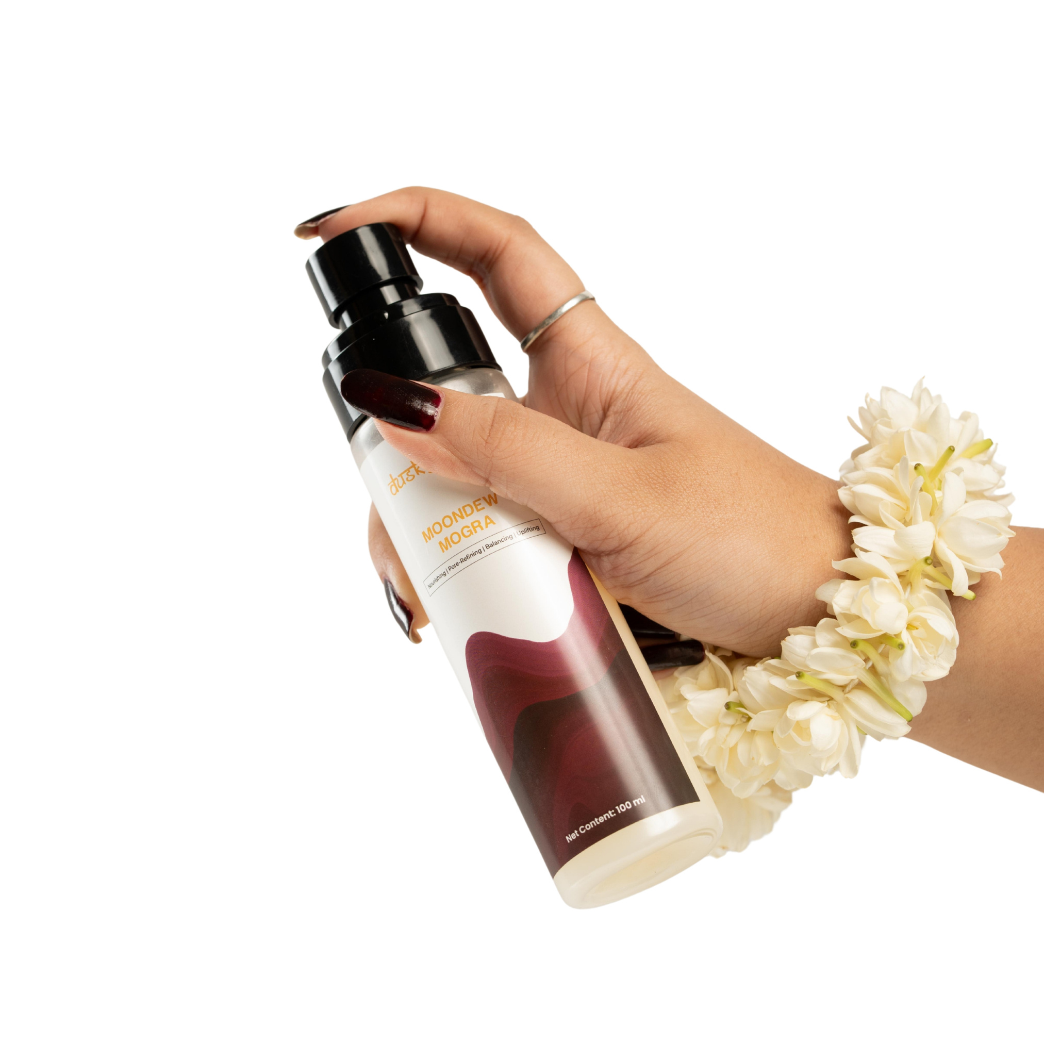

Moondew Mogra: Hydrating Mogra Toner for Glowing, Fresh-Looking Skin
Your skin goes through a lot every day. Pollution, heat, sunlight, air conditioning, makeup, and everyday stress can leave your complexion feeling dry, dull, and tired. While cleansing is an important part of skincare, your routine can benefit from an extra hydration step that helps your skin feel fresh and comfortable.
Moondew Mogra by Dusky India is a lightweight floral toner designed to refresh the skin while providing a soft, hydrated, and dewy-looking finish. Inspired by the delicate beauty of Mogra, this toner fits easily into a simple daily routine and can be used whenever your skin needs a quick refresh.
If you're searching for a hydrating mogra toner, a hydrating face toner for glowing skin, or a natural toner for sensitive skin, Moondew Mogra offers a gentle, refreshing approach to everyday facial care.

Slide 3

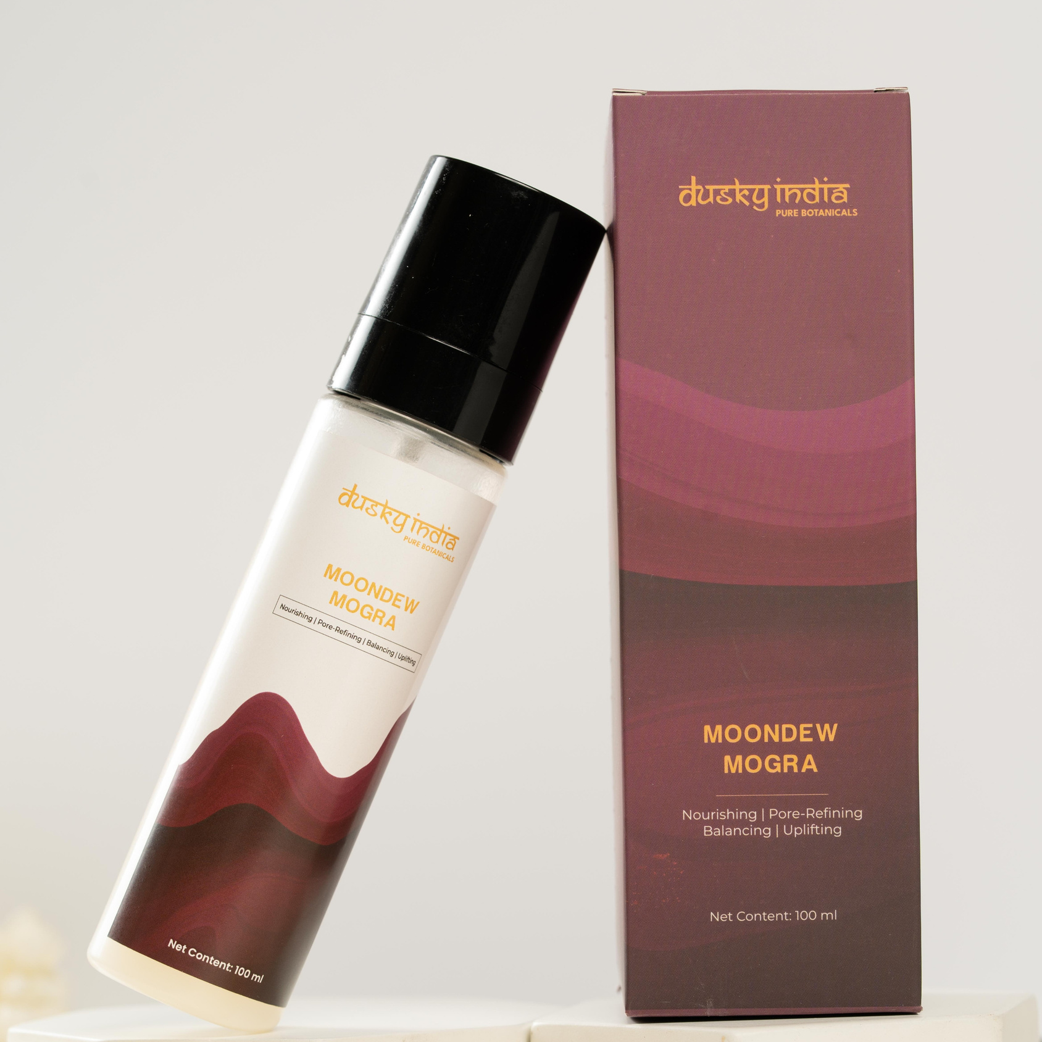

What Is Moondew Mogra?
Moondew Mogra is a refreshing floral facial toner created for people who enjoy lightweight, nature-inspired skincare. Its fine mist format makes it convenient to apply after cleansing or whenever your skin feels dry and tired.
Unlike heavy skincare products that can leave behind a sticky feeling, Moondew Mogra is designed to feel light and comfortable on the skin. A few sprays can instantly turn a regular skincare routine into a refreshing self-care ritual.
The delicate Mogra-inspired experience also makes it an enjoyable addition to both morning and evening skincare.

Slide 4
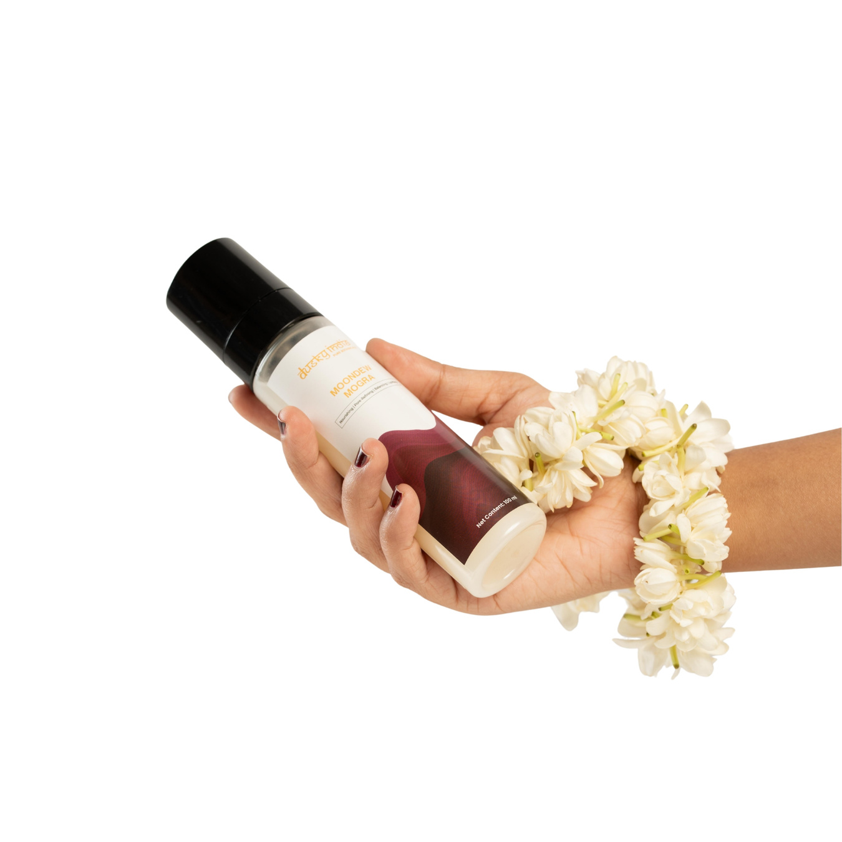

Hydrating Mogra Toner for Everyday Skin Refreshment
Hydration is one of the most important parts of maintaining healthy-looking skin. When your skin lacks moisture, it can appear dull, rough, or tired. A lightweight toner can add an extra layer of moisture to your routine while preparing your skin for subsequent skincare products.
Moondew Mogra works as a hydrating mogra toner, offering a refreshing mist that helps your skin feel soft and comfortable.
You can use it:
  After cleansing your face
  Before applying serum
  Before moisturizer
  During the day for a quick refresh
  Before makeup for a fresh skin feel
  After spending time outdoors
Its easy-to-use mist format makes hydration convenient wherever you are.

Slide 5
Hydrating Face Toner for Glowing Skin
A healthy glow starts with well-cared-for skin. Dryness and environmental exposure can make the complexion appear flat and tired, while consistent hydration can help skin look fresher and more radiant.
Moondew Mogra is a hydrating face toner for glowing skin that helps make hydration a simple part of your daily routine. The lightweight mist leaves the skin feeling refreshed and comfortable while supporting a naturally dewy-looking appearance.
For an effortless glow-focused routine, you can layer Moondew Mogra with your favorite serum and moisturizer. During the daytime, always finish your routine with sunscreen.

Slide 6

Why Choose a Natural Toner for Sensitive Skin?
Sensitive-looking skin often needs a simple skincare routine with products that feel comfortable and non-heavy. Too many complicated steps can make skincare feel overwhelming, especially for people who prefer a minimalist approach.
A natural toner for sensitive skin can be a useful addition when you want lightweight hydration and refreshing care without a complicated routine.
Moondew Mogra is designed around a gentle, refreshing skincare experience. Its mist format allows you to apply a light layer without rubbing or pulling the skin, which can be particularly useful for people who prefer minimal contact during application.

Slide 7
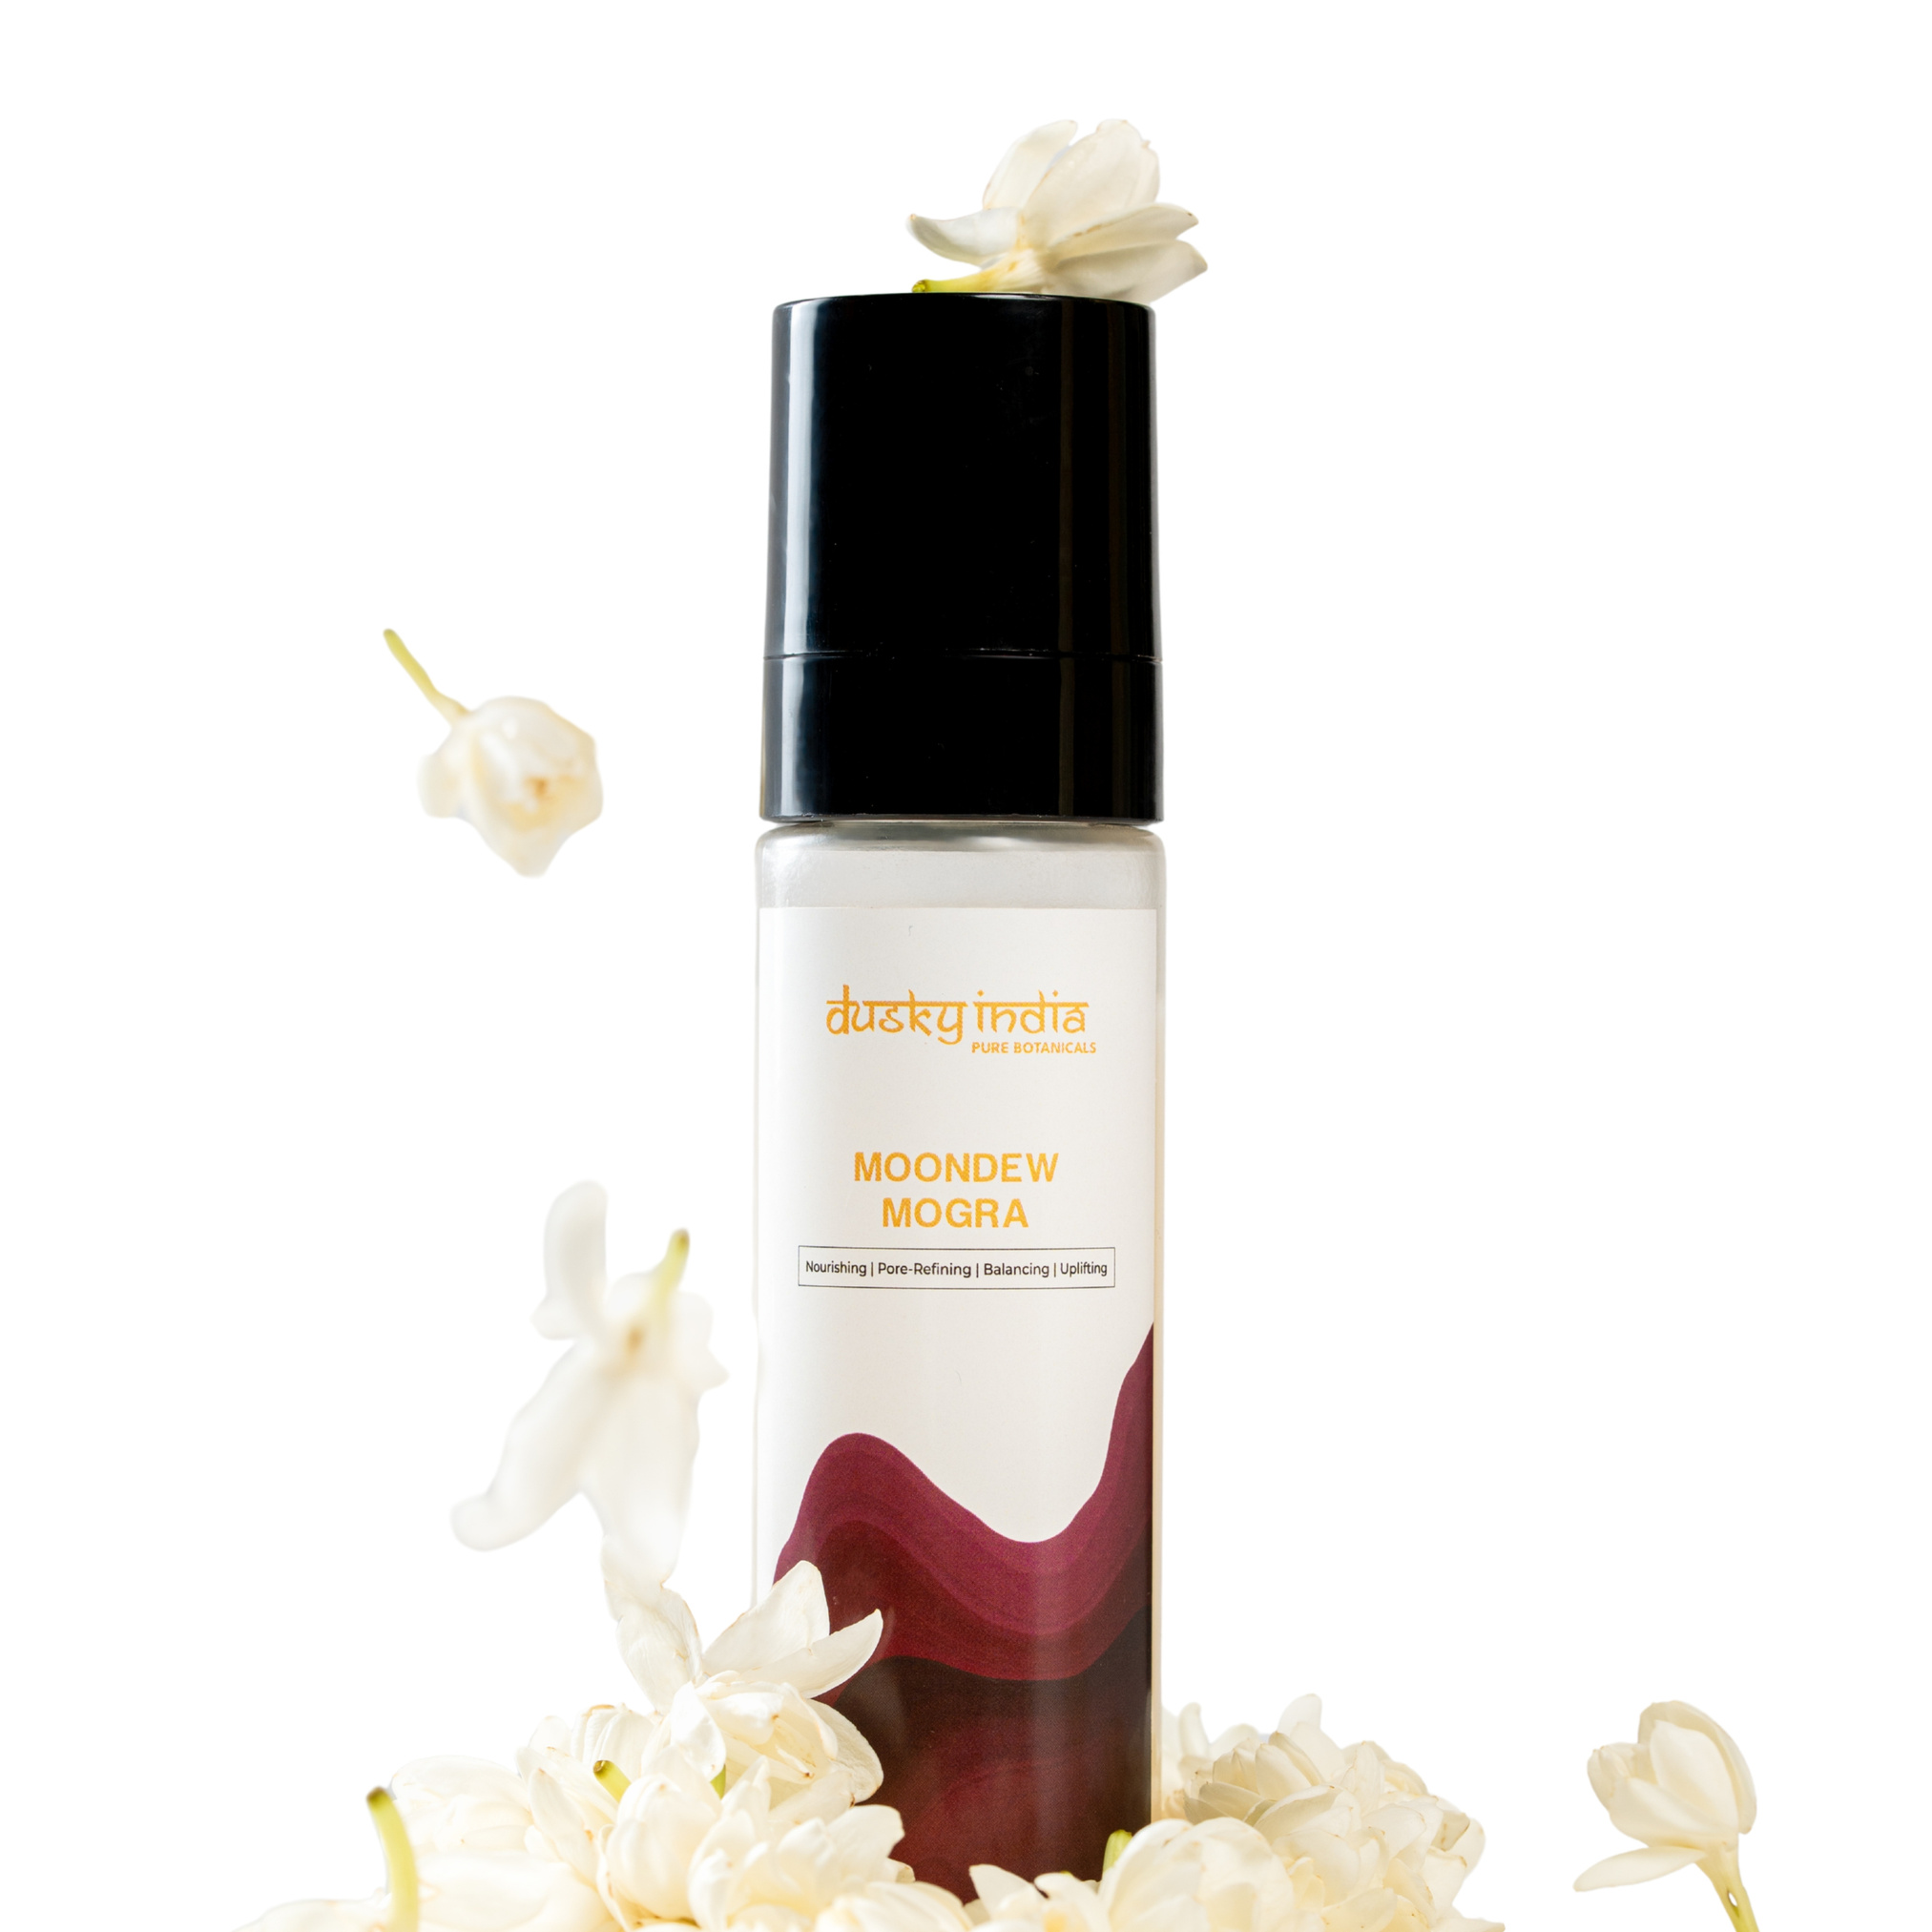
Benefits of Moondew Mogra
Lightweight Hydration
Moondew Mogra helps provide a refreshing layer of hydration without making the skin feel heavy or greasy.
Refreshes Tired-Looking Skin
A quick mist can help revive the feel and appearance of skin after a long day, travel, or exposure to heat and pollution.
Supports a Dewy Appearance
Well-hydrated skin naturally looks fresher and more radiant. Moondew Mogra fits easily into a glow-focused skincare routine.
Floral-Inspired Skincare
The Mogra-inspired character adds a pleasant floral element to your everyday facial care routine.
Easy to Use
The fine mist makes application quick and convenient, whether you're at home, working, travelling, or simply taking a skincare break.

Slide 8
How to Use Moondew Mogra
Adding this hydrating face toner for glowing skin to your routine is simple.
Start by cleansing your face with a gentle cleanser. Hold the Moondew Mogra bottle a few inches away from your face, close your eyes, and mist evenly across your skin. Allow it to absorb naturally rather than rubbing it in.
Once absorbed, follow with your preferred serum and moisturizer. If you're using it during the daytime, finish with a broad-spectrum sunscreen.
Moondew Mogra can also be reapplied during the day whenever your skin feels dry or needs a refreshing boost.

Slide 9
Who Can Use Moondew Mogra?
Moondew Mogra is a convenient choice for people who enjoy lightweight, floral-inspired facial care.
It can be especially useful for skincare routines focused on:
  Everyday hydration
  Dull or tired-looking skin
  A naturally dewy appearance
  Lightweight facial products
  Simple skincare routines
  Floral and nature-inspired skincare
Those looking for a natural toner for sensitive skin can also consider Moondew Mogra as part of a simple routine, while remembering that individual skin sensitivity can vary

Slide 10
Why Choose Moondew Mogra by Dusky India?
Dusky India believes skincare should be simple, thoughtful, and inspired by nature. Moondew Mogra reflects this approach by combining the refreshing experience of a floral mist with the convenience of everyday facial hydration.
Its lightweight format makes it easy to incorporate into modern skincare routines without adding unnecessary complexity.

Slide 11
Dusky India
Conclusion
If your skin often feels dry, dull, or tired, adding a refreshing toner can be an easy way to give your routine an extra hydration step.
Moondew Mogra by Dusky India is a hydrating mogra toner designed to refresh and comfort the skin while supporting a naturally dewy appearance. Whether you're looking for a hydrating face toner for glowing skin or exploring a natural toner for sensitive skin, Moondew Mogra offers a simple and refreshing way to make hydration part of your everyday skincare ritual.
https://duskyindia.in/pages/floral-face-mist-toner-moondew-mogra-by-dusky-india

