Slide 1


DIGITAL
MARKETING
major component of digital marketing course
01

Slide 2
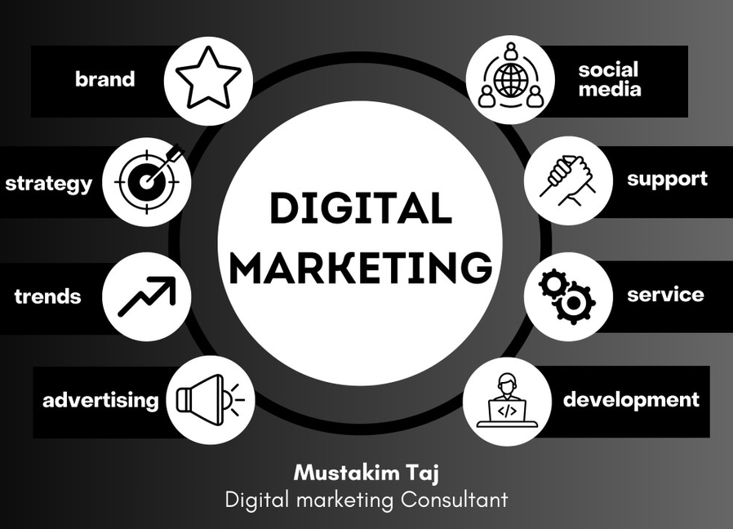
WHAT IS DIGITAL MARKETING
Digital marketing is the method of promoting products, services, or brands using digital technologies and internet-based platforms. It includes every marketing effort that uses a laptop, mobile, internet connection, or digital tool to reach people, attract them, and convert them into customers.
It helps businesses communicate with their audience through channels like websites, search engines, social media, emails, mobile apps, online ads, and more.
02

Slide 3
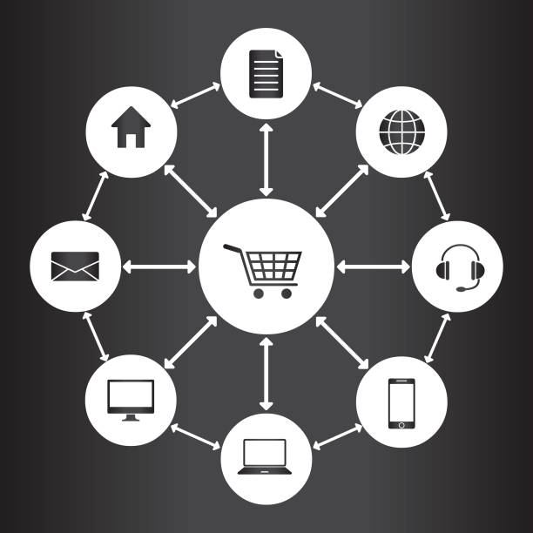

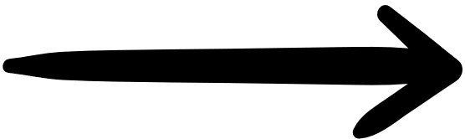
MAJOR COMPONENT OF A DIGITAL MARKETING COURSE
SEARCH ENGINE OPTIMIZATION [SEO]
SEARCH ENGINE MARKETING [SEM]
SOCIAL MEDIA MARKETING [SMM]
CONTENT MARKETING
EMAIL MARKETING
INFLUENCE MARKETING
E- COMMERCE MARKETING
03

Slide 4
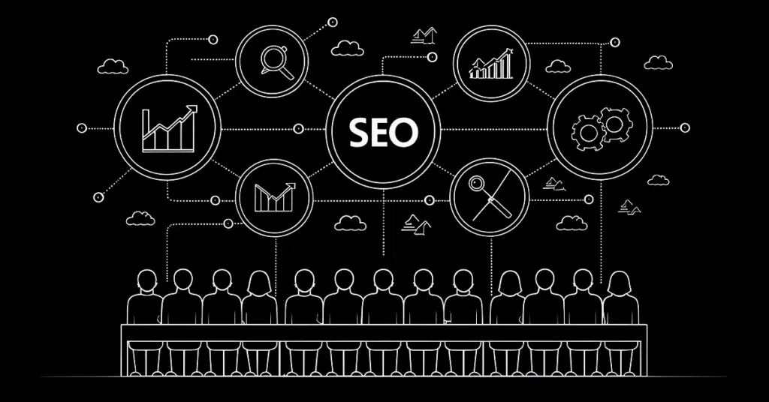

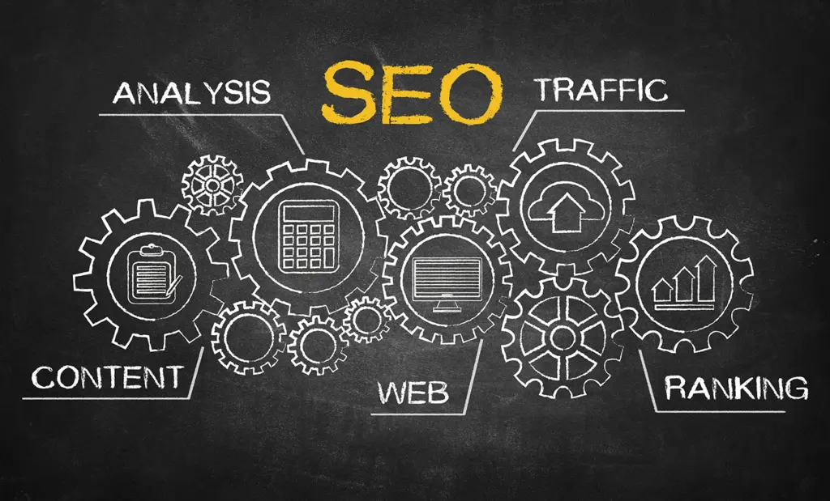

SEARCH ENGINE OPTIMIZATION
SEO is a digital strategy that increases a website’s visibility on search engines like Google. By using keywords, quality content, and technical improvements, SEO drives more organic traffic and builds long-term online growth.
04

Slide 5
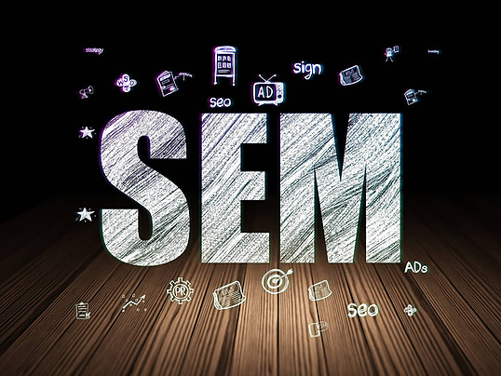
SEARCH ENGINES MARKETING
01
Search Engine Optimization is the process of improving your website’s visibility on search engines through organic (non-paid) methods. It focuses on optimizing content, technical performance, and website authority so your site can rank higher, attract more visitors, and build long-term trust with users.
05

Slide 6
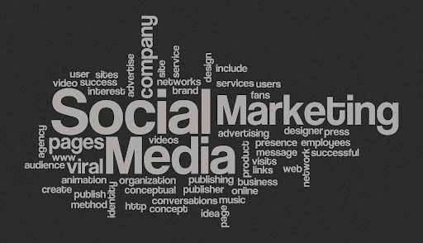
SOCIAL MEDIA MARKETING
Social Media Marketing is the practice of promoting a brand, product, or service on platforms like Facebook, Instagram, YouTube, and LinkedIn. It helps businesses build strong online presence, connect with their audience, increase engagement, and drive sales through organic posts and paid ads.
06

Slide 7
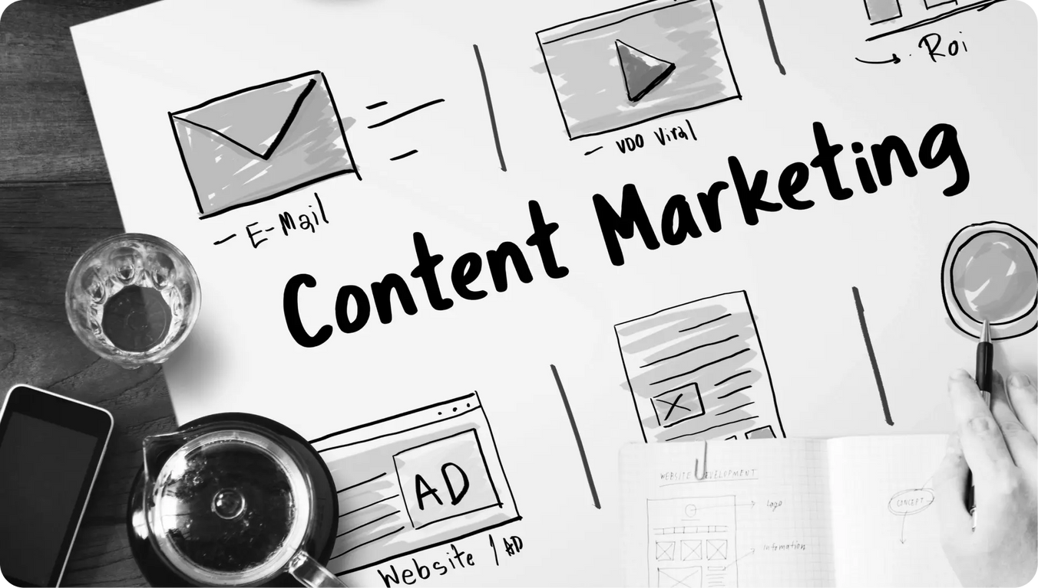
CONTENT MARKETING
Content Marketing is the strategy of creating and sharing valuable content such as blogs, videos, posts, and guides to attract, educate, and build trust with the audience. Instead of directly selling, it helps customers by providing useful information.
07

Slide 8
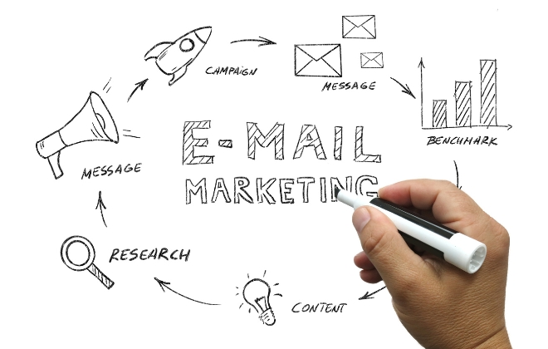
E-MAIL MARKETING
Email Marketing is a direct communication method where businesses send personalized messages, offers, newsletters, and updates to their audience’s email inbox. It’s one of the most effective ways to build relationships and convert leads into customers.
08

Slide 9
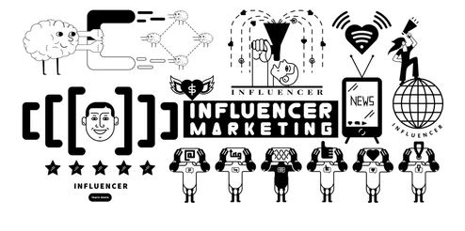
INFLUENCE MARKETING
Influencer Marketing is the art of borrowing trust—where creators share your brand with their loyal community, turning recommendations into powerful results.
09

Slide 10
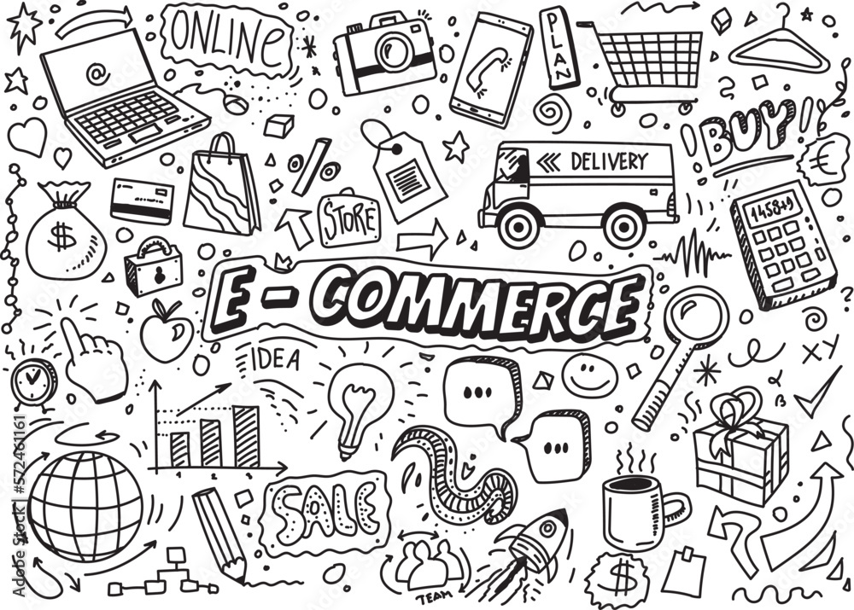
E-COMMERCE MARKETING
E-commerce marketing focuses on promoting online stores using SEO, SEM, social media, product ads, email campaigns, and retargeting. Its goal is to drive qualified traffic, boost sales, and enhance the shopping experience for online customers.

Slide 11

Hom
THANK
YOU
10

