Slide 1




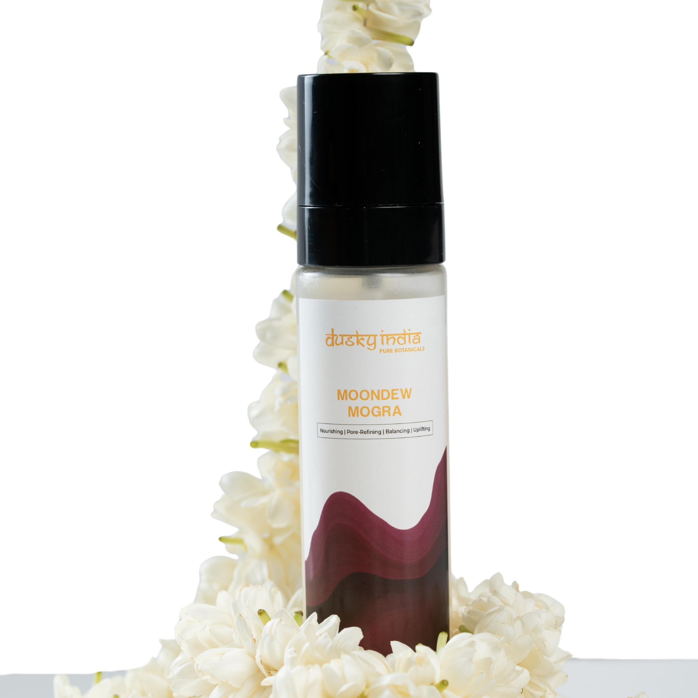

Moondew Mogra – Refresh, Hydrate & Revive Your Skin Naturally

Slide 2
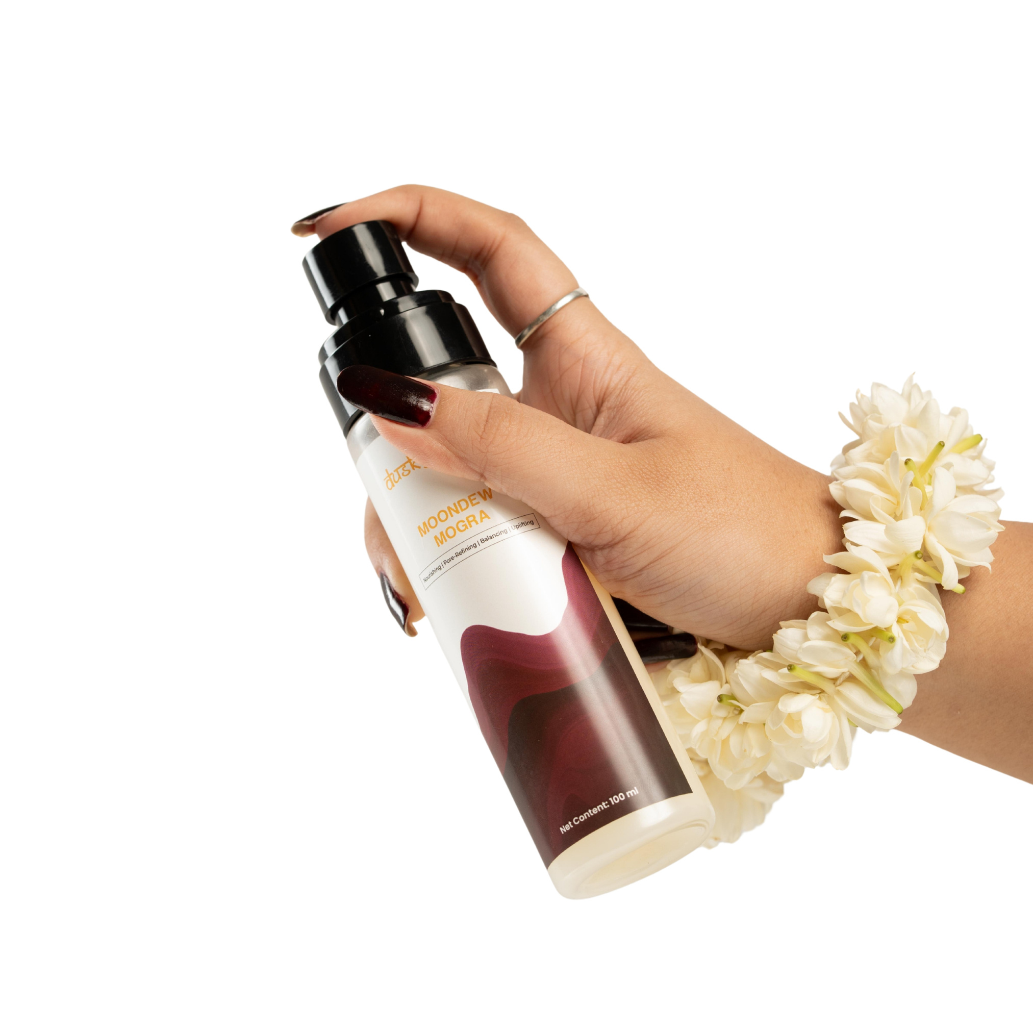

Meet Moondew Mogra
Daily exposure to pollution, heat, sunlight, and environmental stress can leave your skin feeling dry, dull, and tired.
Moondew Mogra provides a simple way to refresh your skin whenever it needs a boost. Its fine mist format makes application quick, convenient, and comfortable.
Everyday Benefits
  Refreshes tired-looking skin
  Provides lightweight hydration
  Helps maintain a fresh-looking complexion
  Leaves skin feeling soft and comfortable
  Adds a naturally dewy appearance

Slide 3

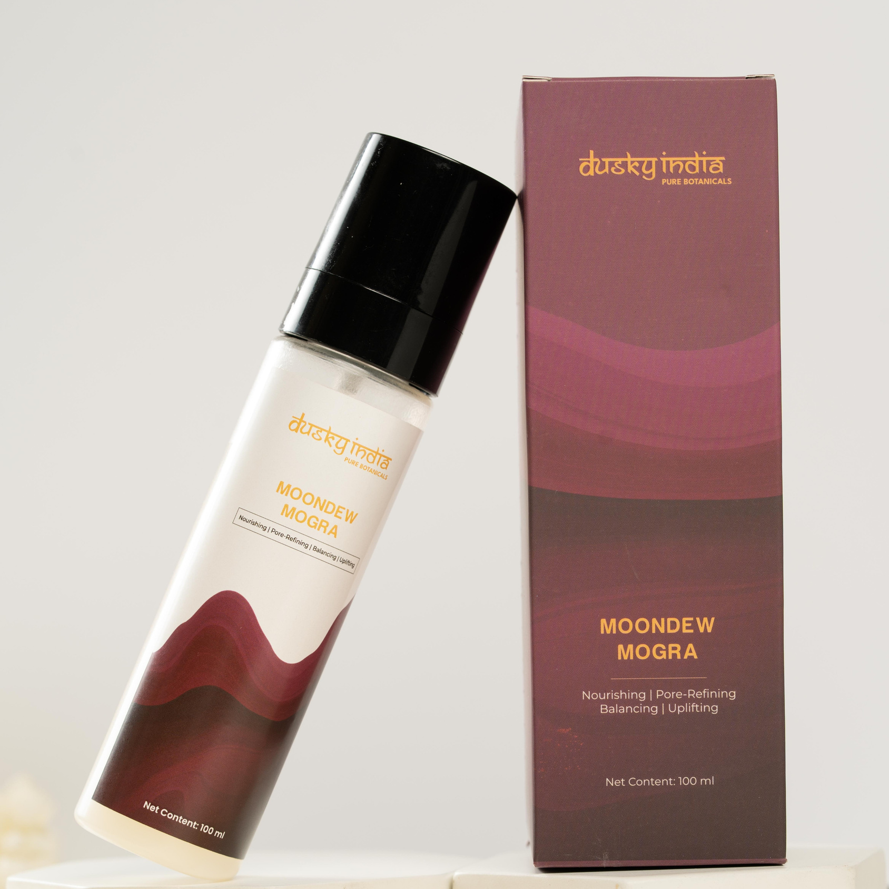

Floral Face Mist Toner for Everyday Refreshment
A floral face mist toner can be an easy addition to your morning, evening, or on-the-go skincare routine.
Moondew Mogra combines the refreshing experience of a fine facial mist with floral-inspired skincare, making it ideal whenever your skin needs a quick hydration and freshness boost.
Use It:
  After cleansing
  Before serum or moisturizer
  Before makeup
  Over makeup for a fresh, dewy feel
  Throughout the day whenever your skin feels tired

Slide 4
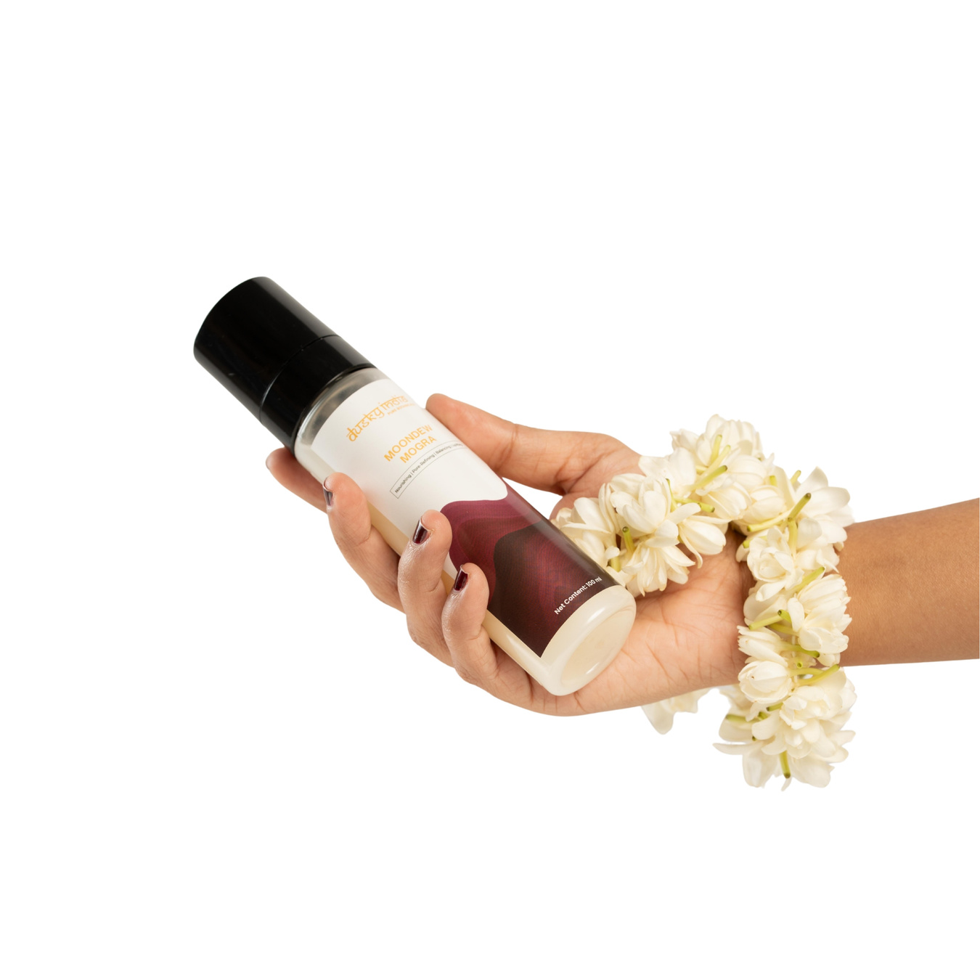

Mogra Water Toner for Fresh-Looking Skin
Mogra, also known as Arabian Jasmine, is loved for its delicate floral character and refreshing appeal.
Moondew Mogra works as a Mogra water toner, bringing floral-inspired freshness into your daily skincare ritual.
Its lightweight mist makes it easy to apply without leaving your skin feeling heavy, sticky, or overloaded with product.
A Simple Step for:
Freshness • Hydration • Softness • Dewy-Looking Skin

Slide 5
Natural Face Toner India for Daily Skincare
For those looking for a natural face toner India skincare users can easily add to their routine, Moondew Mogra offers a simple and refreshing option.
Its floral-inspired mist format makes facial care convenient while providing a lightweight hydration experience.
Perfect for Skincare Routines Focused On:
  Daily hydration
  Refreshing dull-looking skin
  Maintaining a dewy appearance
  Lightweight facial care
  Floral-inspired skincare
  On-the-go refreshment

Slide 6

Why Use a Floral Face Mist Toner?
Cleansing is an important part of skincare, but your routine doesn't have to stop there. A toner can provide an additional layer of hydration and prepare the skin for subsequent skincare products.
A floral face mist toner also makes skincare feel more refreshing and enjoyable.
Moondew Mogra transforms a simple skincare step into a refreshing floral ritual that can be enjoyed throughout the day.

Slide 7
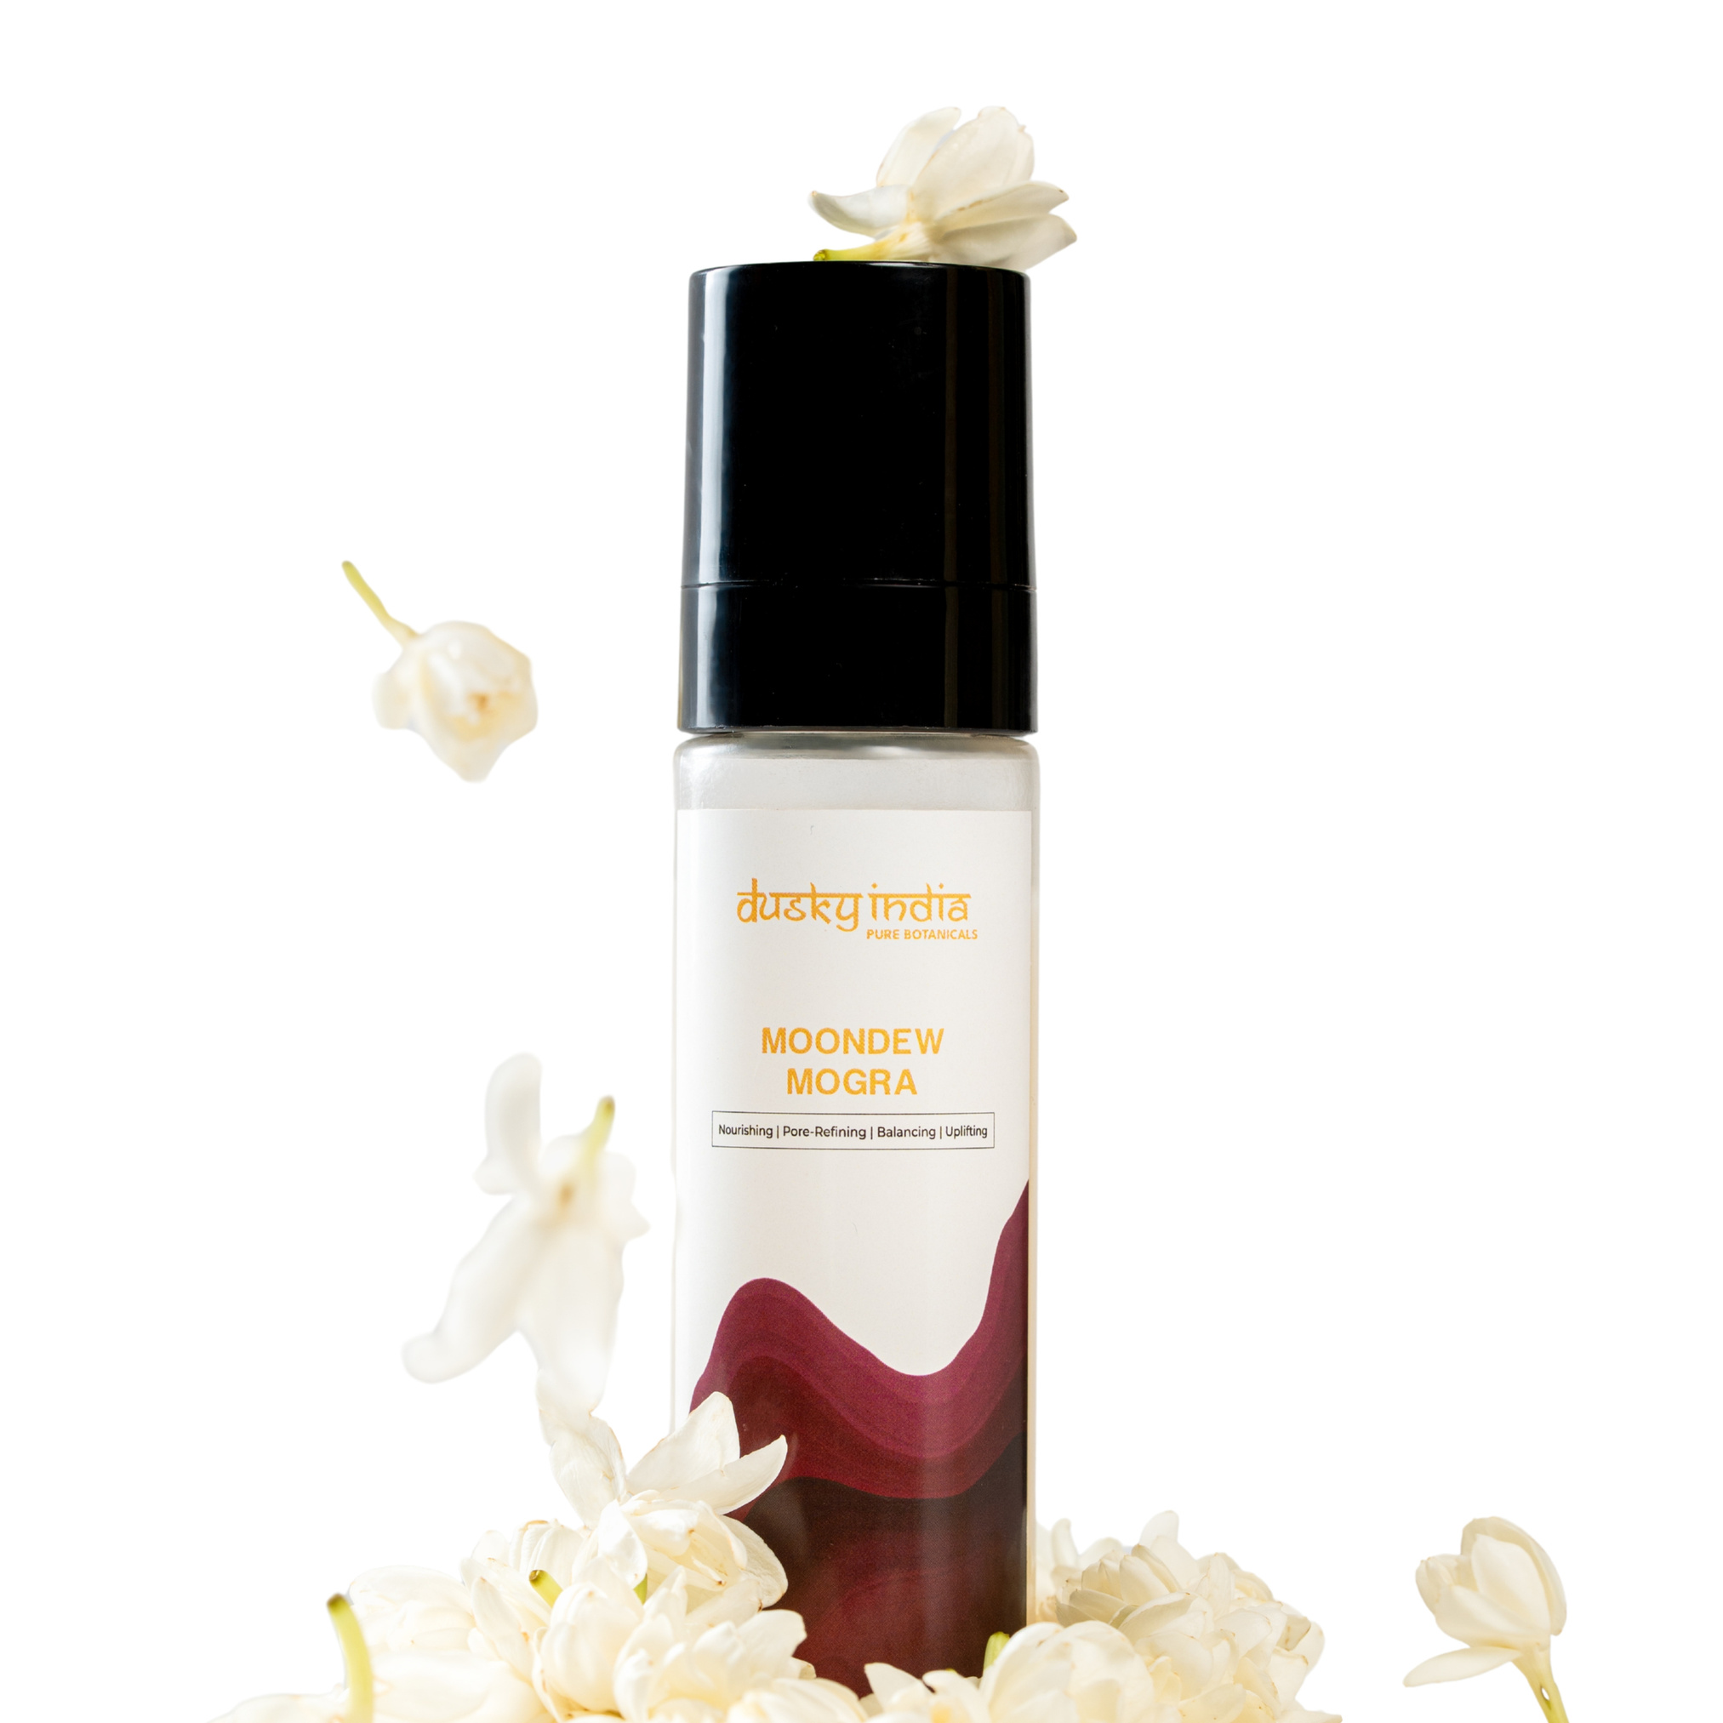
How to Use Moondew Mogra
Using Moondew Mogra floral face toner is simple and quick:
  Cleanse your face thoroughly.
  Hold the bottle a few inches away.
  Close your eyes and spray evenly on your face.
  Let it absorb naturally into the skin.
  Follow with serum or moisturizer for best results.
You can reapply it throughout the day whenever your skin needs a refresh.

Slide 8
Who Can Use Moondew Mogra?
Moondew Mogra is ideal for anyone who enjoys lightweight, refreshing facial care.
It can be added to routines focused on:
  Dry or tired-looking skin
  Everyday hydration
  A fresh, dewy appearance
  Floral-inspired skincare
  Quick skin refreshment
  Simple daily skincare
Its mist format makes it especially convenient for people with busy lifestyles.

Slide 9
Why Choose Dusky India Moondew Mogra?
Dusky India believes skincare should be simple, thoughtful, and inspired by nature.
Moondew Mogra combines floral-inspired care with the convenience of a modern facial mist, making it easy to refresh and hydrate your skin throughout the day.
It is a simple skincare essential for anyone who enjoys fresh, comfortable, and naturally radiant-looking skin.

