Slide 1


Slide 2
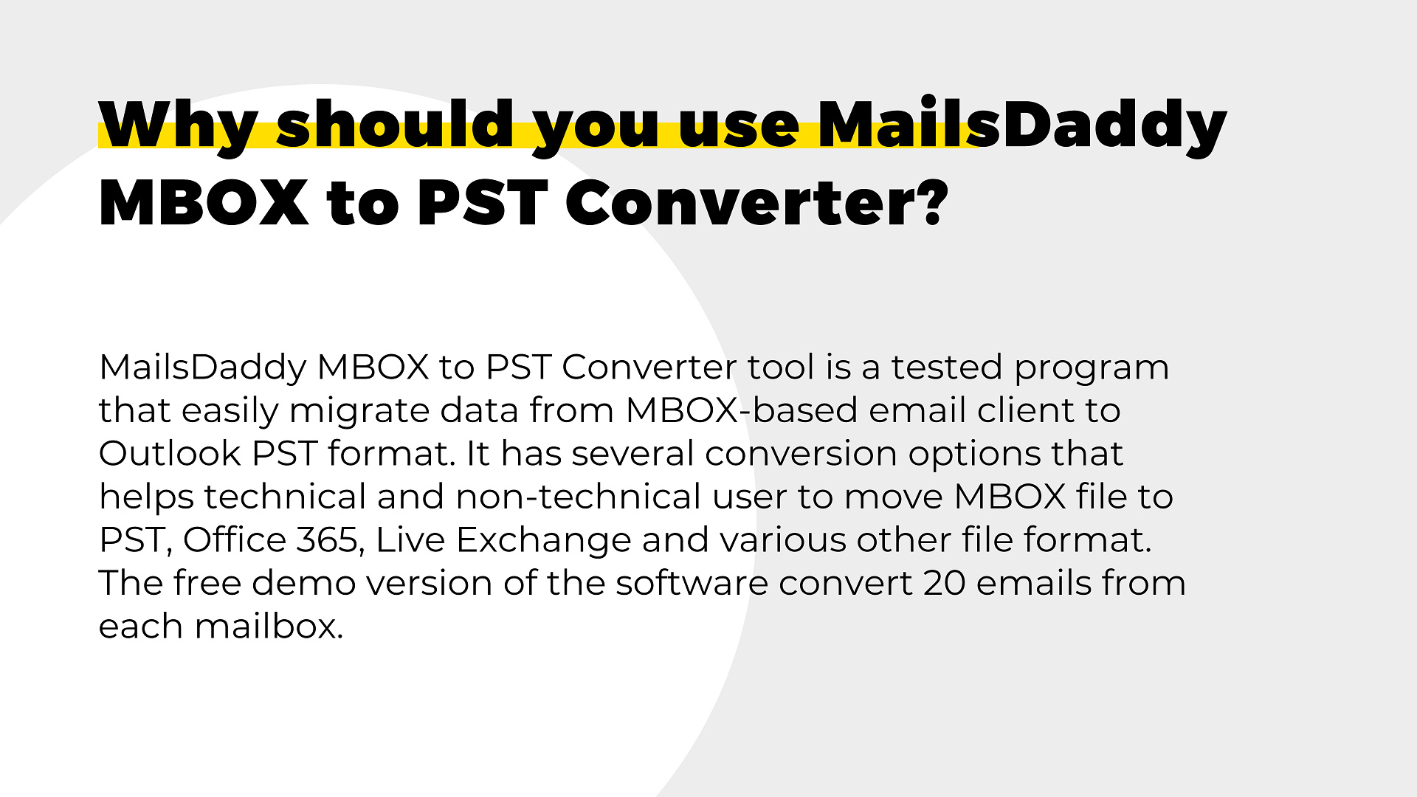

Slide 3
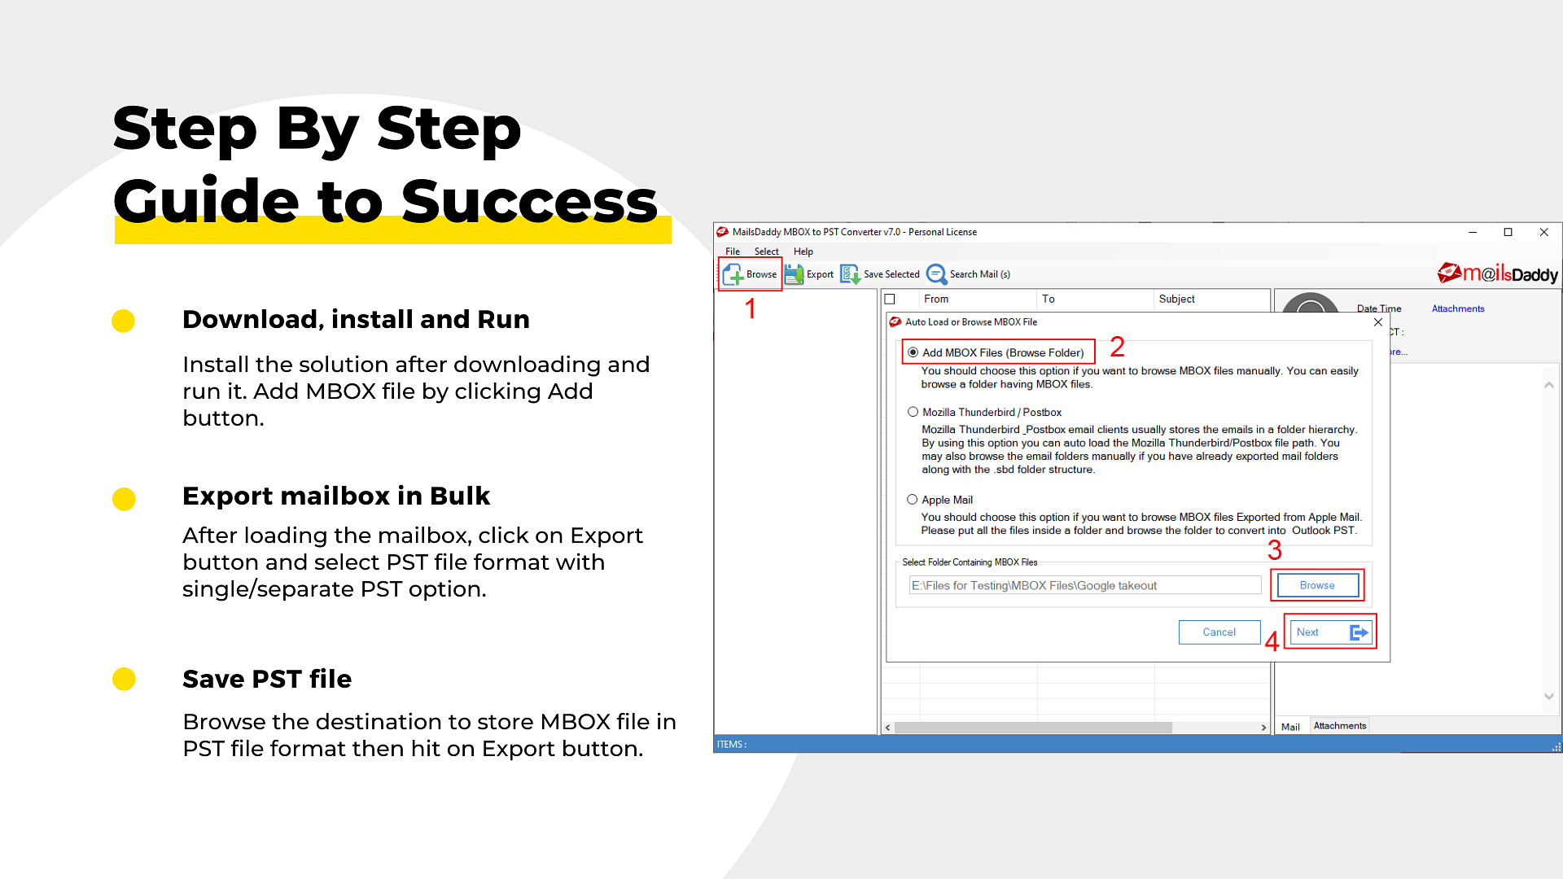

Slide 4
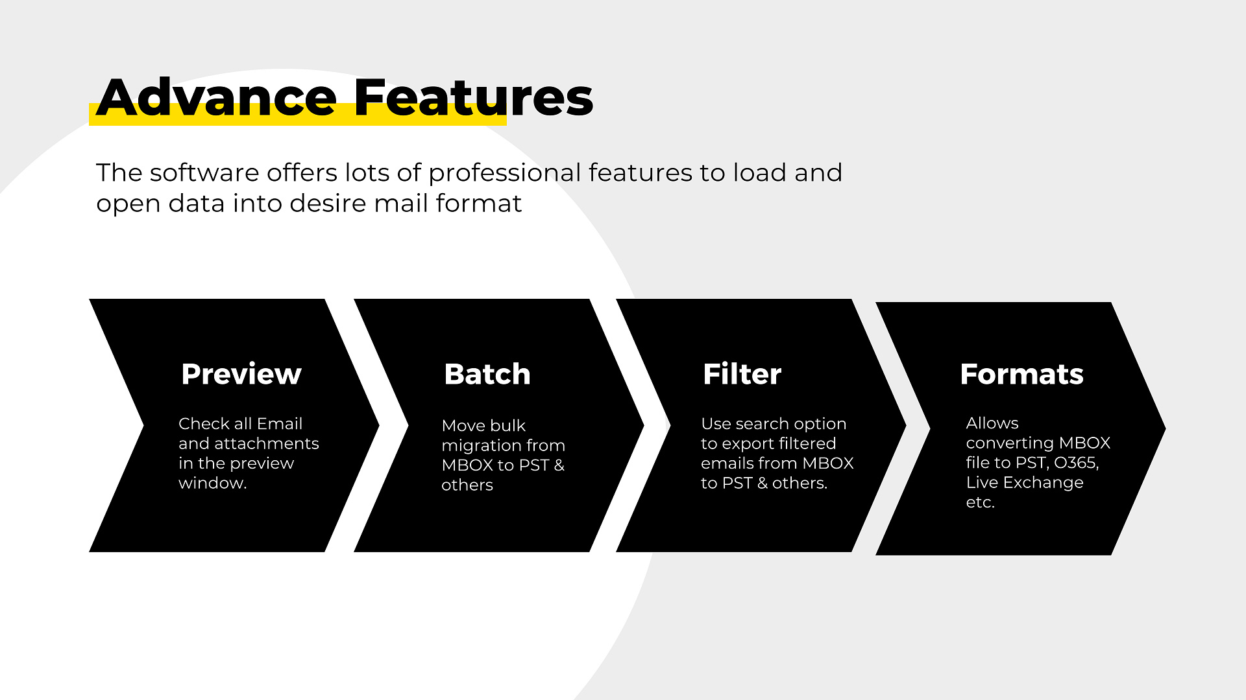

Slide 5


Slide 6
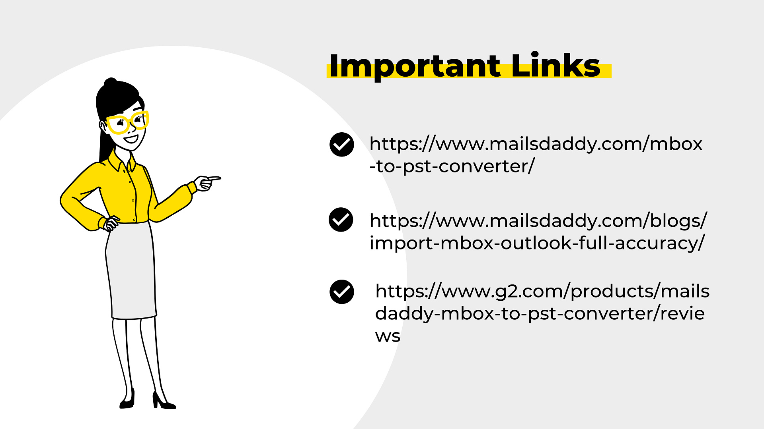
MBOX to PST
Import MBOX to Outlook Manually
Free Download

Slide 7


Slide 8


